Slide 1

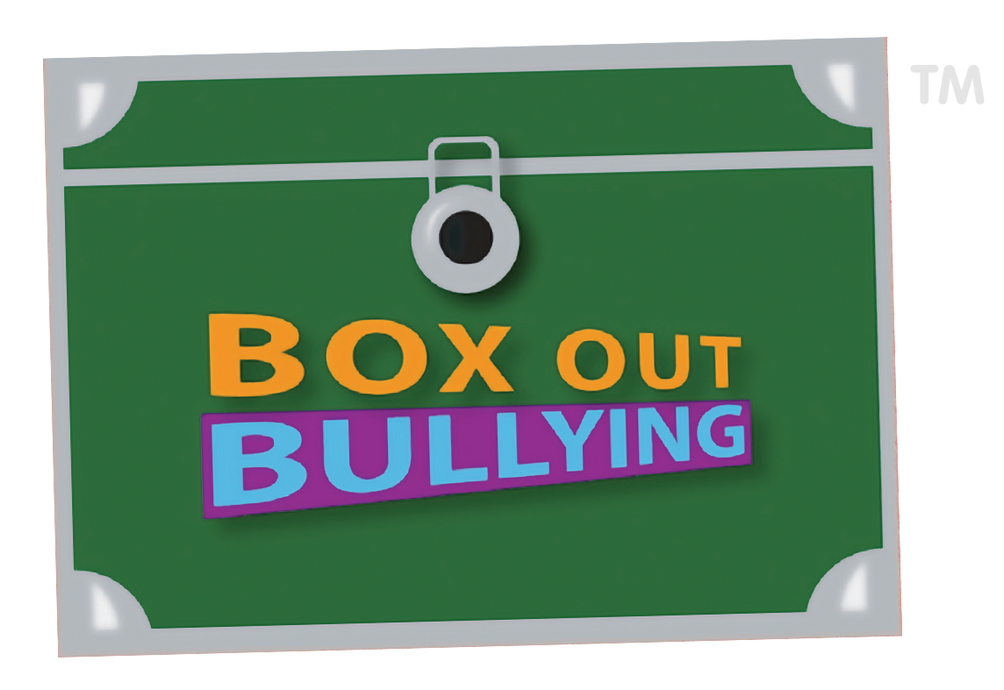

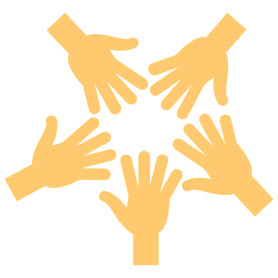
Bullying Prevention & Restorative Practices
Notes:
Presenter Notes: “Welcome, everyone, and thank you for being here. Today, we’re going to take a deep dive into two important topics that affect every school community: restorative practices and bullying prevention.
Now, sometimes when we hear these two terms, they feel like separate ideas. Restorative practices sounds like something we do in discipline or when there’s conflict. Bullying prevention sounds like assemblies, rules, or policies. But here’s the truth—they’re connected at the core. If we want to prevent bullying, we can’t just hand out punishments or give one-time lessons. We need to build a school culture where students feel seen, valued, and connected. That’s exactly what restorative practices are about.
Throughout this session, I’ll walk you through what bullying actually looks like, because there are still a lot of myths out there. We’ll break down the power dynamics that make bullying so harmful, and then we’ll connect that to restorative tools that help us respond in healthier, more effective ways.
As we go through, I want you to think about your own context—your classroom, your school, your district. What’s already working? Where are the cracks? By the end, my hope is that you’ll walk away not only with new strategies, but also with a mindset shift: that discipline and bullying prevention aren’t about control or punishment, but about relationships and growth.
So, let’s get started.”

Slide 2
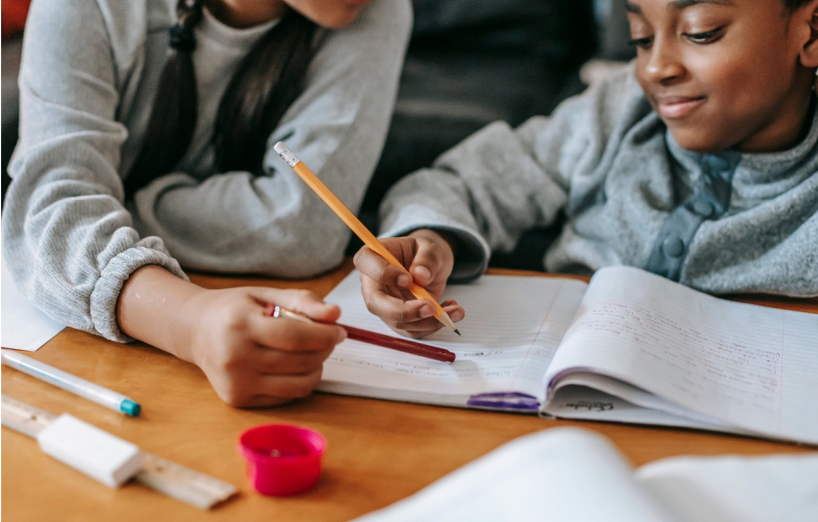





Overview
Learning Objectives
Bullying Defined
Key Findings
Agenda
Best Practices

Slide 3

Overview
Why?
Public Health
Who?
Community Stakeholders
What?
Strategies & Practices

Slide 4

Learning Objectives
Notes:
Presenter Notes: “Let’s talk about what we’ll accomplish together today.
First, we’re going to establish a clear definition of bullying. You might think, ‘I already know what bullying is.’ But definitions matter. If staff, parents, and students don’t share the same language, then what counts as bullying becomes fuzzy—and that’s when kids slip through the cracks.
Second, we’ll explore restorative practices as a framework. Restorative work isn’t just about holding circles or saying ‘sorry.’ It’s about building strong relationships every single day so that when conflict happens—and it will—we have a structure in place to repair harm instead of letting it fester.
Third, I’ll give you practical tools you can bring back tomorrow. Things like affective communication, structured check-ins, and questions that flip the script from ‘Who broke the rule?’ to ‘Who was harmed, and how do we make it right?’ These are tools you can use in a classroom, in a hallway, or even during a staff meeting.
Finally, we’ll connect everything back to your role. Whether you’re a teacher, a counselor, or an administrator, you’ll leave with strategies that fit your context. This isn’t a one-size-fits-all program—it’s adaptable.
So by the end of our time, you’ll not only know what bullying is and how to spot it, you’ll also see how restorative practices create safer, more connected schools where students want to learn and grow.”

Slide 5
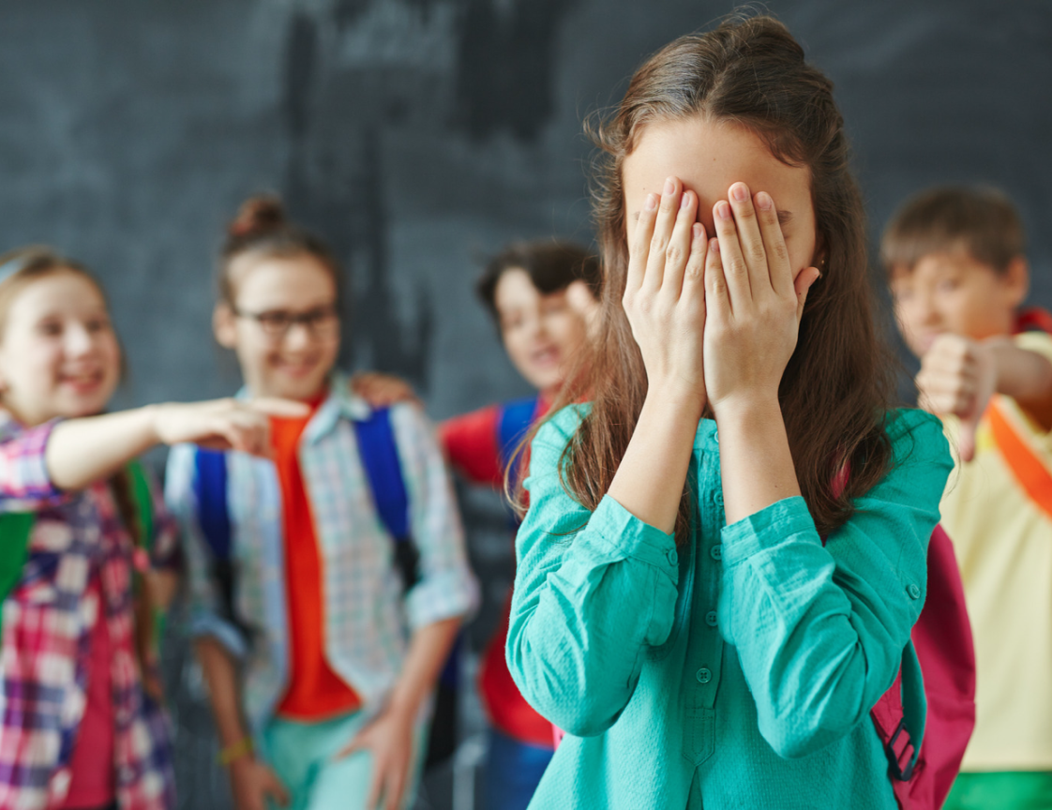
Bullying Defined
Bullying is unwanted, aggressive behavior among school aged children that involves a real or perceived power imbalance. The behavior is repeated, or has the potential to be repeated, over time.
Notes:
Presenter Notes: “Before we can prevent bullying, we need to define it clearly. Bullying is not just two kids who don’t get along. It’s not just an argument or a conflict. Conflict is a natural part of relationships, and with guidance, kids can learn a lot from it.
Bullying is different. Bullying is unwanted, aggressive behavior that involves an imbalance of power. That imbalance might come from physical strength, popularity, access to embarrassing information, or simply having more social influence. The key here is that the target—the student being bullied—can’t easily defend themselves.
Another important piece: bullying is repeated, or at least highly likely to be repeated. It’s not a one-time insult. It’s a pattern of behavior that wears down the victim over time. That’s why bullying is so damaging.
Bullying can take many forms:
Physical aggression, like hitting or pushing.
Verbal aggression, like name-calling or threats.
Relational aggression, like excluding someone on purpose or spreading rumors.
And here’s something we sometimes forget: bullying grows and changes right alongside young people. What it looks like in a second-grade classroom is not what it looks like in tenth grade. In high school, it might show up as online harassment, subtle exclusion, or controlling social dynamics.
As educators, we need to understand these differences so we can recognize bullying when it happens, instead of brushing it off as ‘kids just being kids.’ Because when we minimize it, students lose trust—and the cycle continues.”

Slide 6
Bullying Breakdown
Direct vs Indirect.
Physical, verbal, and relational types.
Matures along with the youth.
Let’s check our influence!
Notes:
Presenter Notes: “Let’s break this down further. There are different categories of bullying, and understanding them helps us see what students might be experiencing.
There’s direct bullying—things like physical aggression, insults, or threats. These are easier to spot because they’re visible. You see the push in the hallway, you hear the cruel comment.
But then there’s indirect bullying, which is often harder to notice. This could be spreading rumors behind someone’s back, deliberately leaving them out of social activities, or turning a friend group against them. The impact can be just as painful, but because it happens in whispers or online, it often flies under the radar.
Bullying also evolves with age. In younger grades, it might look like taking someone’s toy or calling them names. In middle school, it can shift to exclusion, gossip, and online behavior. In high school, it can become even more subtle—but also more damaging—because social status carries so much weight.
Now, here’s the important part: we, as adults, have influence over how these patterns play out. The way we model respect, set boundaries, and intervene sends powerful messages to students. If we only respond with punishment, kids learn to hide their behavior. If we respond with empathy and structure, they learn that relationships can be repaired.
So I want you to reflect for a moment: in your school, which type of bullying do you see most often—direct or indirect? And what’s your current response? Just noticing that difference can shift how we approach solutions.”

Slide 7
How would you know?
50-75% of children do not tell school personnel, but are a bit more likely to tell parents.
Negative social messages about “snitching” or “tattling.”
Lack of confidence in adults’ actions.
Notes:
Presenter Notes: “Here’s one of the biggest challenges: bullying often stays invisible. Research shows that between 50 and 75 percent of children do not tell school personnel when they’re being bullied. Let that sink in—most kids who are bullied never report it to an adult at school.
Some are more likely to tell parents, but even then, silence is common. Why? A few reasons. First, kids are bombarded with negative social messages about ‘snitching’ or ‘tattling.’ Nobody wants to be labeled that way. Second, they don’t always have confidence that adults will act in a way that makes things better. Sometimes when they’ve reported before, nothing changed—or worse, the situation escalated.
That means the burden falls on us, as the adults, to create a culture of trust. When students know that we listen, that we act consistently, and that we prioritize their safety, they’re more likely to come forward.
This is where restorative practices come in. Restorative practices help us build credibility with students. When kids see that adults don’t just punish, but actually take the time to repair harm and restore relationships, trust grows. And when trust grows, reporting increases.
So the question becomes: in your school, what’s the level of trust right now? If a student was being bullied, would they feel safe coming to you? Would they believe you could help? Those are the questions that tell us how strong our current culture really is.”

Slide 8

“Human beings are happier, more cooperative & productive, and more likely to make positive changes in their behavior when those in positions of authority do things with them, rather than to them or for them.”
-Ted Watchel
Notes:
“Here’s a quote that really captures the spirit of restorative practices: ‘Human beings are happier, more cooperative and productive, and more likely to make positive changes in their behavior when those in positions of authority do things with them, rather than to them or for them.’
Let’s pause on that for a moment. Think about the three options: doing things to people, doing things for people, or doing things with people. Which one creates real change?
If we do things to students, it’s usually punishment, control, or consequences without dialogue. It may stop the behavior temporarily, but it doesn’t change the root. If we do things for students, we’re rescuing them—sometimes with good intentions—but it strips away their agency. They don’t learn accountability or responsibility. But when we do things with students, that’s where growth happens. We’re guiding, supporting, and holding them accountable at the same time.
Restorative practices are all about the with. That doesn’t mean letting students off the hook—it means inviting them into the process of repair and making them active participants in the solution.”

Slide 9
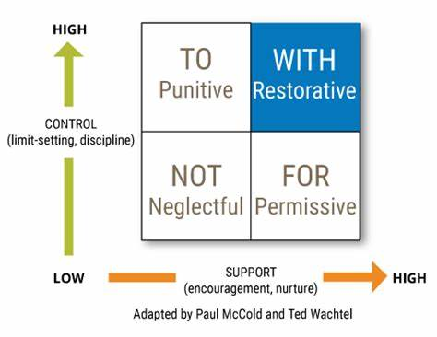
Social Discipline
“Restorative practices is the science of building social capital and achieving social discipline through participatory learning and decision making.”
-Ted Watchel
Notes:
Presenter Notes: “Restorative practices are sometimes described as ‘the science of building social capital and achieving social discipline through participatory learning and decision making.’ That might sound academic, but let’s break it down.
‘Social capital’ is just another way of saying trust and relationships. When students feel connected—to their teachers, to their peers, to their school community—they’re more invested in positive behavior.
‘Social discipline’ means how a community holds itself accountable. Every school has discipline. The question is: is it retributive, where the focus is on punishment? Or is it restorative, where the focus is on accountability and healing?
Restorative practices combine both—structure and relationship. It’s not a free-for-all. There are still boundaries. But the boundaries are held with compassion and fairness, not fear and control.
Think of it like this: every time you engage with students, you’re either adding to or withdrawing from their trust bank. Restorative practices make more deposits than withdrawals, so when you have to correct behavior, the relationship can withstand it.”

Slide 10


Can you create scenarios when each social discipline is helpful?
A
…to your students.
B
…will not _____ to or for your students.
C
…for your students.
Check-In
D
…with your students.
Notes:
Presenter Notes: “This slide brings us back to those three approaches:
Doing to students,
Doing for students, and
Doing with students.
When we operate in the to mode, discipline looks like: ‘You broke the rule, here’s your punishment.’ It’s one-sided. When we operate in the for mode, it’s: ‘Don’t worry, I’ll fix this for you.’ Again, one-sided—only this time, the adult shoulders the responsibility. But when we shift to with, the dynamic changes. The adult sets boundaries, yes, but they also involve the student in finding solutions. It’s collaborative.
This isn’t about being soft. In fact, the with approach often feels harder in the moment because it requires dialogue, patience, and structure. But it’s also the only approach that builds lasting change.
So as you hear me talk through examples today, keep this framework in your mind. Ask yourself: is my current discipline practice mostly to, for, or with? Where might I want to shift?”

Slide 11

Boundaries + Support = Desire
Notes:
Presenter Notes: “One of the simplest ways to understand restorative practices is through this formula: Boundaries plus support equals desire to change.
Boundaries without support often just lead to compliance out of fear. Students might obey in the moment, but nothing changes in their attitude or understanding. Support without boundaries can feel good in the short term, but it creates chaos and inconsistency. Students need limits in order to feel safe.
When we bring boundaries and support together, something shifts. Students feel both safe and accountable. They see that adults care enough to set expectations, but also to walk alongside them as they learn from mistakes. That combination is what creates genuine desire to change behavior—not because they’re scared, and not because someone else fixed it for them, but because they feel invested in the outcome.
This is the heart of restorative work: accountability that comes with compassion.”
Presenter Notes: “Now let’s pause for some interaction. Think of real scenarios in your school or classroom.
For example: a student refuses to do their work. In that moment, would a to response, a for response, or a with response work best? Or picture a conflict between two students that escalates into name-calling. Which discipline approach could actually resolve the situation, not just quiet it down?
Take a moment to reflect—or if you’re in a group setting, share with the person next to you. The goal here isn’t to get it ‘right’ but to start training ourselves to recognize which mode we’re in.
Remember: restorative practices don’t eliminate the need for structure. They balance structure with empathy. And practice is what helps us get better at choosing with instead of defaulting to to or for.”

Slide 12
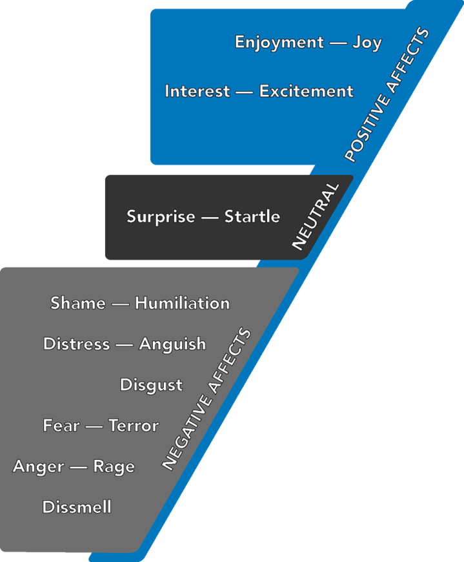
The Nine Affects
Affect is the innate, biological response to the increasing, decreasing or persistent intensity of neural firing. This results in a particular feeling, facial and body display, and skin changes. Affects feel rewarding, punishing, or neutral in their own ways. Affect makes things urgent.
Awareness creates a feeling.
A feeling plus a memory create an emotion.
This helps us to create our rules or scripts that we follow to create more positive and less negative affects.
These rules eventually make up our personalities.
-Silvan Tomkins
Notes:
Presenter Notes: “This slide introduces something that may be new to you: the nine affects. Affect is basically our hardwired, biological response to changes in the intensity of what’s happening around us. When neurons fire more, less, or persistently, we feel it. That’s affect.
Here’s why it matters: affect is the engine behind feelings and emotions. An affect leads to a feeling, a feeling tied to memory creates an emotion, and over time, repeated patterns of emotions create what we might call our personality.
Think about joy for a moment. Joy has a specific facial expression and body posture—you know it when you see it. Anger, shame, fear—same thing. These affects feel rewarding, punishing, or neutral in their own ways. They tell our bodies how urgent something is.
Now, why does this matter in schools? Because the way students experience affect shapes how they behave. If a student feels shame, their body might tell them to withdraw, lash out, or hide. If a student feels joy, they engage, connect, and learn.
As educators, our job is to notice the affective cues—how a student’s body, tone, and expressions are showing us what’s underneath their behavior. And once we see it, we can respond in a way that helps them regulate, not escalate.”

Slide 13
Think of a few scenarios when you’ve noticed an affect?
A
When do you experience joy?
B
What has interrupted your joy?
C
How do you bounce back?
Check-In
D
How about your students?
Notes:
Presenter Notes: “Let’s make this personal. Think about a time recently when you experienced joy. What was happening? What made it possible? Now, think about what interrupted your joy. Maybe it was stress, maybe it was conflict, maybe it was a feeling of being overwhelmed.
And then—how did you bounce back? Did you talk to someone? Did you take a walk? Did you just wait it out?
Now, extend that to your students. When do they experience joy in your classroom? What interrupts it? And do they have the tools to bounce back, or do they get stuck?
Restorative practices give us structures to help students name and regulate these affective experiences. When we build that skill, we’re not just managing behavior—we’re helping kids become emotionally resilient human beings.”
Presenter Notes: “Here’s a quick check-in activity. Think of a few scenarios in your classroom or school when you’ve noticed an affect. Maybe you saw a student light up with joy after being recognized. Maybe you saw shame in a student’s eyes when they were corrected in front of their peers.
Take a moment and jot down one or two examples. These don’t have to be dramatic—they can be small moments. The key is becoming aware of them.
Once you start noticing, you’ll see them everywhere. And the more you notice, the better you’ll become at choosing responses that guide students toward positive affect rather than reinforcing negative cycles.”

Slide 14
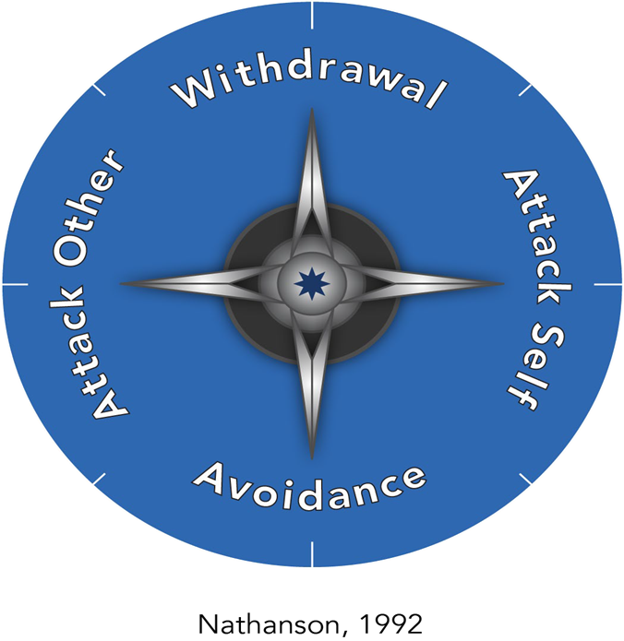
The Longer Heading
“When we recognize we’re in one of these scripted behaviors, we have an opportunity to backtrack to the moment of shame. While it feels toxic, the value of shame is that it points us toward a need for some sort of corrective repair or reconnection.”
-Jennifer Lock Oman,
Notes:
Presenter Notes: “This slide highlights something powerful but often misunderstood: shame.
Here’s the idea: when we recognize that we’re stuck in a patterned behavior, we often find that shame is at the root. Shame feels toxic, but it also points to a need for reconnection or repair.
For example, a student who lashes out might actually be responding to shame—they felt embarrassed, dismissed, or powerless. Instead of just punishing that behavior, restorative practices ask us to look underneath and address the root.
Jennifer Lock Oman says it this way: ‘While shame feels toxic, the value of shame is that it points us toward a need for some sort of corrective repair or reconnection.’
That’s the heart of restorative practices. We don’t ignore the harm, but we also don’t let shame fester. We help students step into accountability and reconnection so they don’t get stuck in cycles of isolation and repeat behavior.”

Slide 15
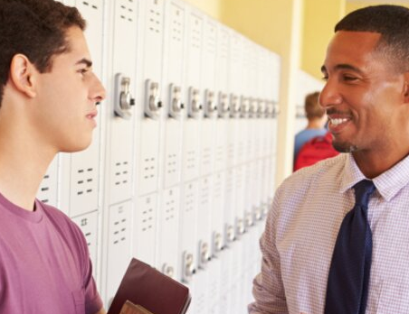
Restorative Justice vs. Retributive Discipline
Notes:
Presenter Notes: “Here’s a key distinction: restorative justice versus retributive discipline.
Retributive discipline is what most of us grew up with. The questions are: What rule was broken? Who did it? What punishment do they deserve? It’s transactional. The focus is on rules and consequences.
Restorative justice flips the script. The questions become: Who was harmed? What are their needs? Who is responsible for addressing those needs?
Notice the difference. Retributive discipline focuses on the offender and the rule. Restorative justice focuses on the community and the harm.
Neither ignores accountability—but restorative justice places accountability in the context of relationships. The goal is not just to stop a behavior, but to repair the harm so the community can move forward stronger.
This is not about being soft. In fact, restorative justice requires more from the student who caused harm. They don’t just serve a punishment and move on. They have to face the impact of their choices, hear from those who were affected, and take active steps to make it right. That’s harder—but it’s also more transformative.”

Slide 16
What is the priority with retributive discipline?
A
What rule was broken?
B
Who did it?
C
What do they deserve?
Check-In
Notes:
Presenter Notes: “Here’s a quick reflection for us. When we think about retributive discipline, the main priority is punishment. So let’s check our instincts: what do you believe the focus is when a school relies heavily on retributive discipline?
Usually, the answer is: it’s all about the rule and the consequence. A rule was broken, someone is guilty, and a penalty is assigned. On the surface, it feels efficient and clear. But if we look deeper, it rarely solves the problem.
I want you to picture a student you know who’s been through this process. They broke a rule, they got detention or suspension, and then… what? Did it change their behavior long term? Did it repair relationships? Or did it simply teach them to be more careful about getting caught next time?
This is where restorative practices offer an alternative. Instead of focusing on the rule, we focus on the harm. Instead of focusing only on the offender, we also focus on the community. That’s a big shift. And the more we practice it, the more natural it becomes.”

Slide 17
What is the priority with restorative justice?
A
Who was harmed
B
What are their needs?
C
Who is obligated to respond?
Check-In
Notes:
Presenter Notes: “Now, let’s flip it. When we focus on restorative justice, the priority becomes: who was harmed, what do they need, and who is responsible for addressing those needs.
So here’s a check-in for you. Imagine two students have a conflict. Under restorative justice, what would you focus on first? You wouldn’t ask, ‘What punishment do they deserve?’ Instead, you’d ask, ‘Who was harmed and how do we repair that harm?’
That small change in questions has a huge impact. It invites empathy. It requires accountability. It creates an opportunity for growth.
Let’s say a student spread a rumor about a peer. Retributive discipline might suspend the student. Restorative justice would bring the two together, allow the harmed student to express the impact, and guide the one who caused harm in making things right. Which process do you think is more likely to reduce bullying in the future?
Exactly. The restorative path is harder, but it builds community and prevents repeat harm.”

Slide 18
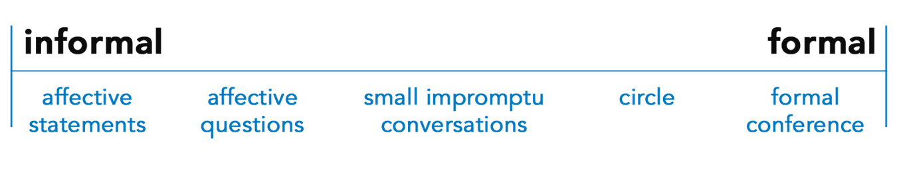
Restorative Practice Continuum
What is already in place within your school?
Where are the gaps you’d like to fill?
Notes:
Presenter Notes: “This slide is about the continuum of restorative practices. The truth is, most schools are already doing pieces of this work. Maybe you already hold restorative circles, or maybe you use affective statements, or maybe you focus on relationship-building in advisory time.
The question to ask is: what’s already in place, and where are the gaps?
On one end of the continuum, you have informal practices—things like quick check-ins, affective statements, or hallway conversations. On the other end, you have formal practices—structured conferences, mediated dialogues, and system-wide restorative approaches.
The magic happens when a school intentionally places practices along the whole continuum. That way, it’s not just something you do when a major conflict arises. It’s a daily habit, woven into the fabric of your school culture.
So take a moment and reflect: where are you strong on the continuum? And where do you see opportunities to grow?”

Slide 19
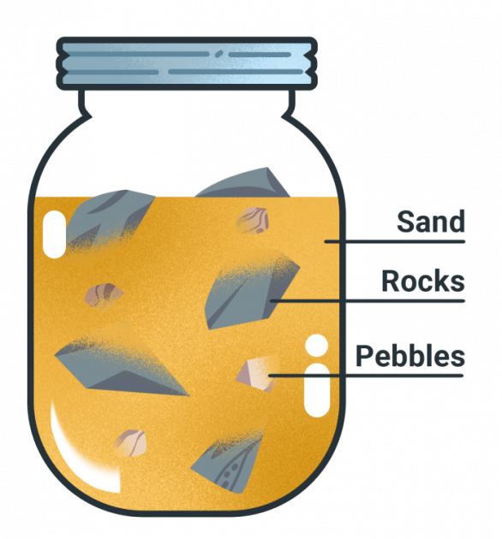
Rocks, Pebbles, Sand, Shoot!
Rocks: Policy, systems, culture, program-wide/school-wide.
Pebbles: Expectations, responses to conflict, smaller groups.
Sand: Checking bias, affective statements, individual.
Notes:
Presenter Notes: “This is a metaphor that helps us prioritize.
The rocks represent the big things: policies, systems, school-wide culture. These are foundational. If we don’t address bullying at a policy and culture level, then everything else feels like patchwork.
The pebbles are the mid-level practices: things like setting classroom expectations, responding to conflict, and small group work. They’re still important, but they rely on the rocks being in place.
The sand represents the micro-level: individual conversations, bias checks, affective statements. These are the everyday practices that, over time, shape culture.
And then there’s the shoot—that’s the growth that comes when everything else is in balance. It’s what happens when the system, the classroom, and the individual level are all aligned.
If you try to pour the sand first, you’ll never fit the rocks in. That’s why we have to prioritize systemic and cultural practices first. Then the rest will fall into place.”

Slide 20
The greatest communication skill is paying value to others.
Denis Waitley
Notes:
Presenter Notes: “This quote reminds us of something simple but powerful: ‘The greatest communication skill is paying value to others.’
Think about the last time you felt truly valued in a conversation. Someone looked you in the eye, listened without interrupting, and acknowledged your perspective. How did that feel?
Now flip it—think about a time when you felt dismissed or ignored. The difference is enormous.
For our students, the same holds true. When we show them that their voice matters, that their feelings matter, and that they bring value to the community, we’re not just preventing bullying—we’re modeling how healthy relationships work.
That’s what restorative practices are all about. It’s not just about fixing problems when they arise. It’s about consistently communicating value so that harm is less likely to happen in the first place.”

Slide 21
Practice: Affective Communication
Round 1: Research (heard, unheard, unresolved conflict)
Round 2: Recall & Repeat
Round 3: Reach (feeling and need)
Round 4: Reassure & Relate
Notes:
Presenter Notes: “Now we’re moving into practice. This slide shows four rounds of affective communication, and I want to take time to unpack each one.
Round 1 is Research. Here, the goal is to surface what’s been heard, what hasn’t been heard, and what conflict remains unresolved. This isn’t about fixing yet—it’s about listening. In schools, we often rush too quickly into solutions. But think about it: how can you solve a problem if you don’t really understand it? By pausing and letting students voice their side, we send a message: ‘I hear you. Your perspective matters.’
Round 2 is Recall & Repeat. This is where the adult repeats back what the student has said. It might sound simple, but it’s powerful. Students often say, ‘Nobody ever listens to me.’ When we repeat their words back—even if we don’t agree—it validates their voice. For example, a teacher might say, ‘So what I’m hearing is you felt embarrassed when the comment was made in class. Is that right?’ That moment builds trust.
Round 3 is Reach. Here, we dig deeper into feelings and needs. This is where affective language comes in. It’s not just about what happened, but about how it impacted the person emotionally. For example, ‘It sounds like you feel angry because you needed respect, and you felt you didn’t get it.’ Helping students name feelings and connect them to needs builds emotional intelligence.
Round 4 is Reassure & Relate. This is the healing stage. We reassure the student that their needs matter and then relate it back to the community: ‘We want you to feel safe here. Let’s figure out together how to rebuild trust so this doesn’t happen again.’
Notice how this sequence moves from listening, to validating, to naming, to repairing. That’s the structure that makes restorative communication different from just saying, ‘Sorry and move on.’ It’s systematic, it’s relational, and it creates actual transformation.”

Slide 22
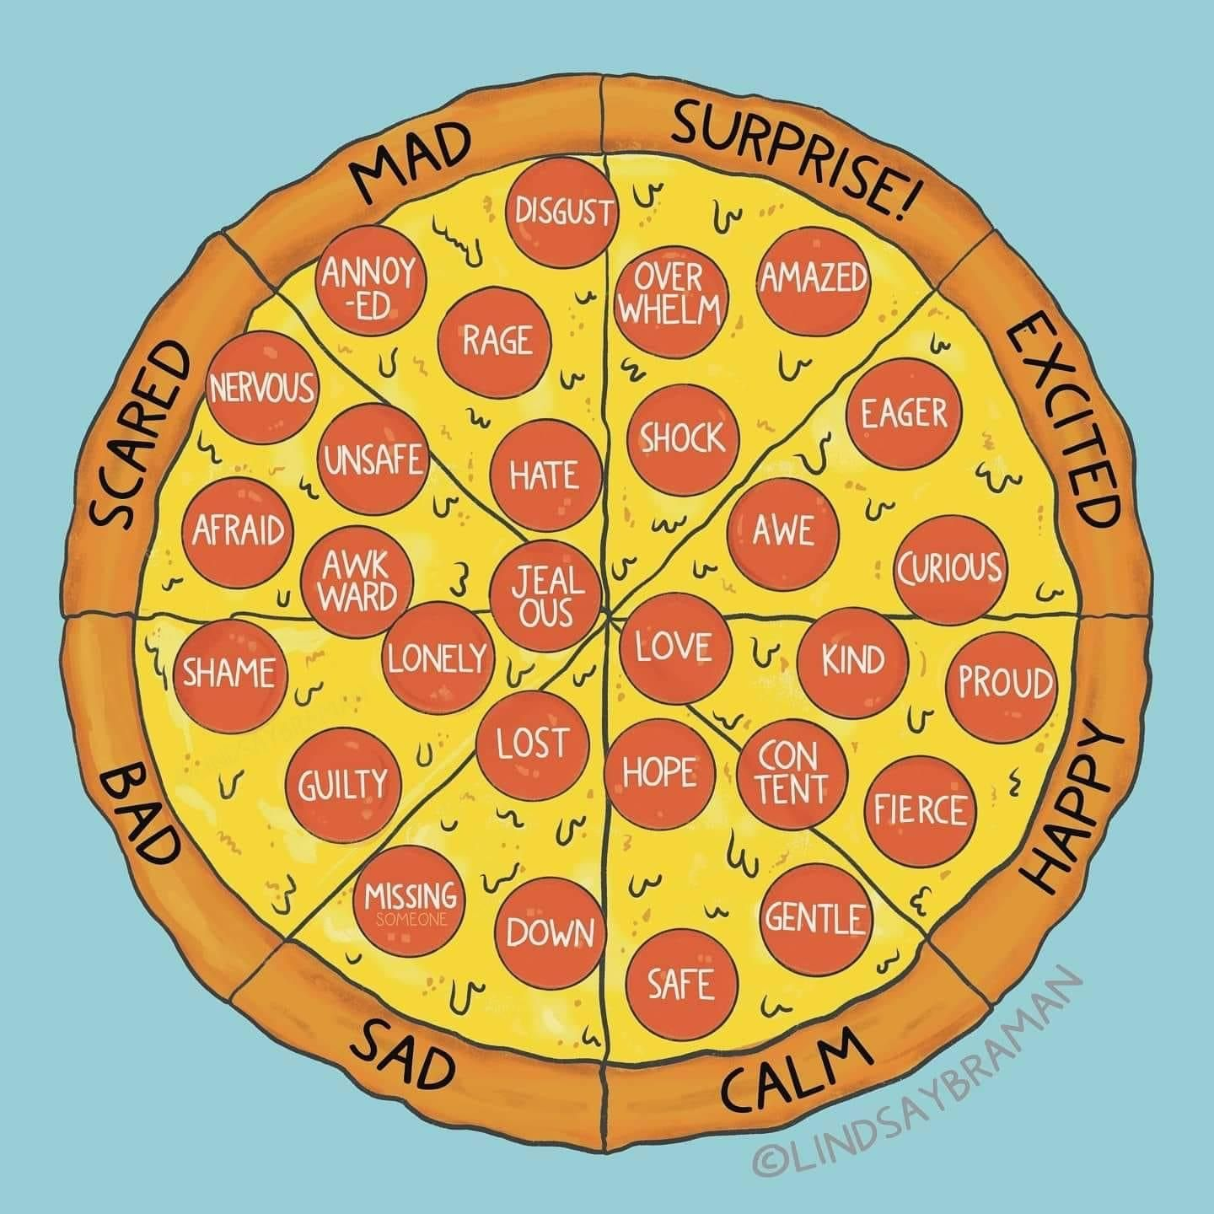
Practice: Affective Communication
It sounds like you feel____________
when __________.
Do you need ______________?
Notes:
Presenter Notes: “Here we see the first of two templates for affective statements: ‘It sounds like you feel _____ when _____. Do you need _____?’
This is deceptively simple. The power lies in the structure. First, you acknowledge the emotion: ‘It sounds like you feel frustrated…’ Second, you connect it to the event: ‘…when your group didn’t include you in the project.’ And third, you check in on the need: ‘Do you need to have a say in who you work with?’
This approach does three things. One, it validates the student’s feelings without judgment. Two, it ties the emotion to a specific situation so it doesn’t become global (‘You’re always left out’ becomes ‘In this project, you felt left out’). And three, it gives the student a chance to name what they actually need.
I want you to imagine what would happen if we used this sentence frame daily, not just in conflict. Imagine walking through the hall and saying to a student, ‘You look really proud when you finished your art project. Do you need some space to show it off?’ Suddenly, affective communication becomes part of the school’s DNA.
Here’s the challenge: try to use this frame once tomorrow. See how it shifts the tone of the interaction. Then ask yourself, what would it look like if this was the norm in every classroom?”

Slide 23
Practice: Affective Communication
I feel___________
when __________.
I need __________.
Can we (or you) _______________?
Notes:
Presenter Notes: “The second template is even more direct: ‘I feel ____ when ____. I need ____. Can we ____?’
This is affective language from the perspective of the adult, modeling what it looks like to own feelings and needs. For example: ‘I feel concerned when I see students interrupting each other. I need everyone to feel respected. Can we try raising our hands to speak?’
Notice the power shift here. Traditional discipline might sound like: ‘Stop talking over each other or you’ll lose points.’ That’s a to approach. The affective statement, on the other hand, is a with approach. You’re naming your own affect, you’re stating your need clearly, and you’re inviting collaboration on a solution.
This teaches students two critical life skills: emotional literacy and problem-solving. They see adults modeling how to express needs without aggression, and they’re given a script they can use themselves.
And here’s the ripple effect: when students practice this, it spreads beyond the classroom. They take it into friendships, into sports teams, even into their families. That’s when restorative practices stop being a school program and start being a life skill.”

Slide 24
Questions or Comments?
Notes:
“This slide is a chance to pause and invite the group in. Up until now, we’ve covered a lot: bullying definitions, the differences between retributive and restorative approaches, and the practice of affective communication.
So here’s the invitation: what’s resonating with you? What feels practical? What feels challenging?
If you’re presenting this in a workshop, stop here and actually take a few minutes for questions or discussion. If you’re using this deck as a self-paced training, take a journal and jot down your thoughts. The point is to not just move through the content, but to let it land.
Sometimes, the most powerful learning happens in these pauses. So make room for them. Ask open questions like, ‘What might this look like in your school?’ or ‘What barriers do you think you’ll face in implementing this?’ And then listen—really listen—to the answers.”

Slide 25
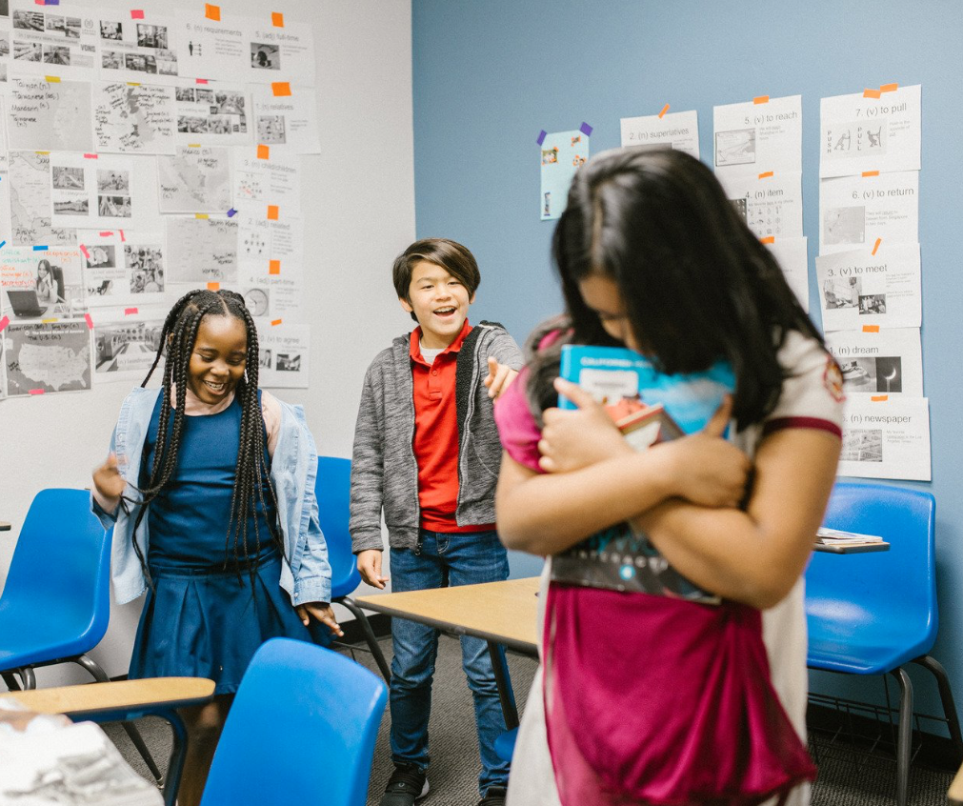
Key Findings
Notes:
“This slide presents an important or interesting quote that stands alone. Here’s how I suggest using it: don’t just read it—unpack it.
First, read the quote slowly. Then pause. Ask the audience: ‘What does this mean to you?’ or ‘How does this connect to your experience?’
After a moment of reflection, share your interpretation. For example: ‘To me, this quote is a reminder that bullying prevention isn’t just about stopping negative behavior—it’s about building positive culture. When students feel connected, supported, and valued, bullying has less room to take root.’
The key with quotes is not to let them pass by as decoration. Treat them as conversation starters. Let them breathe. A single quote, when unpacked with care, can sometimes shift perspectives more than an entire lecture.”

Slide 26
This is an important or interesting quote that you’d want to share on its own particular slide.

Slide 27
Is this the question to test your knowledge?
A
Potential Answer.
B
Potential Answer.
C
Potential Answer.
Check-In
D
Potential Answer.

Slide 28

Best Practices

Slide 29
This is an important or interesting quote that you’d want to share on its own particular slide.

Slide 30
Is this the question to test your knowledge?
A
Potential Answer.
B
Potential Answer.
C
Potential Answer.
Check-In
D
Potential Answer.

