Slide 1
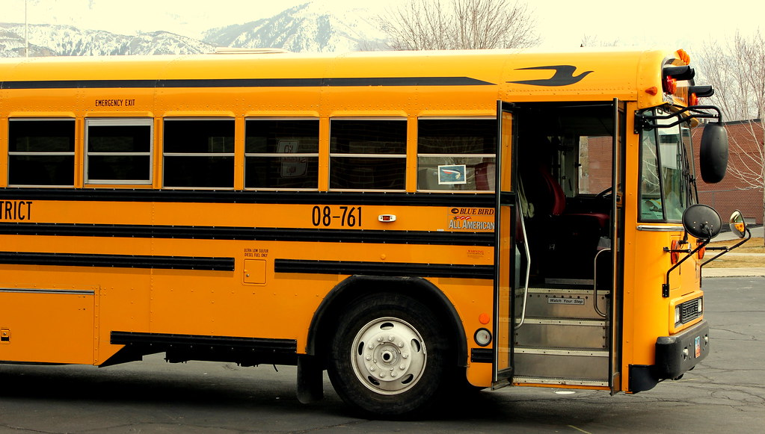


Bullying Prevention and Response Training and Continuing Education
Creating Safe and Respectful School Bus Environments

Slide 2
Introductions
The school(s) for which you drive a bus
How long have you been doing school transportation?
Why do you think you were asked not use your name and to leave your name tag blank?

Slide 3

It’s Your Party
Picture this:
Three students stand up to share something positive they remember about you. What would you hope they say?
In your Groups:
Share the three things that you would want them to remember and say about you.

Slide 4
Workshop Opportunities
Participants will:
Consider what a supportive school bus climate looks like and how it can prevent bullying
Explore the connection between a supportive bus climate and a supportive school climate
Discover the power of positive relationships in shaping school bus climate and preventing bullying
Learn and commit to perform simple, concrete strategies to build positive relationships on the school bus

Slide 5

What is Bullying?
A problem behavior based on power relationships in which a student or a group of students uses power aggressively to cause emotional or physical pain and distress to another student.
Bullying experiences include not only physical aggression but also verbal aggression, including verbal teasing and taunting, spreading rumors, or socially rejecting and isolating another student.

Slide 6
A Supportive Bus Climate
Engagement
Includes relationships, respect for diversity, and school participation
Safety
Includes emotional safety, physical safety, and reduction of substance use
Environment
Includes the physical, academic, and disciplinary environments, and wellness

Slide 7
A Supportive Bus Climate
Engagement
Students experience positive peer and adult relationship, respect for diversity, and shared participation in shaping a positive bus climate
Safety
Students feel physically and emotionally safe
Environment
Students experiencing a safe, fair, and consistent bus environment including clear expectations for student behavior and disciplinary policies that are fairly enforced

Slide 8
Effects of a Supportive Climate
When students experience a safe and supportive climate:
They have an increased sense of bonding to school and caring about their educational experience
They are more likely to stay in school and achieve academically
They are less likely to be involved in bullying and other antisocial behaviors

Slide 9
School Climate/Bus Climate
School
Buses

Slide 10
School Climate/Bus Climate
School
Buses

Slide 11
School Climate/Bus Climate
School
Buses

Slide 12
What is Your Situation?
School
Buses
School
Buses
School
Buses

Slide 13

Who Was There for You?
On your card, record what it was about that person that caused them to have such a positive impact on your life

Slide 14
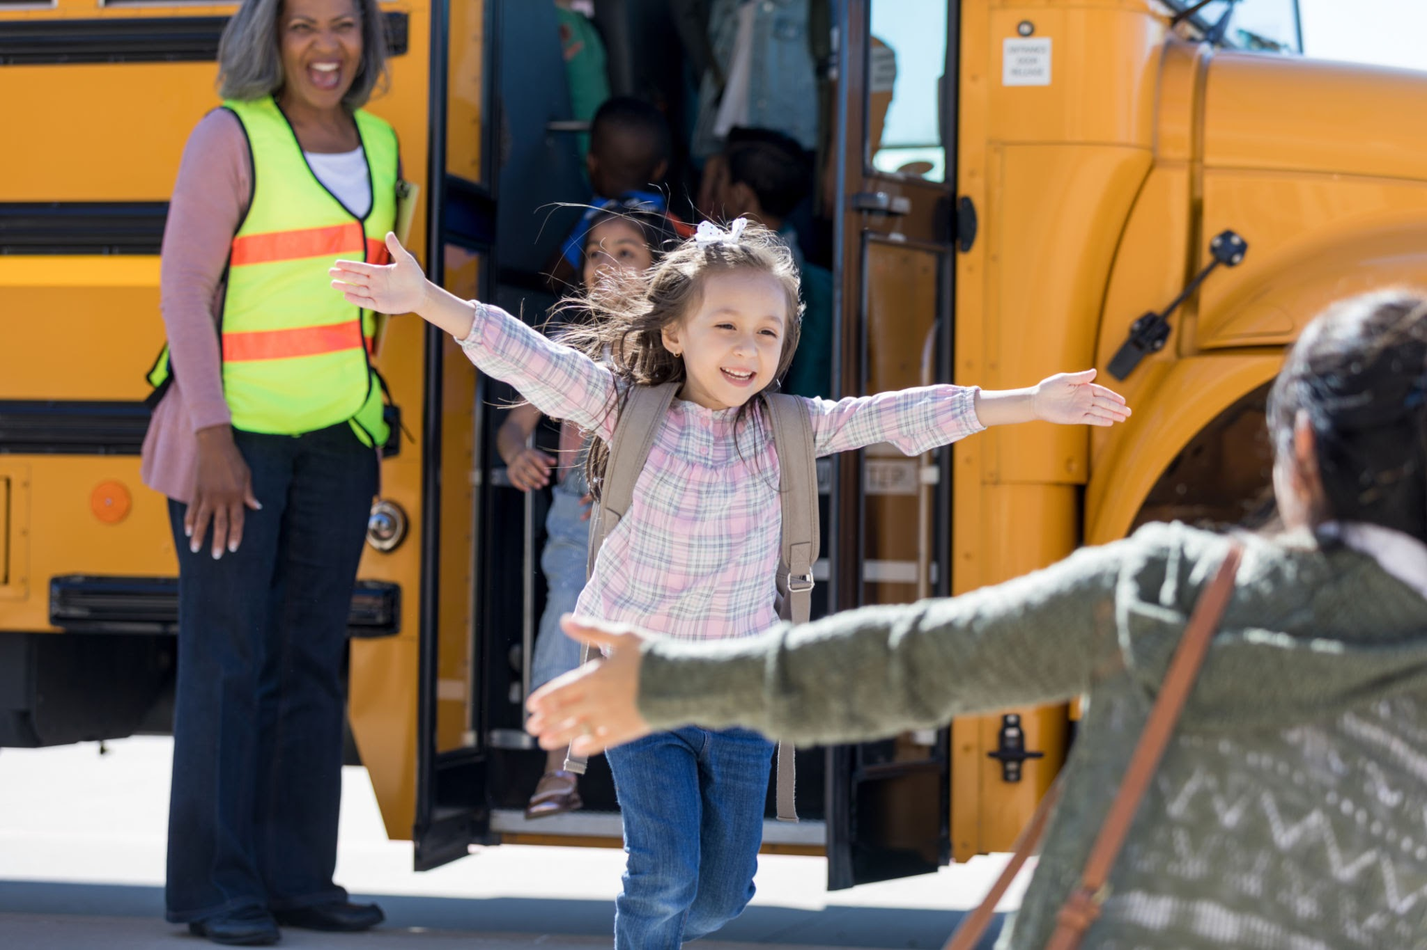
Why Think About Relationships?

Slide 15
Bullying
Bullying is a relationship that requires relationship solutions.
A problem behavior based on power relationships in which a student or a group of students uses power aggressively to cause emotional or physical pain or distress to another student.

Slide 16
The Relationship Solution
When there is a strong, positive bond between a driver and their students, behavior on the bus tends to be positive and less problematic for the driver
Why would anyone want to be mean when the driver is so nice?

Slide 17

Why are Names Important?

Slide 18
Individual Recording
In the first section of Handout 3, record up to three strategies that you already use in building positive relationships with the students on your bus
In the second section of Handout 3, record one strategy that you would like to employ in building positive relationships with your students

Slide 19

Share the strategies you already use on the bus
Share the new strategy you would like to implement with your students
Respond to the following questions:
Why did you choose that strategy?
What do you envision it will look like when you implement the strategy?
What are your concerns as you anticipate trying something new?
Consulting Groups
Use the rest of the planning sheet to record any helpful ideas you receive from your “consultants

Slide 20

Thank You for Participating!

