Slide 1
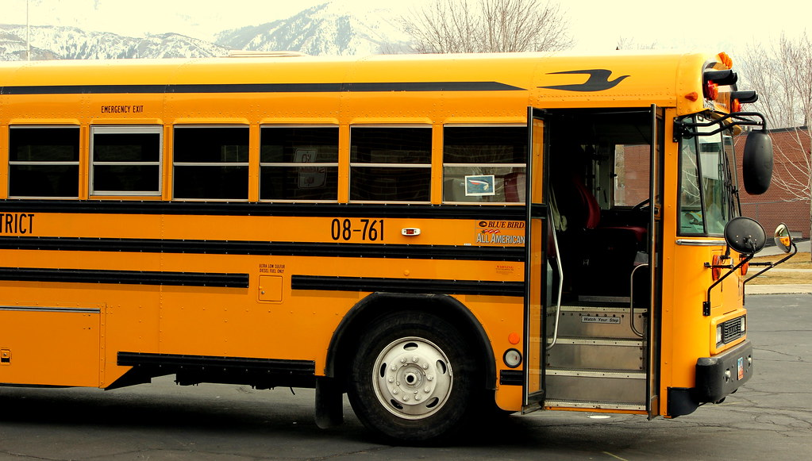


Bullying Prevention and Response Training and Continuing Education
See Something. Do Something:
Intervening in Bullying Behavior

Slide 2
Introductions
Your name
The school(s) for which you drive a bus
How long have you been doing school transportation?
What do you consider to be your primary responsibility as a school bus driver?
What do you like most about your job, and what causes you the greatest degree of stress as a school bus driver?

Slide 3
Workshop Opportunities
This workshop will include:
A definition of what bullying is and isn’t
Clarification of what bullying looks like on the school bus
Ideas for minimizing the occurrence of bullying
Strategies for addressing and reporting bullying when it occurs

Slide 4

What is Bullying?
A problem behavior based on power relationships in which a student or a group of students uses power aggressively to cause emotional or physical pain and distress to another student.
Bullying experiences include not only physical aggression but also verbal aggression, including teasing and taunting, spreading rumors, or socially rejecting and isolating another student.

Slide 5

Student Bullying
Of students ages 12 through 18 surveyed in the 2006-07 school year…
A total of 31.7% report being bullied
Of those students, 8% say they were bullied on the bus

Slide 6
Impact of Bullying on Students
Students being bullied tend to report:
Feelings of depression, anxiety, and isolation
Low self-esteem
Poor school performance
Thoughts of suicide and suicide attempts
Students who bully tend to:
Feelings of depression, anxiety, and isolation
Low self-esteem
Poor school performance
Thoughts of suicide and suicide attempts

Slide 7
Students Being Bullied
Report losing items such as books, electronics, clothing, or jewelry
Have unexplained injuries
Complain frequently of headaches, stomach aches, or feeling sick
Lose interest in visiting or talking with friends
Are afraid of going to/from school or other activities with peers
Appear sad, moody, angry, anxious, or depressed
Talk about suicide
Hurt themselves
Suddenly have fewer friends
Avoid certain places
Act differently than usual
Want to sit near the driver
Want to sit with the same “safe” student or group of students all of the time (behind them, in front of them, or surrounded by them)
Want to sit on the inside seat—not the aisle seat

Slide 8
Students Being Bullied
Become violent with others.
Get into physical or verbal fights with others.
Get in trouble a lot, including being sent to the principal’s office or detention.
Have extra money or new belongings that cannot be explained.
Are quick to blame others.
Will not accept responsibility for their actions.
Have friends who bully others.
Need to win or be best at everything.
Try to move near enough to the student being bullied to continue bullying—for example, the bullying student may move near enough so the student being bullied can hear remarks, be touched, or be bothered.
Vie for attention, talk loudly, wave at the driver in the mirror, or move from seat to seat.
Watch the driver and change seats to be near the student being bullied when the driver is at an intersection or watching the road.

Slide 9
Creating a Positive Bus Climate
Clearly establish with students your expectations for their behavior, what the specific rules are for riding the bus, and the reasons why those rules are in place
Be firm with students but not tough
Be courteous and not sarcastic
Treat all students equally and fairly
Be consistent

Slide 10
Continuum of Response
Assertive
Passive
Aggressive
Assertive means being confident and positive as well as consistent, fair and responsible

Slide 11
Responding to Bullying Behaviors
Before getting on the bus:
Anticipate the time of day and time of year
Keep a short, clear set of rules visible, and talk about them once in a while
Understand ages and stages of children in your bus
Learn what to ignore and what to pay attention to

Slide 12
Responding to Bullying Behaviors
While the bus is in motion:
Give verbal warnings, using students names whenever possible
Call your school or supervisor
Avoid “stare downs” using the rear view mirror
When the bus is stopped:
Have students change seats
Talk with students who bully and/or are bullied.
  This should be done individually to avoid potentially
re-igniting the bullying situation
Implement seat assignments based on district policy
Request assistance from school or teachers as appropriate

Slide 13
Responding to Bullying Behaviors
If student or driver safety becomes a concern:
Always follow district policies
Stop the bus in a safe place out of traffic
Secure the bus
Stand up and speak clearly and calmly to the student(s) who are bullying another student or students
Change the seat of the student who was bullying and/or the student being bullied, if needed, to a safe seat
Never put a student off the bus except at school or at their residence or school bus stop
When intervening, use caution not to challenge or provoke a student who is bullying because it may initiate further negative behavior

Slide 14
Guidelines
Hands off. Don’t place your hands on students except to protect them in an immediate emergency
Don’t try to “assist” as student into the seat by forcing him or her down
Any physical contact between bus driver or attendant and student must be an absolute last resort in an emergency situation

Slide 15
De-escalation Techniques
Maintain Control of Your Emotions
DO: Appear calm, centered, and self-assured. Use a modulated low tone of voice. Be aware of options. Call the school, your supervisor, security, or the police if you need more help Be very respectful even when firmly setting limits or calling for help.
DON’T: Be defensive even if the comments or insults are directed at you.
Communicate Effectively Nonverbally
DO: Allow extra physical space between you and the aggressor, get to the same eye level, keep your hands out of your pockets to protect yourself, and stand at an angle to the student.
DON’T: Turn your back, stand full front to the student, maintain constant eye contact, point or shake your finger, smile, or argue.
De-escalate the Discussion
DO: Trust your instincts, empathize with feelings but not with the behavior, suggest alternatives, and explain limits in a firm but respectful tone.
DON’T: Get loud, yell, scream, argue, or analyze..

Slide 16

Good Advice/Bad Advice
One way to get the attention of students
on the bus and their willingness to address bullying among their peers is to write up the whole bus when serious bullying occurs.
True or False?
FALSE

Slide 17
Good Advice/Bad Advice
If a student swears, it is best to write down the actual curse words a student uses, unless your school policy forbids it.
True or False?
TRUE

Slide 18
Good Advice/Bad Advice
When writing a good report or referral, it is important to include your own personal perspective about the student’s motivation or comparisons to his or her siblings.
True or False?
FALSE

Slide 19
Good Advice/Bad Advice
A high-quality report or referral includes details about what you, as the bus driver, said and did in response to student bullying behavior.
True or False?
TRUE

Slide 20

What is something you learned in this workshop that affirmed what you are already doing as a school bus driver?
What is one idea, strategy, or learning that you feel you can apply to improve your skills and/or experience as a school bus driver?
Reflections
Thanks for participating!

