Slide 1




Bullying Prevention & Response Training
Sources: U.S. Department of Education, StopBullying.Gov
Notes:
Welcome to the Box Out Bullying Bullying Prevention and Response Training and Continuing Education Online Program. I’m (fname lsmae) with (name of organization). I will be delivering this training.
Erin Reiney: HRSA. Thanks so much for joining us today. I wanted to give you a quick welcome on behalf of Jeremy Rubenstein. He is the founder and creative director of Box Out Productions, which produces Box Out Bullying. He’s an educator, producer, and social entrepreneur who has a mission to improve the health, safety, and well-being of infants, mothers, children, youth, and their families. It's a very large mission and since the early 2000s, we have seen bullying as a priority issue to help us meet our mission. In the early 2000s, we did a lot of work around raising awareness and helping people understand that bullying is a serious problem. The great news is awareness is very high, and now folks say, "I'm aware. agree this is a problem. And now, what are we going to do about it?"

Slide 2

Overview
Why?
Public Health
Who?
Community Stakeholders
What?
Long-Term Strategies
Sources: U.S. Department of Education, StopBullying.Gov
Notes:
Research shows that bullying is a public health issue that negatively impacts outcomes for youth involved. And so during today’s training you will learn how to take a public health approach to preventing bullying. You will also learn how to engage a variety of community partners and stakeholders to recognize, intervene, and prevent bullying from all angles.
Please note, that this course is focused on long-term bullying prevention strategies. When it comes to stopping bullying for good, we know that a one size fits all approach won’t work. That is why this course is not intended to provide prescriptive step -by-step interventions. Research -based do’s and do, tips for addressing bullying on the spot, as well as common strategies to avoid will be discussed, but it is important to remember that the overarching goal of this course is to empower you to understand bullying and how to take research on best practices and implement comprehensive, community-wide, long-term prevention strategies.

Slide 3







Overview
Learning Objectives
Bullying Defined
Key Findings
Agenda
Misdirections
Best Practices
Notes:
Now I will set the stage for what we'll be doing together. Here are the goals for today’s session. First, we’ll outline the learning objectives of this training, next we're going to discuss how to talk about the issue of bullying, what the research tell us about bullying , and then we will go into some mis-directions, or ideas that seem like they might work but may actually be harmful. We will complete the training with information about best practices in preventing bullying and responding to it. Throughout the training, you will learn about tools and resources available to help you lead effective community-wide bullying prevention strategies.

Slide 4

Learning Objectives
Notes:
NEW TALKING POINT: THIS COURSE FOCUSES ON PREVENTION MORE THAN INTERVENTION, SO WE WILL NOT SPEND A LOT OF TIME ON WHAT TO DO IF BULLYING OCCURS, OR CASE STUDIES…
Aligning with our agenda points, after completing the training, participants will be able to:
Define bullying and describe its various forms
Describe the basic research on the prevalence of, risk factors for, and impact on youth involved in bullying
Describe the best practices in bullying prevention and response
Identify that bullying is a public health problem and requires a coordinated community response
From Brooke: not putting this on a separate slide because it’s essentially repeating the agenda

Slide 5
Learning Objectives
Identify specific pathways for implementing bullying prevention best practices and policies.
Understanding potentially harmful strategies as well as how and why to avoid them.
Engage your local community in bullying prevention action planning.
Organize a catalyst event and identify key stakeholders for community-level initiatives.
Access free resources to support community bullying prevention efforts.
Notes:
It is the hope that those points of knowledge we accumulate throughout today will support you in being able to implement these research-based best practices AND engage your community in bullying prevention events and action planning.
Describe the potentially harmful bullying prevention strategies and the rationale for avoiding them
Identify key stakeholders for a community-level bullying prevention initiative
Identify specific pathways for translating bullying prevention best practices into policy and practice
Organize a community event to catalyze bullying prevention action planning at the local level
Access free resources to support community bullying prevention efforts

Slide 6

Bullying Defined

Slide 7

Bullying is any unwanted aggressive behavior(s) by another youth or group of youths… that involves an observed or perceived power imbalance and is repeated multiple times or is highly likely to be repeated. Bullying may inflict harm or distress on the targeted youth including physical, psychological, social, or educational harm.*
Bullying
*Center for Disease Control
Notes:
Let’s begin by taking just a few minutes to talk about what it is we mean by the term bullying as it may mean different things to different people. On boxoutbullying.com, and on the US department of education’s website, we define bullying as being unwanted aggressive behavior among children that involves an observed or perceived imbalance of power. Now, this power imbalance may involve differences in many different things; physical strength or size, popularity, ability, wealth, or any number of other factors that can give one or more use and advantage over others.
Bullying is typically repeated over time or at least has a potential to be repeated. Bullying can include a very wide variety of behaviors such as making threats, spreading rumors, attacking another with physical force or with words, or excluding someone from a group on purpose.
Reference:
Gladden, Vivolo-Kantor, Hamburger, and Lumpkin (2014)

Slide 8
Challenge #1:
Is the behavior unwanted aggression or is it rough play?
“Unwanted” 🡪 the targeted youth wants the behaviors to stop
Two children may enjoy taunting each other in a playful manner. This should not be considered bullying.
Helpful cues:
The children’s relationship
Expressions, body language, atmosphere
Notes:
Researchers, practitioners, and policymakers face a number of challenges in defining bullying and knowing how to identify it. A first challenge has to do with identifying—often on the spot— if a behavior that occurs in a school’s hallways, cafeteria, or on a playground is bullying or if it is mutual rough play or teasing.
As mentioned earlier, an important step in defining bullying is that it must be “unwanted, aggressive behavior,” meaning the targeted youth wants the aggressive behavior to stop. How can we tell if behavior is unwanted aggression or if it’s just “playing around”?
We can’t always rely on children to tell us what’s really going on, since children who bully may often explain their behavior as “just messing around” or “all in fun.” Rather, we have to look for cues to help us better understand the behavior and how the children involved relate to each other. For example:
Are they long-standing friends or do they have a history of issues between them?
What are their expressions and body language? Does it look like both are having fun, or is one showing obvious or subtle signs of distress?
When in doubt, it is important to follow up—especially if you don’t know the children well. And of course, even if a behavior you observe isn’t bullying, it still may not be acceptable in a school or other setting.
Reference:
Gladden, Vivolo-Kantor, Hamburger, and Lumpkin (2024)

Slide 9
Challenge #2:
What constitutes repeated behavior?
The child must either:
Experience multiple incidents of aggression (there is a pattern), OR
There is a strong concern that a single aggressive behavior has a high likelihood of being followed by more incidents of aggression.
Notes:
Bullied children typically experience multiple incidents—or a pattern of aggression against them.
But according to the CDC’s Uniform Definition, bullying also may exist if there is a high likelihood that'the behavior will be repeated.'
In other words, just because bullying typically is repeated over time doesn’t mean that a one-time'instance isn’t bullying or that adults should wait for a pattern to emerge before responding.'
Reference:'Gladden, Vivolo-Kantor, Hamburger, and Lumpkin (2024)'

Slide 10
Challenge #3:
What constitutes a power imbalance?
Physical characteristics
Abilities and skills
Popularity or peer association
Being outnumbered or presence of weapons
Background/
demographic characteristics
Access to money, resources, information
Notes:
Power imbalances can be characterized by physical differences between children, such as age, size, and strength. But they need not be physical. Power can also be characterized by:
Popularity
Background/demographic characteristics (such as whether or not a child is a member of a majority racial or ethnic group, whether he or she has a high socio-economic status, etc.)
By social, academic, physical or other skills or abilities
Or by access to money, resources, or information—such as being able to reach an entire student body with a single e-mail button
One also can exert power over others by outnumbering them (for example, having a group of friends join in the bullying of a single child) or by having a weapon.
Reference:
Gladden, Vivolo-Kantor, Hamburger, and Lumpkin (2024)

Slide 11

Which of the following is NOT a key component of definition of bullying?
A
Unwanted aggressive behavior.
B
Physical or verbal actions.
Observed or perceived power imbalance.
Check-In
C
D
Behavior is repeated or highly likely to be repeated.

Slide 12
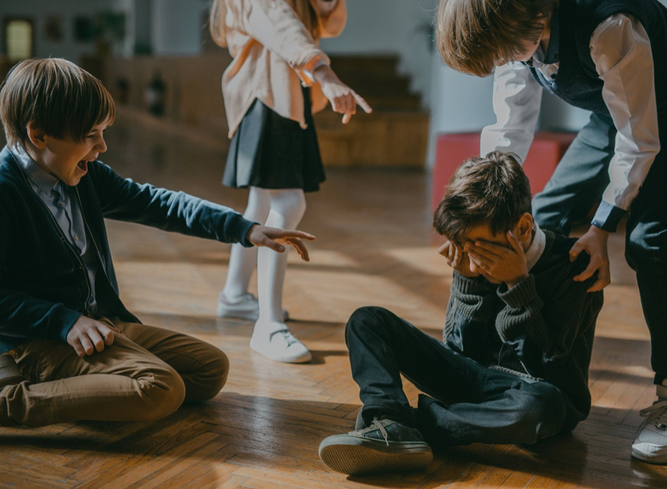
Types of Bullying

Slide 13
Modes of Bullying
Direct bullying vs. indirect bullying
Physical
Verbal
Relational (Designed to harm reputation and relationships)
Notes:
What does bullying look like?'The CDC’s uniform definition document recognized that there are two distinct modes of bullying:'
Direct bullying, which occurs in the presence of the targeted youth (e.g. face-to-face interactions, likepushing or hitting, and direct harmful written or verbal communications, like taunting or mean notes)
Indirect bullying—such as rumor spreading or encouraging others to exclude a peer—which are not directly communicated but reach the target indirectly.
The uniform definition document also recognized that within these different modes, there are also distinct types of bullying:
•
Physical bullying
•
Verbal bullying
•
Relational bullying—which is designed to harm the reputation and relationships of a peer
Reference:'Gladden, Vivolo-Kantor, Hamburger, and Lumpkin (2024)'

Slide 14
Which of the following is true? Indirect modes of bullying…
A
Involve aggressive behavior(s) that are not directly communicated to the youth.
B
May include spreading rumors.
Check-In
C
May include encouraging others to exclude someone.
D
All of the above.

Slide 15

Key Findings

Slide 16


Finding #1
Many children are involved in bullying.
22% of students ages 12-18 were bullied at school in the 2012-2013 academic year.
20% of high school students were bullied on school property at least once in the last year.
U.S. Department of Education (2015), Kann et al. (2014)
Notes:
The first finding is that many children are involved in bullying. Let’s take a look at what we know about the prevalence of bullying.
National estimates of bullying vary and depend on such variables as the definition used, the age of the study’s participants, and the time frame examined. However, studies are consistent in showing that substantial percentages of children are involved: as those who bully others, those who are bullied, or both.
For example, the School Crime Supplement to the National Crime Victimization Survey reported that 22% of students ages 12-18 had been bullied at school during the 2012-2013 school year.
Another national survey, the Youth Risk Behavior Survey, published by the Centers for Disease Control and Prevention, found that 20% of high school students (grades 9-12) had been bullied on school property at least once in the previous 12 months.
References:
Cook, Williams, Guerra, and Kim (2020)
Kann, Kinchen, Shanklin et al. (2024)
U.S. Department of Education (2025)

Slide 17
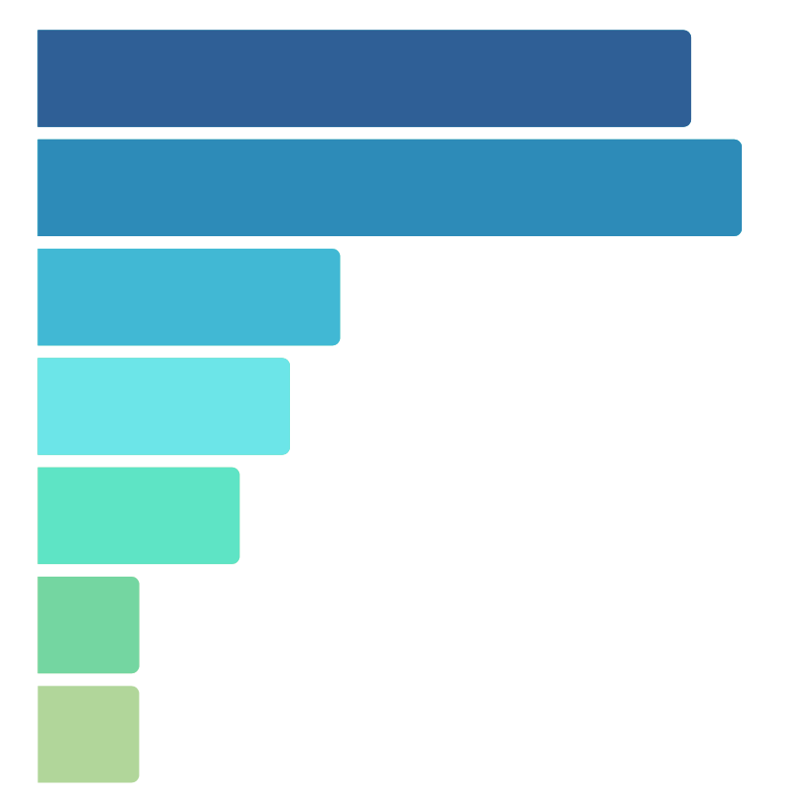
Forms of Bullying
14%
Made fun of, called names, insulted
13%
Subject of rumors
6%
Pushed, shoved, tripped, spit on
5%
Excluded from activities on purpose
4%
Threatened with harm
2%
Forced to do things they didn’t want to do
2%
Had property destroyed
U.S. Department of Education (2015)
Notes:
This National Crime Victimization Survey of 12-18-year-olds examined different types of bullying that students had experienced. The most common forms of bullying were verbal bullying and rumor-spreading. 14% of 12-18-year-olds said they had been made fun, called names, or insulted, and 13% had been the subject of rumors.
6% had been pushed, shoved, tripped, or spit on; 5% had been excluded from activities; 4% had been threatened with harm; 2% had been forced to do things they didn’t want to do; and 2% had property destroyed.
The study also found 7% had been cyberbullied anywhere – in other words, not just on school property
– in the previous 12 months.
Reference:
U.S. Department of Education (2025)

Slide 18



Finding #2
There are gender similarities and differences with regards to experience with and presentation of bullying.
Boys and girls experience similar rates of bullying
Boys are 1.7x more likely to bully others
Boys are 2.5x more likely to bully and also be bullied
U.S. Department of Education
Notes:
The second key finding is that there are both similarities and differences in boys’ and girls’ experiences with bullying.
Most studies find either small differences or no differences in the likelihood that boys'and girls are bullied. For example, in the School Crime Supplement to the National Crime Victimization'Survey (NCVS), 20% of boys reported that they had been bullied at school during the 2012-2013 school'year, and 24% of girls said they had been bullied.'
Important differences do emerge, however, in the frequency with which boys and girls bully others.'Boys are, on average 1.7 times more likely to bully others, and 2.5 times more likely to both bully others'and be bullied (i.e., be “bully-victims”).'
There also are some interesting similarities and differences in the types of bullying that boys and girls'experience. For example, the 2012-2013 NCVS found that girls aged 12-18 were more likely than boys to'say that they had been bullied through rumor-spreading (17% vs 10%), name-calling (15% vs. 13%), social exclusion (6% vs. 4%), and cyberbullying (9% vs. 5%). Boys were more likely than girls to say they'had been physically bullied (7% vs. 5%).'
References:'Cook et al. (2020)'
U.S. Department of Education (2025)

Slide 19


Gender Differences
Similar rates of threats, being forced to do things they don’t want to, and property damage
More likely to experience physical bullying
More likely to experience verbal bullying, rumor spreading, exclusion, and cyber bullying.
Notes:
Most studies find either small differences or no differences in the likelihood that boys'and girls are bullied. For example, in the School Crime Supplement to the National Crime Victimization'Survey (NCVS), 20% of boys reported that they had been bullied at school during the 2012-2013 school'year, and 24% of girls said they had been bullied.'
Important differences do emerge, however, in the frequency with which boys and girls bully others.'Boys are, on average 1.7 times more likely to bully others, and 2.5 times more likely to both bully others'and be bullied (i.e., be “bully-victims”).'
There also are some interesting similarities and differences in the types of bullying that boys and girls'experience. For example, the 2012-2013 NCVS found that girls aged 12-18 were more likely than boys to'say that they had been bullied through rumor-spreading (17% vs 10%), name-calling (15% vs. 13%), social exclusion (6% vs. 4%), and cyberbullying (9% vs. 5%). Boys were more likely than girls to say they'had been physically bullied (7% vs. 5%).'
References:'Cook et al. (2020)'
U.S. Department of Education (2025)

Slide 20
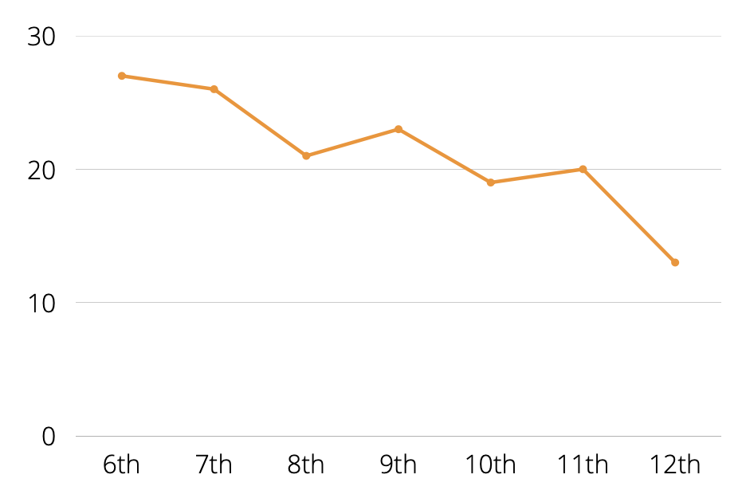
Finding #3
Children’s experiences with bullying vary by age.
Percent bullied in the 2012-2013 school year
Children most likely to be bullied in elementary school
Likelihood decreases through middle and high school
U.S. Department of Education (2015)
Notes:
The third finding is that children’s experiences with bullying also vary with age.
Children and youth are most likely to be bullied in elementary school. Anonymous self-report surveys of children and youth indicate that the likelihood that they will be bullied decreases steadily through middle school and high school.'
Here, you can see data from the National Crime Victimization Survey, which assessed the frequency with'which middle and high school youth were bullied during the 2012-2013 school year.'
Of course, somewhat different age trends emerge for different forms of bullying. For example, although'verbal bullying, and physical bullying decrease steadily through middle and high school, youth are most'likely to report being cyberbullied in high school (10th and 11th grade), according to the National Crime'Victimization Survey.'
References:'Finkelhor, Ormrod, Turner, and Hamby (2009)'Luxenberg, Limber and Olweus (2014)'Nansel et al. (2021)'
U.S. Department of Education (2025)

Slide 21
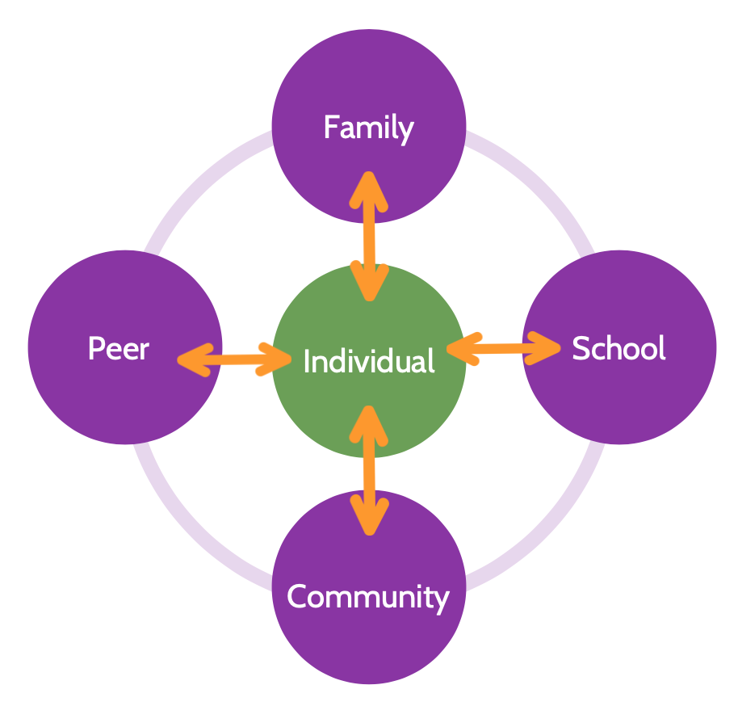
Finding #4
There are various risk and protective factors for bullying.
Ecological perspective
Notes:
A fourth key finding from research is that there is not one single cause of bullying. There are many different factors that place children and youth at risk for being involved in bullying. There also are protective factors that can reduce or eliminate these risks. Another way of saying this is that bullying results from a complex interaction between’ individuals and their broader social environment, including families, peers, school and community.'
References:'
Cook, Williams, Guerra, Kim, and Sadek (2010)'Espelage and Swearer (2010)'Kowalski, Limber, and Agatston (2012)Swearer and Doll (2001)'Swearer, Espelage, Koenig, Berry, Collins, and Lembeck (2012)'

Slide 22

Individual Factors
Individual temperament
Social competence
Alcohol and drug use
Disability
Social isolation
Sexual orientation
Notes:
Research has confirmed that there are individual factors or variables that are related to'a child or adolescent’s involvement in bullying.'
For example, individual temperament may play a role. Children and youth who bully are more likely to'have an active, “hot-headed” temperament, while children who are bullied are more likely to have a'quiet, passive temperament.'
The social competence of children and youth is also related to involvement in bullying. Children who are bullied and particularly those who are bullied and who also bully others are more likely than their peers'to lack social skills.'
As we’ll discuss in more detail in a few minutes, children and youth are at a higher risk of being bullied if'they are socially isolated, if they have a disability, or if they are gay, lesbian, bisexual, transgender or if'they are questioning their sexual identity.'
References:'
Cook, Williams, Guerra, Kim, & Sadek (2010)'Olweus (1993)'Reijntjes, Kamphuis, Prinzie, & Telch (2010)'Swearer et al. (2012)'

Slide 23

Peer Factors
Exposure to aggressive, violent, or delinquent peers
Having at least one close friend
Social support
Notes:
There also are important peer factors that make it more or less likely that a child or'adolescent will be involved in bullying. The peer group is a particularly important influence during'adolescence.'
Research has shown that exposure to aggressive, violent, or delinquent peers may increase the'likelihood that child or adolescent will bully others.'
Of course, peers can also have positive or protective influences. Children and youth who are bullied tend'to be socially isolated. Research has found that those who have at least one friend are less likely to be'bullied.'
Not only having a friend but feeling supported by peers is important. For example, children and youth'who feel supported by their peers are less likely to experience negative psychological effects from'bullying.'
References:'
Cook, Williams, Guerra, Kim, & Sadek (2010)'Hodges, Boivin, Vitaro, & Bukowski (1999)'Olweus (1993)'Swearer et al. (2012)'

Slide 24

Family Factors
Parental warmth and engagement
Parental conflict
Parental use of drugs and alcohol
Domestic violence
Parental involvement in justice system
Child maltreatment
Notes:
Many family variables are related to children’s involvement in bullying. A number of examples are listed here.'
Having disengaged parents increases the risk that a child will bully others, while having warm, involved parents reduces this risk.'
Exposure to parental conflict, parental use of drugs & alcohol, and domestic violence increases the likelihood that a child will bully others and the likelihood that a child will be bullied.'
Youth who have had a parent in jail or prison are more likely than peers to be involved in bullying.'
Child abuse has been found to be related to a greater likelihood of bullying others and also being bullied by peers.'
References:'
Baldry (2003)'Bowes, Arseneault, Maughan, Taylor, Casi, & Moffitt (2009)'Olweus (1993)'Pellegrini (1998)'Swearer, Espelage, Koenig, Berry, Collins, & Lembeck (2012)'

Slide 25

School Factors
School Climate
Student’s sense of belonging to the
school
Degree of respect and fair treatment
Good adult supervision
Awareness and responsiveness of staff
Notes:
Factors within the school environment are also related to the likelihood of bullying.
Variables related to school climate have been found to be important. For example, having a sense of'belonging to one’s school is associated with less involvement in bullying (bullying others and being'bullied).'
The degree to which staff actively supervise behavior, are aware of bullying issues, and are responsive to'bullying problems is also critical.'
References:'Cook, Williams, Guerra, Kim, & Sadek (2010)'Olweus (1993)'Pellegrini & Bartini (2000)'Swearer, Espelage, Koenig, Berry, Collins, & Lembeck (2012)'

Slide 26

Community Factors
Neighborhood safety
Connection to adults in neighborhood
Notes:
Finally, factors within the larger community are also related to the likelihood of bullying.
For example, research has found that children and youth are more likely to be bullied if they perceived'that their neighborhood is less safe and if they felt they were not known by neighbors.'
References:'Cook, Williams, Guerra, Kim, & Sadek (2010)'Swearer, Espelage, Koenig, Berry, Collins, & Lembeck (2012)'

Slide 27
Protective Factors
Individual and Family
Secure, caring, and self-confident children
Supportive parenting – modeling positive relationships
Consistent and affectionate parent-child interactions
Peer and School
Close, positive friendships with peers
Engaged and responsive teachers and school staff
Inclusive, nurturing, and safe schools
Notes:
Protective factors can reduce the likelihood that a child will be involved in bullying.'Here are examples of characteristics of individuals, families, peer interactions and school environments that have been found to protect children and youth from involvement in bullying.'
Individuals who are secure, caring and self-confident children are less likely to be bullied. Protective'factors within the family include: supportive parenting and modeling of positive relationships and'consistent and affectionate parent-child interactions.'
Having close positive friendships with peers can reduce the likelihood that a child is bullied and the'support of peers--even one good friend--can also lessen the negative psychological effects from bullying.'
Positive school climates, where teachers and staff closely supervise behaviors and are aware of and'responsive to behavior issues reduces the likelihood of bullying.'
References:'Cook, Williams, Guerra, Kim, and Sadek (2010)'Baldry, and Farrington (2005)'Olweus (1993)'Pellegrini and Bartini (2000)'Swearer, Espelage, Koenig, Berry, Collins, and Lembeck (2012)'

Slide 28
Protective Factors
Community
Cultural norms and beliefs that are pro-social and non-violent
Positive adult-child connections
Safe neighborhoods
The commission for the Prevention of Youth Violence (2000) outlines a coordinated public health approach to preventing youth violence.
Notes:
Children and youth need to feel safe and cared for by adults everywhere. Collective attitudes and social norms within neighborhoods and communities also influence risk and protective factors for bullying. Bullying is less likely in communities where cultural norms and beliefs are pro-social and non-violent, where there are positive adult-child connections, and where neighborhoods are safe.
Health professionals from medicine, nursing and public health issued a Call-to-Action in 2000 that instructs communities to adopt a coordinated public health approach to preventing bullying and other forms of youth violence. They advocate for reforms in policies and practices that:
Give parents and caregivers the education and support needed to nurture and discipline children in ways that are supportive, developmentally appropriate, and non-physical (corporal punishment);
Incorporate social skills training and social-emotional lessons in classrooms and youth programs;
Coordinate intervention strategies across disciplines and institutions;
Reduce risks within communities related to the ease of access by children and youth to alcohol and drugs, media violence, and firearms;
And, most importantly, realize that violence is learned behavior: In other words, what adults do to children and each other, children will also do (Commission for the Prevention of Youth Violence, 2000)
References:'Hong, and Espelage (2012)'Cook, Williams, Guerra, Kim, and Sadek (2010)'Swearer, Espelage, Koenig, Berry, Collins, and Lembeck (2012)'Commission for the Prevention of Youth Violence (2000)'Wilkins, Tsao, Hertz, Davis, and Klevens (2014).'

Slide 29
Finding #5
Although any child may be targeted, some are at particular risk of being bullied.
Children and youth at higher risk include those who:
Have learning disabilities
Have special health needs or chronic diseases
Have attention-deficit/hyperactivity disorder (ADHD)
Are overweight or underweight
Have autism spectrum disorder (ASD)
Are lesbian, gay, bisexual, transgender, or queer (LGBTQ+); are questioning their sexuality; or do not conform to gender stereotypes
Speak another language at home
Notes:
A fifth key finding is that any child or youth may be bullied by peers, but some groups of children and youth are at a particularly high risk of being bullied.
No single factor puts a child at risk of being bullied or bullying others. Bullying can happen anywhere—cities, suburbs, or rural towns. Depending on the environment, some groups may be at an increased risk of being bullied.
Children and youth with learning disabilities are at greater risk of being teased and physically bullied, compared with other children;
Those with attention-deficit/hyperactivity disorder are more likely to be bullied (and also to bully their peers);
Those with autism spectrum disorder are more likely to be ostracized;
Children and youth with special health care needs or chronic diseases (diabetes, muscular dystrophy, spina bifida, atopic eczema) are more frequently bullied;
Overweight and obese youth, and those who are underweight may be more likely to be bullied;
Youth who identify themselves as lesbian, gay, bisexual or transgender, youth who may be questioning their sexual orientation, and those who do not conform to gender stereotypes frequently face bullying by their peers.
And finally, students who speak another language at home are more likely to be frequently bullied because of their religion or race than those who speak English.
*** however, even if a child has these risk factors, it doesn’t mean that they will be bullied ***
References:'Dawkins (1996)'Espelage, Aragon, Birkett, and Koenig (2008)'Gray, Kahhan, and Janicke (2009)'Hamiwka, Yu, Hamiwka, Sherman, Anderson, and Wirrell (2009)'Harris Interactive and GLSEN (2005)'Kowlaski and Fedina, 2011'Kosciw, Greytak, Bartkiewicz, Boesen, and Palmer (2011)'Magin, Adams, Heading, Pond, and Smith (2008)'Martlew and Hodson (1991)'Mepham (2010)'Mishna (2003)'Puhl, Luedicke, and Heuer (2011)'Storch et al. (2004)'Twyman, Saylor, Saia, Macias, Taylor, and Spratt (2010)'Wang, Iannott and Luk (2010)'Wiener and Mak (2009)'

Slide 30
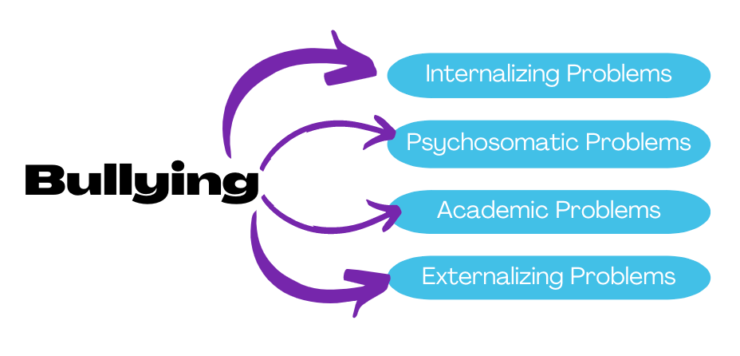
Finding #6
Bullying can affect the health, mental health, and academic well-being of children who are targeted.
Notes:
The sixth finding relates to the known effects of bullying on the health, mental health, and academic well-being of children and youth who are bullied.
Over the last decade, a number of longitudinal studies have looked at whether being
'bullied is related to the development of problems for the health and well-being of bullied children.
'
Research has confirmed that individuals who are bullied are more likely than peers to develop a variety
'of internalizing problems, including depression, anxiety, panic disorder, self-harm, suicidal thoughts and
'attempts. Researchers have found that not only does bullying lead to internalizing problems, but having
'internalizing problems also leads to further bullying by peers. So, often, children and youth may become
'caught in a vicious cycle of bullying by peers that is difficult to escape.
'
Bullied children are also more likely than their peers to develop later psychosomatic problems, such as
'headaches, stomach pain, sleeping problems, and poor appetite.
'
Not only may bullying affect the emotional and physical well-being of children, but it may also affect
'their academic work. Children and youth who are bullied are more likely than non-bullied peers to feel
'as if they don’t belong in school and want to avoid going to school. They also are more likely to have
'somewhat lower academic achievement, whether measured through grades or standardized test scores.
'In addition, several longitudinal studies—which measure children’s experiences of bullying over time—
'suggest a causal relationship between bullying and academic achievement. For example, in a recent
'study of students in the U.S., middle schoolers’ grade point averages and levels of academic
'engagement were predicted by whether or not they had been bullied. The researchers concluded that
the effect of bullying could account for up to a 1.5 letter grade decrease in an academic subject over the
3 years of middle school (Juvonen et al., 2011).
'
References:
'
Buhs, Ladd, and Haerald (2006)
'Arsenault, Walsh, Trzeniewski, Newcombe, Caspi and Moffitt (2006)
'Copeland Wolke, Angold, and Costello (2013)
'Faris and Felmlee (2014)
'Gini and Pozzoli (2013)
'Glew, Fan, Katon, Rivara, and Kernic (2005)
'Juvonen, Wang, and Espinoza (2011)
'Klomek, Sourander, Njemelä, Kumpulainen, Piha, Tamminen, Almqvist, and Gould, (2008)
'Kochenderferand Ladd (1996)
'Lereya, Copeland, Costello, and Wolke (2015)
'Reijntjes, Kamphuis, Prinzie, Boelen, van der Schoot, and Telch (2011)
'Reijntjes, Kamphuis, Prinzie, and Telch (2010)
'Ttofi, Farrington, Lösel, and Loeber (2011a)

Slide 31
Biological Changes
Harmful biological changes are associated with bullying
Genetics research, neuroimaging, and studies of the body’s stress response provide insight into how bullying and its effects can alter our biology
Being bullied leads to changes in the body’s stress response system, which can in turn affect academic outcomes
Recognizing the “invisible scars” that bullying can leave is an essential step in promoting youth well-being
Notes:
How does being bullied lead to health, mental health, and academic problems?’ Researchers have identified some biological mechanisms that show that bullying can “get under the'skin.”'
Genetics research, neuroimaging studies, and studies of the stress response system reveal harmful biological changes associated with being bullied.'
For example, studies suggest that being bullied affects the body’s stress response system, which can'affect their memory (and ultimately their academic outcomes).'
However, far more research is needed to understand the complex relationship between bullying, health'outcomes, and neurobiology. For example, a better understanding of the neurobiology of peer'victimization could help explain why some children and youth become ill as a consequence of bullying, while others do not.'
Recognizing the “invisible scars” bullying can leave is an important step in promoting positive well-being'for youth through adolescence and into adulthood.'
References:'Institute of Medicine and National Research Council (2014)'Ouellet-Morin, Wong, Danese, Pariante, Papadopoulos, Mill, and Arseneault (2013)'Sugden, Arseneault, Harrington, Moffitt, Williams, and Caspi (2010)'Vaillancourt and Edgerton (2015)'

Slide 32
Finding #7
Children who bully are more likely than others to be involved in other antisocial behavior.
Exhibit antisocial or delinquent behaviors (e.g. fighting, stealing, vandalism)
Come from homes with intimate partner violence
Dislike and drop out of school
Think about and attempt suicide
Drink alcohol and smoke cigarettes
Carry a weapon
Notes:
Not only is there reason to be concerned about children who are bullied, but there also is reason to worry about children who bully others. A seventh key finding is that children who bully are more likely than other children to be involved in antisocial and troubling behaviors.
Children who bully are more likely than their peers to:
•
Exhibit delinquent behaviors (such as fighting, stealing, vandalism)
•
Dislike school and drop out of school
•
Drink alcohol and smoke cigarettes
•
Carry a weapon
•
Think about and attempt suicide
Longitudinal research also has found that bullying others is related to:
•
An increased likelihood of criminal and antisocial behavior in adolescence and adulthood
•
Later sexual harassment of peers in middle school
References:
'Berthold and Hoover (2000)
'Byrne (1994)
'Cook et al. (2010)
'Espelage, Basile, and Hamburger (2012)
'Klomek et al. (2008)
'Nansel et al. (2001)
'Nansel et al. (2004)
'Olweus (1993)
'Ttofi, Farrington, Lösel, and Loeber (2011b)
'

Slide 33
Children Who Bully
Bullying others is related to
Later criminal and antisocial behavior
Later sexual harassment perpetration among middle school students
Notes:
Children who bully are more likely than their peers to:
•
Exhibit delinquent behaviors (such as fighting, stealing, vandalism)
•
Dislike school and drop out of school
•
Drink alcohol and smoke cigarettes
•
Carry a weapon
•
Think about and attempt suicide
Longitudinal research also has found that bullying others is related to:
•
An increased likelihood of criminal and antisocial behavior in adolescence and adulthood
•
Later sexual harassment of peers in middle school
References:
'Berthold and Hoover (2000)
'Byrne (1994)
'Cook et al. (2010)
'Espelage, Basile, and Hamburger (2012)
'Klomek et al. (2008)
'Nansel et al. (2001)
'Nansel et al. (2004)
'Olweus (1993)
'Ttofi, Farrington, Lösel, and Loeber (2011b)
'

Slide 34

Finding #8
Many children do not report bullying experiences to adults.
Why?
Negative messaging about “tattling” and “snitching”
Concern about retaliation
50%-70% of children and youth do not tell school personnel (a bit more likely to tell parents)
Gender stereotypes
Lack of confidence in adults’ actions
Notes:
An eighth research finding involves the likelihood that children and youth will report bullying to adults if they experience it. Unfortunately, most studies suggest that the majority of children and youth who have'been bullied (50-75% in most studies) have not told an adult at school. Somewhat more indicate they'have told a parent, but many are silent.'
The likelihood that a child will tell someone about their bullying experiences varies by age and gender.'Older youth and boys are less likely than younger children and girls to report that they have been'bullied.'
There likely are numerous reasons why children and youth are reluctant to report being bullied.'Particularly for older children and youth, they may fear being labeled “tattlers” or “snitches” by their'peers. Likely, many are concerned about possible retaliation by their aggressors if they report them.'
Boys may feel pressure to try to deal with bullying on their own so as not to appear “weak” or vulnerable. Some may lack confidence in adults’ abilities to stop the bullying. Research suggests that'with age, students are less and less likely to perceive that adults are helpful in stopping bullying.'
As a result, it is critical that adults respond quickly, effectively, and sensitively when bullying is reported'to them and that they are vigilant to stop bullying that is NOT reported, particularly among older youth'and boys.'
References:'Boulton and Underwood (1992)'Fonzi, Genta, Menesini, Bacchini, Bonno, and Constable (1999)'

Slide 35
Finding #9
Many children and youth are concerned about bullying.
Most children and youth have negative feelings about bullying and feel sympathy for bullied peers
Sympathy often does not translate into action
When bystanders try to help a bullied child, they are often effective in stopping it
Notes:
Our ninth finding includes some good news to share, which is that many children and youth are concerned about bullying. Research confirms what many parents and educators believe, which is that most'children and youth don’t like bullying and feel sorry for their peers who are bullied.'
In one study (Luxenberg et al., 2014), researchers found that 90% of third-fifth graders said they felt'sorry for students who are bullied. With age (in to middle and high school grades), fewer and fewer'students expressed sympathy for bullied students, and girls were more likely than boys to say they felt'sorry for bullied peers.'
Unfortunately, this sympathy often does not result in positive action to help stop the bullying. In one'study, researchers found that even though the vast majority of elementary school children felt sorry for'bullied students, fewer than half said they would try to help if they saw or knew that a student was being bullied (Luxenberg et al., 2014).'
However, when witnesses do try to help a bullied student, they are often effective in stopping the bullying in the moment. One study found that in the majority of these cases, the bullying stopped within 10 seconds (Hawkins, Pepler, and Craig, 2001).'
References:'Baldry (2004)'Hawkins, Pepler and Craig (2001)'

Slide 36
Finding #10
A variety of laws in the U.S. address bullying
Federal Laws & Bullying and Harassment
School Districts and Federal Civil Rights
State Anti-Bullying Laws and Policies
Notes:
A final finding to share is that there are a variety of state and federal laws in the United States related to bullying.
Schools that receive federal funding (including colleges and universities), are required by federal law to address discrimination based on a number of different personal characteristics.
For example:
Title VI of the Civil Rights Act of 1964 (referred to as Title VI) prohibits discrimination based on race, color, or national origin
Title IX of the Education Amendments of 1972 (referred to as Title IX) prohibits discrimination based on sex
Section 504 of the Rehabilitation Act of 1973 and Title II of the ADA (1990) prohibits'discrimination based on disability'
Reference:'Ali (2010)'Lhamon (2014)'Musgrove and Yudin (2013)'

Slide 37
Federal Laws
Schools that receive federal funding must address discrimination based on a number of different personal characteristics.
Title VI of the Civil Rights Act of 1964 prohibits discrimination based on race, color, or national origin
Title IX of the Education Amendments of 1972 prohibits discrimination based on sex
Section 504 of the Rehabilitation Act of 1973 and Title II of the ADA (1990) prohibits discrimination based on disability
Notes:
Schools that receive federal funding (including colleges and universities), are required by federal law to address discrimination based on a number of different personal characteristics.
For example:
Title VI of the Civil Rights Act of 1964 (referred to as Title VI) prohibits discrimination based on race, color, or national origin
Title IX of the Education Amendments of 1972 (referred to as Title IX) prohibits discrimination based on sex
Section 504 of the Rehabilitation Act of 1973 and Title II of the ADA (1990) prohibits'discrimination based on disability'
Reference:'Ali (2010)'Lhamon (2014)'Musgrove and Yudin (2013)'

Slide 38
School Districts
School districts may violate federal civil rights laws when:
Peer harassment based on race, color, national origin, sex, or disability is sufficiently serious that it creates a hostile environment, and
The harassment is encouraged, tolerated, not adequately addressed, or ignored by school employees
Several Dear Colleague Letters from the U.S. Department of Education remind school officials of their responsibility to respond to bullying and harassment
Notes:
School districts may violate federal civil rights laws when:
Peer harassment based on race, color, national origin, sex, or disability is sufficiently serious that it creates a hostile environment, and when
The harassment is encouraged, tolerated, not adequately addressed, or ignored by school employees.
School personnel are also responsible for addressing bullying behavior that meets this threshold if they'know about the behavior or if they reasonably should have known about the behavior.'
All school personnel are encouraged to be familiar with information on this topic presented to school personnel in several Dear Colleague Letters from the U.S. Department of Education to educators in the'field.'
References:'Ali (2010)'Lhamon (2014)'Musgrove and Yudin (2013)'

Slide 39
State Laws
School districts may violate federal civil rights laws when:
Peer harassment based on race, color, national origin, sex, or disability is sufficiently serious that it creates a hostile environment, and
The harassment is encouraged, tolerated, not adequately addressed, or ignored by school employees
Several Dear Colleague Letters from the U.S. Department of Education remind school officials of their responsibility to respond to bullying and harassment
Notes:
State and local lawmakers have taken action to prevent bullying and protect children. Through laws (in their state education codes and elsewhere) and model policies (that provide guidance to districts and schools), each state addresses bullying differently.
Bullying, cyberbullying, and related behaviors may be addressed in a single law or may be addressed in multiple laws. In some cases, bullying appears in the criminal code of a state that may apply to juveniles

Slide 40
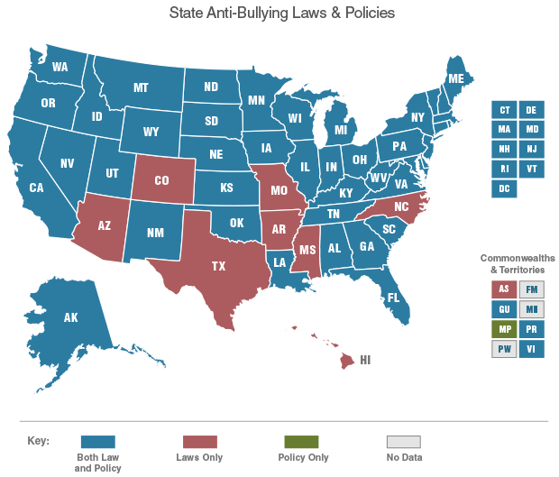
State Laws
Notes:
Every state now has a law on the books which addresses bullying. You can find out how your state refers to bullying in its laws and what they require on the part of schools and districts by exploring this map, located on www.StopBullying.gov which provides links to state laws and policies. Link to online map: http://www.stopbullying.gov/laws/index.html

Slide 41

The two most common forms of bullying that children experience, according to the National Crime Victimization Survey, are:
A
Being pushed, shoved, tripped, or spit on (physical bullying); and being the subject of rumors.
B
Being threatened with harm; and being excluded from activities
C
Being the subject of rumors; and being made fun of, called names, or insulted
Check-In
D
Being cyberbullied; and being verbally bullied

Slide 42
Which of the following are protective peer-related factors of bullying?
A
Close, positive friendships with peers
B
Consistent and affectionate parent-child interactions
C
Domestic violence
Check-In
Peers who have high academic achievement
D

Slide 43

Misdirections

Slide 44
Misdirection #1:
Zero Tolerance for Bullying
Also referred to as “student exclusion” policies. Concerns:
They potentially affect a large number of students
Threats of severe punishments may actually discourage children and adults from reporting
Bullying can be an early marker of other problem behaviors. Children who bully need positive, prosocial role models, including adults and students in their school.
School safety may occasionally demand that a student be removed from a school environment, but these situations should be rare.
Notes:
Unfortunately, well-meaning educators, mental health professionals and advocates sometimes use bullying prevention and response strategies that are not supported by research or our'understanding of best practices.'
I’d like to highlight a few:'
Some schools have adopted “zero tolerance” or “3 strikes” policies towards bullying, in which children'who bully others are suspended or expelled from school. These policies (also called “student exclusion'policies”) raise a number of concerns:'First, they potentially affect a large number of students.'Second, threats of severe punishments such as suspension or expulsion, may actually discourage'children and adults from reporting.'Third, bullying can be an early marker of other problem behaviors. Children who bully are in need of'positive, prosocial role models, including adults and students in their school.'
School safety may occasionally demand that a student be removed from a school environment, but'these situations should be rare.'
References:'American Psychological Association Zero Tolerance Task Force (2008)'Cornell and Limber (2015)'

Slide 45
Misdirection #2:
Conflict Resolution and
Peer Mediation
Are often used to address conflicts among students. Concerns:
Bullying is a form of victimization, not conflict
Mediating a bullying incident may send inappropriate messages to the students who are involved
Mediation may further victimize or traumatize a child who has been bullied.
Notes:
Dr. Sue Limber: A second misdirection involves the use of conflict resolution or peer mediation to address bullying problems. Conflict resolution and peer mediation are common strategies for dealing with conflicts among students, but in most cases, they are not recommended to deal with bullying.
Why?
•
First, bullying is a form of victimization, not conflict.
•
Second, mediating a bullying incident may send inappropriate messages to the students who are involved. The message should NOT be: “You’re both partly right and partly wrong—we need to work out this conflict between you.” The appropriate message for a bullied child should be, “No one deserves to be bullied, and we are going to see that it stops.” And, the appropriate message for students who bully is, “Your behavior is wrong and we’re going to work with you to ensure that it stops.”
•
Third, mediation may further victimize a child who has been bullied. Being bullied can be a traumatic event for a child, and forcing a child to face his or her tormentor (or encouraging him or her to do so without preparation or support may re-traumatize the child.
A trauma-informed approach should recognize that children who have been bullied may have
'experienced trauma and need special care to address the trauma and avoid practices that may re-
traumatize them.
'
In some cases, restorative practices may be appropriate, but these typically require considerable time
'and training by professionals—program aspects that are not typical of most peer mediation programs in
'schools.
'
References:
'Limber and Snyder (2006)
'Molnar-Main (2014)
'Substance Abuse and Mental Health Services Administration (2014). SAMHSA’s Concept of Trauma and
'

Slide 46
Misdirection #2:
Conflict Resolution and
Peer Mediation
Consider a trauma-informed approach
Children who have been bullied may have experienced trauma
May need practices to address trauma and avoid those that re-traumatize
Restorative practices require significant time and training by professionals
Could be appropriate in certain contexts with the right professionals
This situation is not common in most peer mediation programs in schools
Notes:
A trauma-informed approach should recognize that children who have been bullied may have experienced trauma and need special care to address the trauma and to avoid practices that may re-traumatize them
In some cases, restorative practices, which focus on restoring relationships and repairing the harm done, may be appropriate but these typically require considerable time and training by professionals – situations that are not common to most peer mediation programs in schools

Slide 47
Misdirection #3:
Group Therapeutic
Treatment
Group treatment with children who bully
May involve anger management, skill-building, empathy-building, and self-esteem enhancement
Well intentioned but often counter-productive
Why? Group members can serve as poor role models and reinforce each others’ antisocial and bullying behavior.
Notes:
Another strategy that some schools use to address bullying behavior involves group therapeutic treatment for children who bully, including anger management, skill-building, empathy-building and self-esteem enhancement. Although well-intentioned, these group interventions are often'counter-productive, as group members tend to serve as poor role models and reinforce each others’ antisocial and bullying behavior.'
Reference:'Dishion, McCord, and Poulin (1999)'

Slide 48
Misdirection #4:
The Relationship Between
Bullying and Suicide
Overstating or simplifying the
relationship between bullying and suicide
Media publicity around suicides by youth who were bullied by peers has led to assumptions that bullying often leads directly to suicide
These assumptions are unhelpful and potentially harmful. Why?
It encourages sensationalized reporting
It fails to recognize the complex causes and risk factors of suicide
It perpetuates the false belief that suicide is a natural response to being bullied
Notes:
A fourth misdirection involves overstating or simplifying the relationship between bullying and suicide. Recent media publicity around suicides by youth who were bullied by their peers has led many to assume that bullying often leads directly to suicide. Although research clearly indicates a connection between involvement in bullying and suicide-related behaviors, it is important not to overstate or misinterpret the extent of this connection. Discussing suicide as directly caused by bullying, or implying that bullying is the only cause of suicide is not helpful and potentially harmful because:
One, it encourages sensationalized reporting.
Two, it fails to recognize that the causes of suicide are complex and many individual, relational, community, and societal factors contribute to a risk of suicide. Common risk factors include mental illnesses, coping with disease/disability, and family dysfunction.
Three, it perpetuates the false notion that suicide is a natural response to being bullied, which has the dangerous potential to normalize the response and may even lead to “suicide contagion” among youth.
References:'Centers for Disease Control and Prevention (2012)'Hinduja and Patchin (2010)'Karch, Logan, McDaniel, Floyd, and Vagi (2013)'

Slide 49
Misdirection #5:
Simple, Short-Term
Solutions
Often administrators and staff adopt a short-term, piecemeal approach
Bullying may be the topic of a staff in-service training, PTO meeting, school-wide assembly, lessons taught by individual teachers
These efforts may be good first steps but are unlikely to reduce bullying on their own.
Notes:
A final misdirection involves implementing simple short-term solutions to prevent and'address bullying. Sometimes, school administrators and their staff adopt a short-term piecemeal'approach to bullying prevention. It may be the topic of a staff in-service training, a PTA meeting, a'school-wide assembly, or lessons taught by individual teachers. Although each of these efforts may'represent important initial steps in adoption of a comprehensive, long-term strategy, they should not be'ends in and of themselves, as they are unlikely to significantly reduce bullying problems.’
References:'Institute of Medice and National Research Council (2014)'Limber and Snyder (2006)'Ttofi and Farrington (2009, 2011)'

Slide 50
Which of the following is NOT
a common misdirection in bullying prevention and response?
A
Overstating or simplifying the relationship between bullying and suicide.
B
Group therapeutic treatment for children who bully.
C
Using peer mediation to address bullying problems.
Check-In
The use of developmentally appropriate and proportional consequences for bullying others.
D

Slide 51
Why is it problematic to suggest that suicide is directly caused by bullying?
A
It encourages sensationalized reporting.
It fails to recognize that the causes of suicide are complex.
B
It perpetuates the false notion that suicide is a natural response to being bullied; may lead to suicide contagion.
C
Check-In
D
All of the above.

Slide 52

Best Practices
Notes:
Best Practices in Bullying Prevention and Response

Slide 53
1. Focus on the Social Climate
Bullying prevention requires changes in social climates of schools and organizations.
Students feel connection to schools where they know, care about, and support one another, and have common goals.
Changing social norms around bullying requires commitment, time, and effort but can have a positive effect on behavior.
Increasing adult supervision is also important.
Notes:
First, in order to reduce bullying and create positive communities where youth feel safe, emotionally secure and connected, it is important to focus on the social climate of the school,'neighborhood center, recreation league, or other settings where children and youth gather.'
Research indicates that students feel more connected to schools where they know, care about, and'support one another, have common goals, and actively contribute. And where students are more'connected to their schools, there is less problem behavior.'
By working together, members of a school or other community organization can change the social'norms so that it becomes “uncool” to bully; so that children, youth, and adults notice if children are'being left out, made fun of or bullied in other ways; and so that it is expected that students step in to be'a friend or to help out in other ways if someone is bullied.'
Changing these norms takes commitment, time and effort on everyone’s part–parents and guardians, teachers, counselors, coaches, school resource officers, bus drivers, administrators, and of course youth'themselves. But it can have significant effects on behavior.'
Bullying also tends to thrive in locations where adults are not present or are not “intentionally” looking'out for it. All adults should be vigilant for signs of bullying and investigate whenever bullying is'suspected.'
Local data collection can help to identify “hot spots” where bullying is most likely to occur and can help'focus supervision efforts.'
References:'Gregory, Cornell, Fan, Sheras, and Shih (2010)'Hargreaves, Earl, and Ryan (1996)'IOM (Institute of Medicine) and NRC (National Research Council) (2014)'Mulvey and Cauffman (2001)'Olweus and Limber (2010)'Payne, Gottfredson, and Gottfredson (2003)'Swearer et al. (2010)'Ttofi and Farrington (2009)'

Slide 54
2. Community-Wide Assessments
Collect local data on bullying, social climates, and
the extent of youth violence.
Resources to get started:
Landscape Assessment, Community Action Toolkit (www.stopbullying.gov)
Measuring Bullying Victimization, Perpetration, and Bystander Experiences: A Compendium of Assessment Tools (www.cdc.gov/violenceprevetion)
School Climate Survey Compendium (http://safesupportivelearning.edu.gov/topic-research/school-climate-measurement/school-climate-survey-compendium)
Notes:
Adults are not always very good at estimating the nature and prevalence of bullying. Research has found, for example, that teachers and other staff are often surprised by students' reports about how often they're bullied or how often they witness bullying, the forms it takes, and even the hotspots where bullying may occur.
This is why the second best practice is focused on conducting community-wide assessments. These kinds of assessments can help leaders understand the need for training and how to tailor training and bullying prevention strategies to the needs of schools and programs. Also, doing the assessment process helps to provide a baseline so that leaders can measure progress in reducing bullying over time.
There are various sources of information on the prevalence of bullying in schools and of youth violence in communities, including state and regional data from the Youth Risk Behavior Survey. We supply you with the box out bullying school climate assessment. Also available is the Landscape Assessment (listed here). Also listed here are two online resources with information about surveys that may be administered to assess bullying and school climate in schools and communities:
One is a compendium of assessment tools on bullying, published by the Centers for Disease Control and Prevention (CDC)
The second is the School Climate Survey Compendium, a listing of valid and reliable surveys, assessments, and scales of school climate, published by the National Center on Safe Supportive Learning Environments (NCSSL).

Slide 55
3. Seek Out Support
Early and enthusiastic support from school leaders
and youth programs is critical
Commitment from a majority of the youth-serving adults is also important
Adults must be willing to address bullying wherever it happens if bullying prevention strategies are to be fully implemented.
Notes:
Effective bullying prevention requires the early and enthusiastic support from school leaders, but these efforts should not be the responsibility of a single administrator, counselor, or case-manager at a school, after-school, or recreation center. Effective bullying prevention requires buy-in from a majority of the staff and from parents and guardians.
Applying these same lessons to community prevention efforts means reaching out and getting commitments from leaders and professionals throughout the community.
The Action Planning Matrix, which is part of the Community Toolkit and is available in the Training Center section of boxoutbullying.com has a list of potential stakeholder groups, along with relevant user guides to help in reaching out and informing these leaders and professionals about roles they can take in bullying prevention.

Slide 56
4. Coordinate Prevention Efforts
Bullying prevention should be coordinated and integrated with other related efforts
A coordinating group or committee will inform decisions or ways to combine, coordinate, or adopt strategies
School-based teams should represent staff, parents, and youth leaders
Forming a community group of representatives from many disciplines and partnering agencies will avoid costly duplications and ensure greater success
Notes:
Of course, many schools (and other settings where children and youth gather) are working hard not only to address bullying, but also to address and prevent other social and emotional problems. Coordinating when and where appropriate, integrating prevention efforts has been shown to consistently re-enforce messages and ensure that time, energy, and resources are being well spent.
A coordinating group or committee can help to combine, coordinate, or adopt prevention strategies. For example:
School-wide efforts to prevent bullying and violence are more effective when coordinated by safety or planning groups that represent the entire staff, parents, community volunteers and youth leaders.
A community coordinating team may include a variety of partners across many disciplines and service sectors (e.g. health and mental health professionals, educators, law enforcement and juvenile justice officers, etc.).

Slide 57
4. Coordinate Prevention Efforts
There are many stakeholders you will want to consider engaging in your coordinating group or committee:
Elected Officials/Community Leaders
Health and Safety Professionals
Law Enforcement Officials
Child Care/ After-School and Out-of-School Professionals
Faither Leaders
Corporate and Business Professionals
Mental Health and Social Service Professionals
Educators
Parents and Caregivers
Youth Leaders Organization Members
Notes:
Part of coordinating and integrating these efforts is having a diverse group of stakeholders that represent the many corners that bullying can touch. Your coordinating group should not be limited to parents and school officials but also members of the community who may not have direct contact with bullying or students but could have influence in your prevention efforts such as law enforcement officials or elected officials.

Slide 58
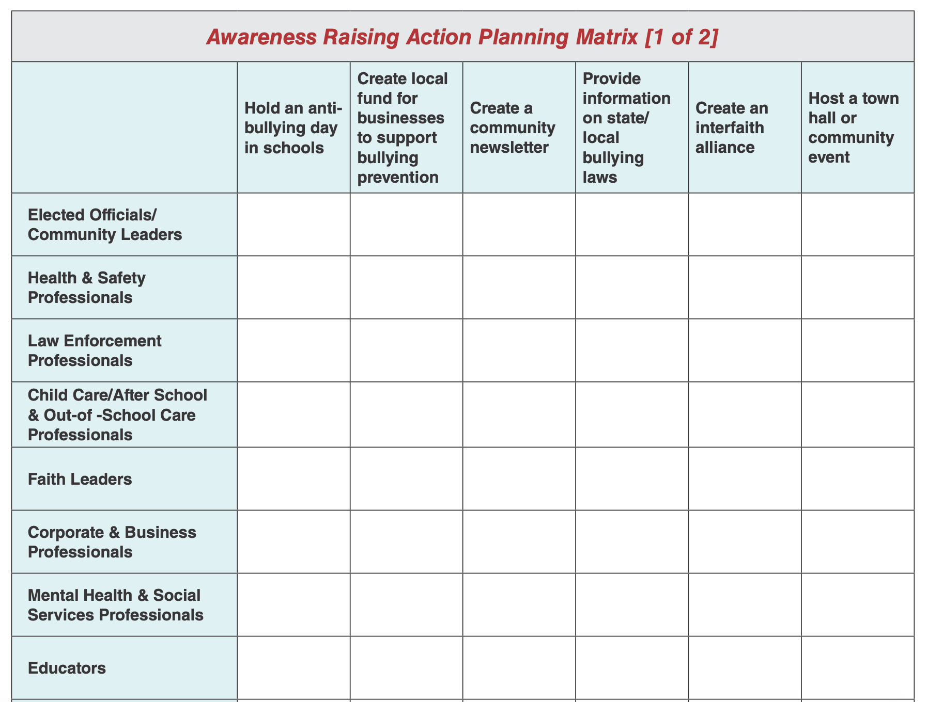
4. Coordinate Prevention Efforts
Notes:
The Action Planning Matrix, on boxoutbullying.com includes the action steps that various individuals and organizations can take to address bullying in their communities
Action steps are divided into two categories:
Awareness Raising: Steps to raise awareness about the impact of bullying and best practices
Prevention and Response: Steps to take action through prevention and response methods
Examples of awareness raising activities include:
Holding an anti-bullying day in schools
Creating a local fund for businesses to support bullying prevention
Creating a community newsletter
Providing information on state/local bullying laws
Creating an interfaith alliance
Hosting a town hall or community event
Submitting op-eds and letters to the editor to local media
Helping youth develop a media campaign
Holding a PSA contest
Examples of prevention and response steps include:
Developing a taskforce to assess bullying in schools
Conducting team building exercises with youth
Creating a safety plan for children who are bullied
Developing screening processes to promote early detection and response
Training adults on gathering and using bullying data
Developing a follow-up procedure to monitor youth who have been bullied
Establishing in-school committees
Monitoring internet activities and mobile devices
Sponsoring training sessions for adults on best practices in bullying prevention, response, and crisis planning
Link to online Community Planning Action Tool kit: http://www.stopbullying.gov/prevention/ training-center/community-action-toolkit.pdf

Slide 59
4. Provide Training
Many state laws encourage or require training of school staff on bullying prevention and response
Adults must understand:
The nature of bullying
Its effects
How to prevent bullying (e.g. importance of adult supervision)
Appropriate responses if bullying is known or suspected
Notes:
Well-trained staff are critical to effective bullying prevention and many state laws now encourage or require training of school staff in bullying prevention.
Staff must understand the nature of and prevalence of bullying, its effects, and effective prevention strategies, including those covered in this training module.
Every adult who interacts with youth also needs to develop skills in how to stop bullying on-the-spot and what to do if bullying is suspected. Designated adults will need training to follow-up with those involved afterwards.

Slide 60
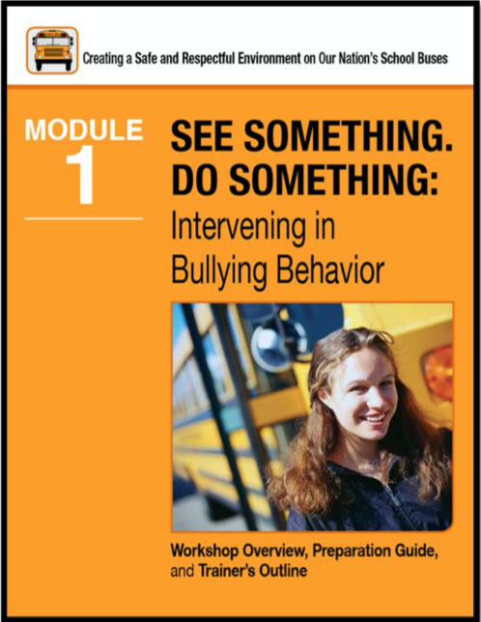
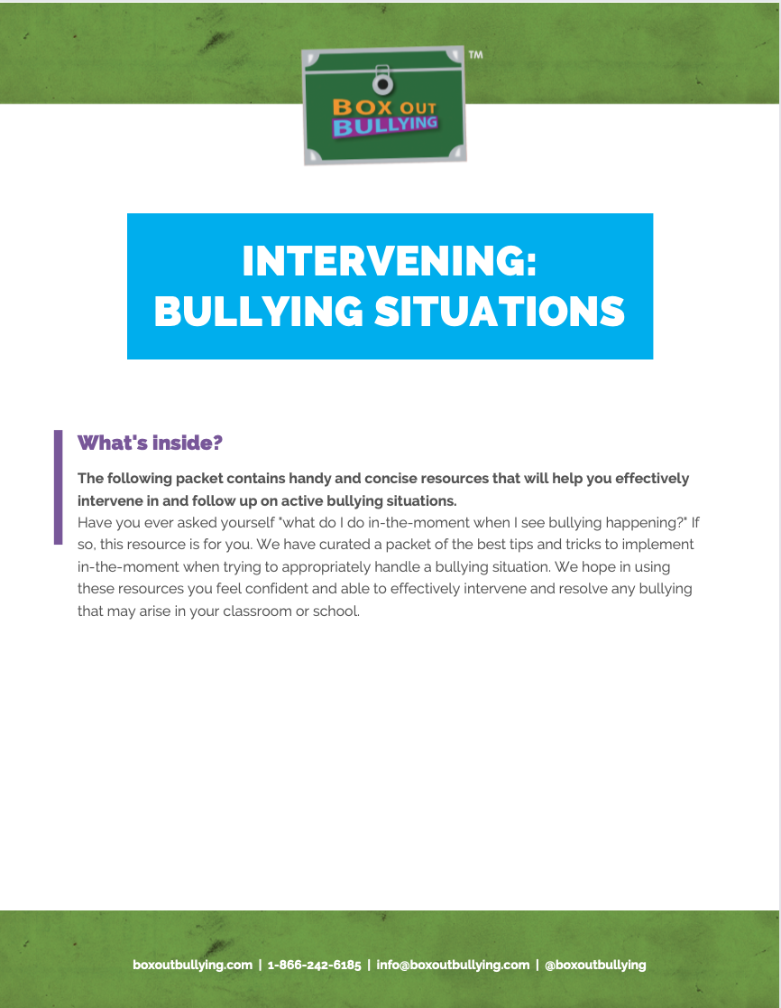
4. Provide Training
Notes:
Different trainings tailored for educators and school bus drivers, developed by the National Center for Safe Supportive Learning Environments are also available at boxoutbullying.com as well as a classroom module which is available on the Training Center.

Slide 61

4. Provide Training
Notes:
The National Registry of Evidence-based Programs and Practices (NREPP) and Blueprints for Healthy Development are two free, searchable online databases of mental health and substance abuse interventions and positive youth development programs. Each has a somewhat different focus and criteria for evaluating programs, but each includes programs and practices related to bullying.
NREPP is available at http://www.nrepp.samhsa.gov.
Blueprints for Healthy Development are available at http://www.blueprintsprograms.com.

Slide 62
The Longer Heading
Something important to discuss.
Something else we’ll talk about a little bit for this page.
Another thing that is of note.
And another thing.

Slide 63

No one can make you feel inferior without your permission
-Elanore Roosevelt

Slide 64
Children mimic those they love. They don’t learn grit and resilience by talk—they lean it by watching you.
-Jeremy Rubenstein

Slide 65
Is this the question to test your knowledge?
A
Potential Answer.
B
Potential Answer.
C
Potential Answer.
Check-In
D
Potential Answer.

