Slide 1
Box Out Bullying Parent & Caregiver Workshop
Together We Can Make A Difference
Notes:
- Make sure you handout the questions to audience members before the start of the workshop.
(after school rep introduces you)
- If there are not that many people and they are all sitting In the back (joke) “I’m sorry for those people that ididn’t get the memo, but the last (how many # of rows) are reserved and I need everyone to move up. (it will either work or not work, if it works act surprised, and if it doesn’t work say, well I tried) .
(Joyfully say) Hi everyone. My name is ____ and I’m (position) with Box Out Bullying. For the past ten years, our organization has been at the forefront of this bullying epidemic facing our country. Over 100,000 parents and children each school year experience our interactive programming. We’ve had the opportunity to present at the White House under former preseident Barak Obama. We’re kinda a big deal!
And I want to thank you for coming. To take time out of your schedule. To attend this very important workshop because parents (next slide)

Slide 2
Question 3
“What does it mean to Box Out Bullying?
Notes:
Oh I’m sorry, did you have a question…
Audience member: Yes, what does it mean to Box Out Bullying?

Slide 3
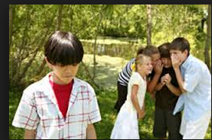
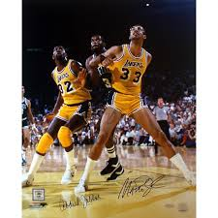
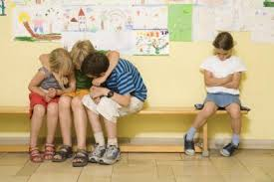
Answer: To “Box Out”
Notes:
Box Out is a basketball term. It’s a common manuever where you prevent your opponent from getting into the key. Don’t give them that rebound. Now you might notice that in school, children will circle up and prevent other students from joining in.

Slide 4
To “Box Out” Bullying
*Vaudeville – Trunk Show
*Inside Is The Answer
*Keep Bullying From Keeping School Joyful
Notes:
And we have the assembly, Box Out Bullying, which draws on the vaudville tradition of a trunk show. We have a specially constructed box and inside in the answer that will solve the problem of bullying.
SO there are a lot of levels, but to Box Out Bullying combines the term from basketball, from theater, and from education where we are going to prevent Bullying from attaining it’s goal. From making school not fun or jouful. But we need to do this together as a community.

Slide 5
Answer: SCOPE OF SERVICES
Comprehensive Programming
“Bullying doesn’t just affect school. It affects the entire community”
-Jeremy R
Notes:
we offer comprehensive presentations Bullying doesn’t just affect the school. It affects the entire community. for all stakeholders in a childs experience Box Out Bullying gives clear, consistent methodology and pedogogy during our assembliy presentations, faculty professional development, parent workshops, week long schoolwide residencis.

Slide 6
SCOPE OF SERVICES
Follow Up Activities, Lesson Plans
Additional services
*Banners
*Handbooks
*Website Resources
Notes:
This is more than a once and done assembly, Those don’t work, rather we provide dyanmic acitivites and lesson plans that will integrate bullying prevention into the curriculium and last for the entire school year and beyond

Slide 7
Nothing About Our Programming Is Original
Notes:
But I have to tell you something. And I’m kinda proud about this. Nothing about our programming is original.
(click slide)
We’ve stolen all the best ideas from Maria Montessori, The US Department of Education, Dr. Dan Olweus, Aristotle and Aseop,
(click slide)
“Education,
(click slide)
Is a lot like medicine, it must build upon 1000 years of experience.” We’re not reinventing the wheel, we are going to show you what works, and will work.

Slide 8
Question 4
Are there some common misconception you can help shed light on regarding bullying?
Notes:
Are there some common misconception you can help shed light on regarding bullying, or making sure we’re engaged in making our schools positive and fun?

Slide 9
Notes:
Absolutel, because much of my work as a researcher these past 9 years, and efforts with my collegues at Box Out Productions has focused identifying best practices in bullying prevention
(clidk slide)
But… also identifying misdirection

Slide 10
Identifying Mis-directions
Wasteful of
Time
Energy
Adding Unintended Harm
Notes:
While well intended, Misdirections are wasteful and do not make the school environment better at all. Now Box Out Productions aren’t the only organization that have identified misdirections
(click slide)
The national academies of sciences.
(Click Slide)
An organization that is the gold standard in using data to address the most pressing issues facing society and humanity has a whole, came out with
(click slide)
Their findings dealing with the prevention of bullying. And we paid attention! The cool thing is their findings, we have been saying the exact same things for the past nine years. And I’d like to share those findings with you.

Slide 11
Answer: Understanding Misdirection's Let’s Get The Facts!
One Person will read the statement
Presenter will ask “True” or “False”
Presenter will then count 1…2…3
On three, group will shout their choice
Notes:
Here’s how we are going to go about doing that. READ OVER THE BULLET POINTS
Can I have a volunteer? (IF NOT VOLUNTEER GET ONE TO START)

Slide 12
True or False?
Federal Anti-Bullying Laws Are In Place To Protect Students From Bullying Situations
Notes:
They will read, you will give an affirmation, then 1…2..3..

Slide 13
True or False?
Notes:
FALSE…There is no Federal anti-bullying law. Although 50 states have anti-bullying legislation, and 3 out of the 4 US territories have passed some kind of anti-bullying legislation, bullying is not illegal.
When bullying is also harassment, it does break Federal law.

Slide 14
When Bullying Is Harassment
Color
Religion
Ancestry
National Origin
Sexual Orientation
Gender Identity
Mental, physical, or sensory disability
Notes:
When bullying is also harassment, yes it does break Federal law. And harassment can be a single or a series of incidents that can be resonibly precived as motivated by an individuals (quickly read over categories) and it’s intended to emotional or physically hurt the other person.

Slide 15
True or False?
Zero Tolerance Policies towards bullying does more harm than good.
Notes:
Get another person to read, same routine as before

Slide 16
True or False?
Notes:
First, there is no evidence that this is effective in curbing bullying prevention. Zilch.
From other findings, this
-discourage children from going to an adult because of threats of sever punishments – they might be friends with the student who is bullying
-also children who bully others need help too, they need role models, and kicking them out of school isn’t the right message.
What is the right message is fostering an environment of mutual respect and understanding.

Slide 17
True or False?
Peer Mediation has been found to be effective in addressing bullying situations.
Notes:
Same as before

Slide 18
True or False?
Notes:
FALSE –
Peer mediation works for conflicts. But not for bullying.
-concept of peer mediation, I did something wrong, you did something wrong, find the common ground. No! No one did anything to deserved to be bullied. It sends the wrong message.

Slide 19
Bullying - True or False?
Students who bully others suffer from lower self esteem then other students

Slide 20
True or False?
Notes:
No. They have enormous amounts of self esteeem. They know how to control someone else and get away with it. Don’t think of this as a reason why people bully others. We are going to build your child’s self esteem in a positive way with a story regarding teaching children grit. More on that later.

Slide 21
Bullying - True or False?
Students are more likely to be bullied in high school than in middle school or elementary school.

Slide 22
True or False?
Notes:
False. This start as early as Pre-K. It changes. We see much more direct bullying for lower level elementary, which turns into indirect bullying for middle school and high school. But this is something that we can all curb by identifying what bullying is, and I’ll give you a definition of that later!

Slide 23
Bullying - True or False?
Most Bullying At School Occurs In The Classroom.

Slide 24
True or False?
Notes:
Bullying will occur where there are a lot of kids and not a lot of adult supervision. Three hot spots bus, playgound, cafeterial.

Slide 25
Bullying - True or False?
Students who are being bullied will tell an adult or guardian at home more-so than a friend or teacher or someone else.

Slide 26
True or False?
Notes:
That’s absolutely true. From the findings in the box out bullying schoolwide climate assessment, over 90% of students will go to an adult at home and an adult at school rather than someone else. And that’s something that you should all be happy about. You are superheros in your kids eyes. And by superhero, I mean you’re individuals that possess an enormous amount of power, but you use that power for good. Now let’s get you all on the same page to augment that power! That goodness!

Slide 27
Parenting - True or False?
Parents should strive to be their child’s best friend.

Slide 28
True or False?
Notes:
Bullying will occur where there are a lot of kids and not a lot of adult supervision. Three hot spots bus, playgound, cafeterial.

Slide 29
Notes:
Kids respond best with logiacal expectations and structure

Slide 30
Parenting - True or False?
The best investment you can make with your relationship with your child is spending time with them.

Slide 31
True or False?
Notes:
That’s absolutely true. From the findings in the box out bullying schoolwide climate assessment, over 90% of students will go to an adult at home and an adult at school rather than someone else. And that’s something that you should all be happy about. You are superheros in your kids eyes. And by superhero, I mean you’re individuals that possess an enormous amount of power, but you use that power for good. Now let’s get you all on the same page to augment that power! That goodness!

Slide 32
Notes:
Kids respond best with logiacal expectations and structure

Slide 33
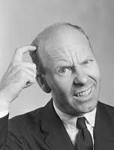
WHAT IS BULLYING?
Who? What? Where? When? Why? How?
Who? What? Where? When? Why? How?
Notes:
When we first started this, bullying prevention was a whisper. There was something called Character Education, but the focus was getting kids to come forward, because the fear at the time was they were suffering in silence. Now, bulying prevention is a ROAR not a whisper, to the point where everything that is unkind or hurtful is bullying. Someone may cut in front of your child in line. Unkind, but not bullying. Someone may exlucde your child from the group, unkind but not bullying. Someone may EVEN call your child a bad name, again, unkind, but not bullying.

Slide 34
Old Bridge School District: Anti-Bullying Code Of Conduct, 2010
AN ACT to amend the code concerning character education.
Be it enacted by the General Assembly of the State of New Jersey:. ( The school safety specialist training program shall provide: (1) annual training sessions, which may be conducted through distance learning or at regional centers; and (2) information concerning best practices and available resources; for school safety specialists and county school safety commissions. (c) The department of education shall do the following: (1) Assemble an advisory group of school safety specialists from around the state to make recommendations concerning the curriculum and standards for school safety specialist training. (2) Develop an appropriate curriculum and the standards for the school safety specialist training and certification program. The department of education may consult with national school safety experts in developing the curriculum and standards. The curriculum developed under this subdivision must include training in identifying, preventing, and intervening in bullying. (3) Administer the school safety specialist training program and notify the institute of candidates for certification who have successfully completed the training program. (d) The institute shall do the following: (1) Establish a school safety specialist certificate. (2) Review the qualifications of each candidate for certification named by the department of education. (3) Present a certificate to each school safety specialist that the institute determines to be eligible for certification. SOURCE: IC 5-2-10.1-12; (05)SE0285.1.3. --> SECTION 3. IC 5-2-10.1-12 IS ADDED TO THE INDIANA CODE AS A NEW SECTION TO READ AS FOLLOWS [EFFECTIVE JULY 1, 2005]:Sec. 12. (a) Each school within a school corporation shall establish a safe school committee. The committee may be a subcommittee of the committee that develops the strategic and continuous school improvement and achievement plan under IC 20-10.2-3. (b) The department of education and the school corporation's school safety specialist shall provide materials to assist a safe school committee in developing a plan for the school that addresses the following issues: (1) Unsafe conditions, crime prevention, school violence, bullying, and other issues that prevent the maintenance of a safe school. (2) Professional development needs for faculty and staff to implement methods that decrease problems identified under subdivision (1). (3) Methods to encourage: (A
Notes:
In 2010, New Jersey became the first state to pass comprehensive anti-bullying mandates. This was known as the Anti-Bullying Bills of Rights Act or HIB (harassment, Intimidation, and bullying) Policies. We were contracted with the Old Bridge public school district to revise their bullying prevention policy, written by laywers and politicans
(click slide)

Slide 35
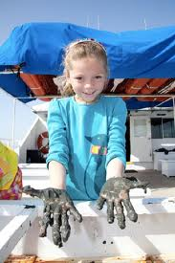
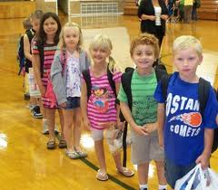
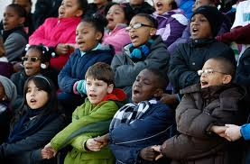
Notes:
Into something that a Kindergardener to an 8th grader can understand.

Slide 36
Notes:
This definition isn’t something we’ve invented, we stole it, it’s the same definition used by the US Department of Education, Nationally Recognized bullying prevention programs, pick audience member for bit it’s recongized, and actually,
This is the part of the presentation where the spotlight is in you.
It’s up to you to let everyone here know exactly what bullying is.
Not I know that you know exactly what bullying is. That you can confidently tell it to everyone here, BECAUSE…I wrote it down on the next slide for you to read.

Slide 37
“Bullying is when a stronger person, hurts or frightens someone, again and again (on purpose). And that person who is being bullied cannot easily defend themselves.”
Boil that down to the following……
- Intentional
Repeated
-Imbalance of Power
Notes:
Well read (click slide)

Slide 38
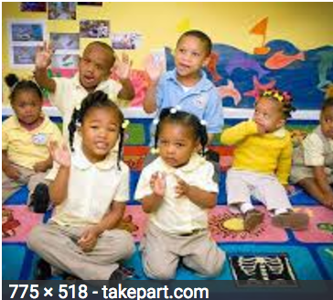
“Bullying is when does something mean to someone else many, many times.”
Boil that down to the following……
- Intentional
Repeated
-Imbalance of Power
Notes:
For those of us with children in Pre-K we can modify that even more to say….

Slide 39
“Bullying is when a stronger person, hurts or frightens someone, again and again (on purpose). And that person who is being bullied cannot easily defend themselves.”
Boil that down to the following……
- Intentional
Repeated
-Imbalance of Power
Notes:
So in order for an action to be considering bullying it must consist of three things AND all three things. First, it has to be an action that doesn’t happen by accident, but happens on purpose, would you agree with that?
School rep: YES
AND it has to not happen one time, but again and again, would you agree with that?
School rep: Yes!
AND finally we have an imbalance of power. And imbalace of power means it’s not a positive relationship. There are many ways people exert power over someone. Like in PreK, do this or you can’t come to my birthday party. That’s social power. Or using physical strength, or being able to throw out five put downs before someone can come up with one to defend themselves. This is not a positive relationship, and whomever is doing this has a lot of self-esteem.

Slide 40
Boil that down to the following……
- Intentional
Repeated
-Imbalance of Power
Notes:
Show clip from the simpson.
It’s intentional, they made a sign. It’s repeated over time, he’s not changing his name, and we have an imbalance of power, one person against a whole group.

Slide 41
Game – Heads Up 7 up
Bullying
Repeated Over Time
Not =
On purpose
Conflict
Once
=
Accident
Real Fighting
Notes:
But not everything is Bullying. We also have conflicts. Very different. Where bullying is repeated over time, conflicts happen once. Where bullying occurs with unequal power, conflicts occurs with equal power, there’s a positive relationship. And where bullying happens on purpose, conflicts will happen by accident.

Slide 42
Real Fighting
Notes:
There’s a third category called real fighting. And real fighting is when someone solves conflicts by hitting, kicking, punching, and even though this happens once, it’s still considered an act of bullying, because hitting or punching or kicking someone in school is not allowed.

Slide 43
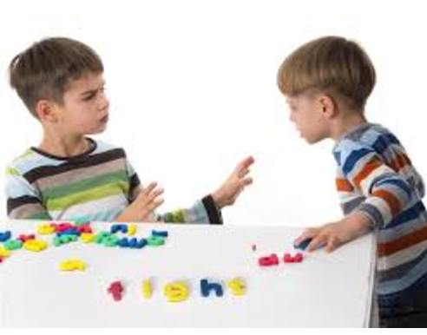
Solve Conflicts With Words
Notes:
Wise Parents will teach their children to solve CONFLCITS with this (their mouth). Yes, this can get you in trouble, but it’s your job to teach them how to use it to get them out of trouble. Because your children will be more successful in school and in the real world when they can solve conflcits with their words. And I’ll teach you how we can do that a little later with someone called a Peace Table. And I love those words so much please repeat after me, PEACE TABLE
Audience (peace table) but more on that later, first.

Slide 44
Game – Heads Up 7 up
Bullying
Repeated Over Time
Not =
On purpose
Conflict
Once
=
Accident
Story of BULLYING or CONFLICT
Point left or right
Heads down, eyes closed
Notes:
We’re going to really hit home that everyone here know’s the difference between bullying and conflict. So we’re going to play a game. It’s kinda like heads up seven up.
(hit slide) I’m going to tell a story and it will either be a story of bullying or conflict. You’ll have to choose.
(hit slide) Instead of pointing up and down, we will point this way if you think it’s bullying, and this way if you think it’s conflict.
(hit slide) and we are going to put our heads down and close our eyes.
(watch video)
Story 1 – student gets excluded from a game at recess (CONFLICT)
Story 2 – if needed, student in art class with a crayon (CONFLICT)
Story 3 – if needed, student gets excluded from game at recess, art class, and on the bus (Bullying)

Slide 45
Level Up!
We have a clear definition of bullying and conflicts!
Notes:
Well done everyone, we have leveled up!

Slide 46
Contact information
Jeremy@boxoutbullying.com
(cell) 717.538.1235
(office) 866.242.6185
boxoutbullying.com

