Slide 1
Class Meetings
Building Community in the Classroom

Slide 2
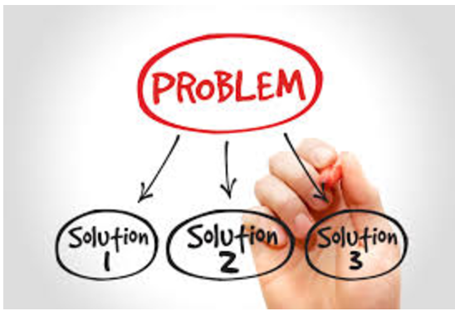
Class meetings usually serve one or more of the following purposes:
Notes:
to plan and make decisions, to “check in,” and
to solve problems or raise awareness.

Slide 3
Appropriate Topics For Consideration
Notes:
Both academic and social issues are appropriate topics for consideration.

Slide 4
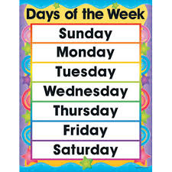
Notes:
Depending on their purpose, class meetings can be a regularly scheduled part of the school day, week or can occur as needed.

Slide 5
Why Have Class Meetings
Kids are involved in constructive decisions making. It is a forum for students to voice and directly effect how they want their class to be.
It creates a climate of trust and respect between kids and kids and teachers
It helps build self esteem by having kids involved in decisions that affect their world.

Slide 6
What is an Effective Class Meeting?
The teacher “shares the control” with students by letting them help set the agenda. The focus is always on school, not home.
Students do most of the talking and the teacher acts as facilitator. The teacher teaches students to really listen to and respect each others’ ideas.
Students work together to improve the learning environment, friendships and cooperative group work through class plans.
Individual students with problems or conflicts seek help and ongoing support from their classmates.

Slide 7
Seven Building Blocks for Effective Class Meetings
Form a circle.
Practice compliments and appreciations
Create an agenda.
Develop communication skills
Learn about separate realities.
Practice brainstorming and role playing.
Recognize the reasons people do what they do

Slide 8
Sample Topics
Relationships
What can I do when a person is bugging me?
What can I do when I’m feeling left out?
What can I do when someone hurts my feelings?
How can I help my friends do the right thing?
What can I do when my friend won’t share me with my other friends?

Slide 9
Working in small groups
What would help us bring the best out of everyone when we work in small groups?
What could we do to help from the teacher without getting too embarrassed?
What could we do when our group ins’t working very well together?

Slide 10
Attitude toward school
What really works for me at school?
What can I do when school is not much fun?
What can I do when I’m becoming turned off to school?
Places and activities that are not routine
How can we make a field trip, guest speaker, or assembly work for everyone?

Slide 11
Lunch and Free Time
How can we make lunch free-time enjoyable for everyone
How can we help our friends do the right thing during lunch and free time?
Diversity/teasing
How can we help everyone feel respected?
What can we do when we see or are targets of teasing and harassment?

Slide 12
Establishing Ground Rules
Listening and Getting a Turn to Speak
Important to help students see that class meetings are about them coming to understandings as a group, and that this requires them not to hog the floor and to speak and listen to teach other. Need to help students learn to speak to each other
Older kids can learn to have conversations without raising hands, without interrupting, etc. with practice and time
Raising hands, teacher can still call on them, but direct with speech or nods to talk to others. NO one has hands up while someone is talking
Teddy bear, talking stick, wand.
Avoiding put downs
Ground rule
Discuss problems without naming names
Eventually need to learn to speak respectfully but deal with problems and take responsibility
Norm is on solving problems

Slide 13
Establishing Ground Rules
DURATION
Depends on age and experience of students
Depends on topic(s) and purpose of the meeting
Primary concern is not too long or too short
Don’t want students to feel abridged or frustrated because they didn't’t get to express their concerns.
If an important topic comes up you want to be able to address it.

Slide 14
How To Manage and Encourage Participation
Brainstorming
Small-Group Discussions
Partner Chats
Individual Reflection and Writing

Slide 15
Partner Idea Lists - you want them to brainstorm and record, encourage them to listen carefully to each other – no interrupting! Then have them discuss lists, telling each other what they do or do not like about each idea and star he ideas that are most important to both partners
Collected Ideas - one group give one idea, all groups with same idea raise hands. Invite another group to offer a different idea.

Slide 16
Troubleshooting
(I) Nobody talking - Is it because they are so interested? – Ask them to tell their idea to a partner. Is it because they are not interested - Rephrase the question, add interest, or drop. Check, is it because they have not heard the topic – Get their attention, check your timing, review the ground rules
(II) Side conversations - Do they understand – Rephrase the question and give more info? Are they interested – add interest or drop topic. Do they need to think more, to formulate their ideas – work with partners, or write ideas down.

Slide 17
Troubleshooting cont.
(III) Shocking or “funny” or “stupid” statements - Is it really in order to get attention or to cover up embarrassment – deal with this directly. Keep you sense of humor. Sometimes you may have a private talk with person if repeated Check, is it from an inability to express themselves clearly – rephrase, “do you mean” or ask them to rephrase and give them time.

Slide 18
Troubleshooting cont.
(IV) Everybody talking - How can I stop the behavior and not build resentment? How can I help the person take responsibility for his behavior. Ask person to leave the group until she or he is able to return without being disruptive?

Slide 19
Planning and Decision Making Meetings
Ways we want our class to be
Class name
Back-to-school night/open house
Substitutes
Choosing to learn

Slide 20
Check In Meetings
Is this the way we want to be?
What did we learn?
How did it go with the substitute?

Slide 21
Problem Solving Meetings
My friends won’t let me play
Cliques
Problem Solving

Slide 22
THINGS TO THINK ABOUT

Slide 23
When is a problem suitable for a class meeting?
Is this an issue that can be discussed in a climate of trust?
Does this issue affect all of the children or most of them.
Is this the best time to address the problem
If the issue involves specific students, do all parties involved agree to have the problem taken to the class?

Slide 24
Ways to Begin Meetings
Explain meetings
Talk about student’s hopes for the meeting
Record student ideas
Have a partner chat
Engage students’ personal experiences
Introduce vocabulary or concepts
Remind students of earlier meeting results or topics
Read a related story

Slide 25
Ways to End Meetings
Post a list and ask students to keep thinking about it
Preview the next meeting
Reflect on the meeting – process, results, learning
Ask for volunteers to create a document about what you did
Establish a timeline for completing activities
Celebrate what you have accomplished
Add final observations

