Slide 1
Module 2: Creating a Supportive Classroom Climate

Slide 2
Introductions
Name
School(s) for which you work
What subjects do you teach, and how long have you been teaching?
When you close out your career as an educator, how would you like to be remembered by your students?

Slide 3
Workshop Objectives
Participants in the workshop will:
Consider what a supportive classroom climate looks like and how it can prevent bullying.
Examine the role of teacher-to-student and student-to-student relationships in building a supportive classroom climate.
Explore strategies for preventing bullying in the classroom, including establishing a culture of respect for differences among students.
Consider how a web of positive support among students and other adults across the school community can help prevent bullying.
Identify and commit to use one new strategy for preventing bullying in their daily work with students.

Slide 4
Bullying Behaviors Defined
Bullying is unwanted, aggressive behavior among school aged children that involves a real or perceived power imbalance. The behavior is repeated, or has the potential to be repeated, over time. Bullying includes actions such as making threats, spreading rumors, attacking someone physically or verbally, and excluding someone from a group on purpose.
www.stopbullying.gov
Citation ▪ 13

Slide 5
Core Elements of Bullying Behaviors
Bullying is a form of youth violence that includes:
Unwanted, aggressive behavior
A real or perceived imbalance of power between the student(s) doing the bullying and the student(s) being bullied
Behavior that is repeated, or has the potential to be repeated, over time
www.stopbullying.gov
Citation ▪ 13

Slide 6
A Supportive Classroom
What would you see going on in a classroom in which there is a supportive climate for students?
How would teachers be relating to their students and students with one another?
What three words would you use to describe a supportive classroom climate?

Slide 7
Supportive Classroom Settings
Engagement: includes relationships, respect for diversity, and school participation
Safety: includes emotional and physical safety and reduction of substance use
Environment: includes the physical, academic, and disciplinary environments and wellness
Citation ▪ 10

Slide 8
Effects of a Positive Classroom Climate
In a positive school climate, students:
Do better academically.
Attend school more regularly.
Feel better about themselves.
Engage in fewer risky behaviors like drinking alcohol or using drugs.
Engage less in bullying and other problem behaviors.
Citation ▪ 8

Slide 9
Willingness to Intervene
When teachers and staff feel valued, they are more likely to become involved and intervene in a bullying situation.
When teachers and paraeducators report high levels of connectedness, they report greater comfort levels intervening in a bullying situation.
Feelings of comfort in being willing to intervene are correlated to:
Knowing effective intervention strategies
Knowing that others in the school also are likely to intervene
Citation ▪ 3

Slide 10
A Relational Problem
Bullying is a relationship problem that requires a relationship solution.
Notes:
Citation (9)

Slide 11
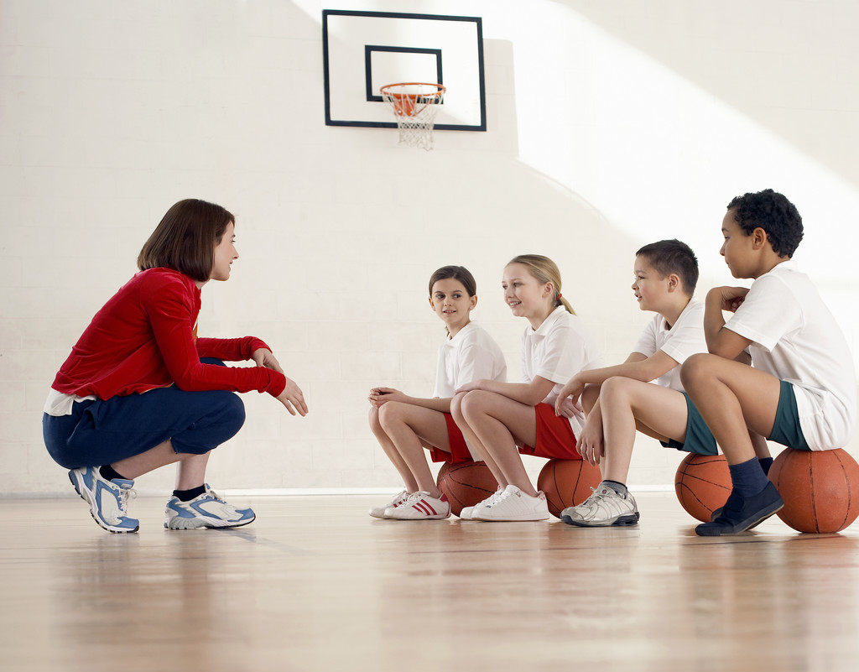
Who Was There for You?
Teacher
Family
Coach

Slide 12
The Little Things That Teachers Do
Be available.
Listen.
Be positive.
Have fun.
Be real.
Citation ▪ 8

Slide 13
Student Intervention
In the majority of bullying episodes in which students intervene, the bullying stops within:
A. Two minutes
B. Ninety seconds
C. One minute
D. Ten seconds
Citation ▪ 9

Slide 14
Inclusion
Clear Classroom Norms
Developed with student input
Simple and understandable
Posted in the classroom
Fairly enforced with positive and negative consequences
Citation ▪ 8

Slide 15
Sample Anti-Bullying Rules
We will treat others with respect.
We will not use bullying behavior on others.
We will try to help students who are bullied.
We will try to include students who are excluded from groups.
If we know that somebody is being bullied, we will tell an adult at school and an adult at home.
Citations ▪ 8, 13

Slide 16
Respect
Respect is a learned behavior and attitude—we cannot make it happen, but we can teach and encourage it.
Set a tone of respect in the classroom.
Expose students to accurate information and positive representations of those who they may perceive as different from them.
Talk about differences in a respectful way including examples of people with varied backgrounds and orientations.
Provide time for learning and practicing positive, respectful behaviors.
Citations ▪ 1, 6, 8, 13

Slide 17
Communication
Communication can take many forms, including via:
Posted norms
Class lessons and meetings
Individual conversations

Slide 18
Classroom Discussions
Classroom discussions can:
Raise awareness of ideas and strategies.
Teach and practice the difference between respectful deliberationand intolerant dialogue around issues of difference.
Provide opportunities for students to express their discomfort about witnessing bullying behaviors within the safety of a classroom discussion.
Help students realize that they are not alone in their wish for bullying behaviors to stop.
Provide an opportunity for students to brainstorm possible solutions to common situations involving bullying behaviors.
Citation ▪ 8

Slide 19
Intervention Skills
Students can:
Refuse to participate in the bullying behaviors.
Tell the person to stop bullying.
Tell a trusted adult what is happening.
Be a supportive friend or ally to the student who is being bullied.
Citations ▪ 8, 13

Slide 20
Supportive Classroom Settings
Engagement: includes relationships, respect for diversity, and school participation
Environment: includes the physical, academic, and disciplinary environments and wellness
Safety: includes emotional and physical safety and reduction of substance use
Citation ▪ 10

Slide 21
Engagement
Be a role model by treating all students and colleagues respectfully.
Teach the difference between respectful deliberation and name calling.
Let students know you are available to talk.
Use conversations with students to find out what is going on in their lives and actively listen.
Encourage positive thinking and offer positive strategies for dealing with problems.
Teach inclusively. Integrate examples of people from different backgrounds every day.
Use inclusive language.
Have fun! It will make personal connections and help students feel like they belong.
Citations ▪ 1, 6, 7, 8, 13

Slide 22
Environment
Weave positive behaviors into daily interactions with students and colleagues.
Set a positive tone in your classroom.
Demonstrate appropriate boundaries and expectations for positive relationships.
Examine your own beliefs, and examine your own assumptions, biases, or stereotypes.
Work directly with both students who are being bullied and students who are bullying others.
Establish a culture of respect for difference.
Talk about differences in respectful and informative ways.
Work with parents and youth to send a unified message against bullying.
Citations ▪ 1, 6, 7, 8, 13

Slide 23
Safety
Step up during problematic situations, actively using your power to identify concerns and offer solutions.
Make a safe culture the “norm.”
Encourage students to do what they love. Special activities can boost confidence, help students make friends, and protect them from bullying behavior.
Make time for daily conversations with students about their lives and feelings.
Ask a variety of questions when you talk with students.
Talk about bullying behaviors. If concerns come up, be sure to respond.
Read and learn about bullying.
Create supportive ground rules for your classroom.
Be positive—tell students what to do, not just what not to do.
Teach positive relationship skills.
Citations ▪ 1, 6, 7, 8, 13

Slide 24
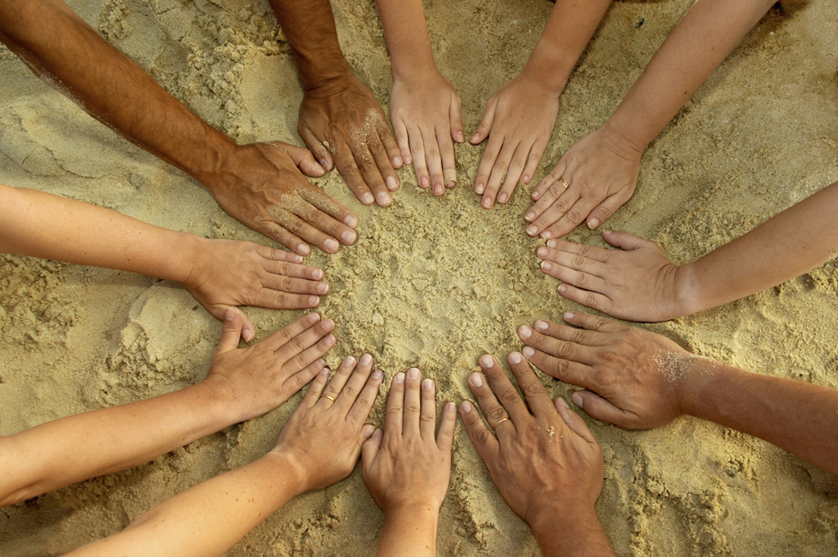
Building a Web of Support

Slide 25
A Legacy
“Children are living messages we send to a time we will not see.”
John W. Whitehead
The Stealing of America, 1983
Thank You for Participating!
Citation ▪ 14

