Slide 1


Bullying Prevention and Response Training and Continuing Education
Creating Safe And Respectful School Bus Environments

Slide 2


Introductions
The school(s) for which you drive a bus.
How long have you been doing school transportation?
Why do you think you were
asked not to use your name
and to leave your name tag
blank?
Notes:
Notes: Risk behaviors, ranging from alcohol and other drug abuse to aggression and violence, imperil safety for students and staff, and undermine the teaching and learning climate. Positive Youth Development (PYD) strategies help simultaneously to reduce risk behaviors, promote thriving, and stimulate school success by building positive relationships, opportunities, skills, values, and self-perceptions in students and school communities.

Slide 3


It’s Your Party
Think about . . .
Three students stand up to share something positive they remember about you. What would you hope they say?
In your groups:
Share the three things that you would want them to remember and say about you.

Slide 4
Workshop Opportunities
Participants will:
  Consider what a supportive school bus climate looks like and how it can prevent bullying.
  Explore the connection between a supportive bus climate and a supportive school climate.
  Discover the power of positive relationships in shaping school bus climate and preventing bullying.
  Learn and commit to perform simple, concrete strategies to build positive relationships on the school bus.

Slide 5
What Is Bullying?
“A problem behavior based on power relationships in which a student or a group of students uses power aggressively to cause emotional or physical pain and distress to another student.”
Bullying experiences include not only physical aggression but also verbal aggression, including verbal teasing and taunting, spreading rumors, or socially rejecting and isolating another student.

Slide 6
A Supportive School Climate
Engagement: Includes relationships, respect for diversity, and school participation.
Safety: Includes emotional safety, physical safety, and reduction of substance use.
Environment: Includes the physical, academic, and disciplinary environments and wellness.

Slide 7
A Supportive Bus Climate
Engagement: Students experience positive peer and adult relationships, respect for diversity, and shared participation in shaping a positive bus climate.
Safety: Students feel physically and emotionally safe.
Environment: Students experience a safe, fair, and consistent bus environment including clear expectations for student behavior and disciplinary policies that are fairly enforced.

Slide 8
Effects of a Supportive Climate
When students experience a safe and supportive climate:
They have an increased sense of bonding to school and caring about their educational experience.
They are more likely to stay in school and achieve academically.
They are less likely to be involved in bullying and other antisocial behaviors.

Slide 9
School Climate/Bus Climate
School
Buses

Slide 10
School Climate/Bus Climate
School
Buses

Slide 11
School Climate/Bus Climate
School
Buses

Slide 12
What Is Your Situation?
School
Buses
School
Buses
School
Buses

Slide 13
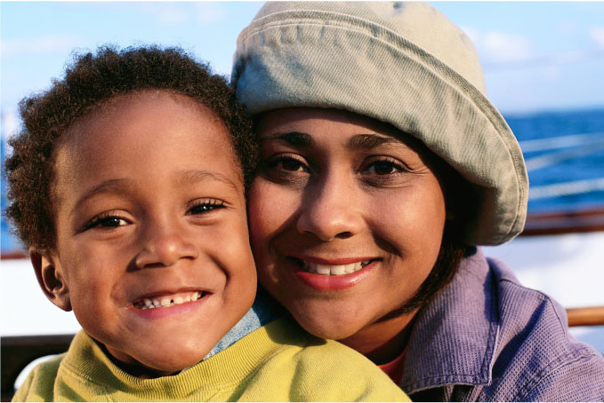
Who Was There for You?
On your card, record:
What was it about that person that caused him or her to have such a positive impact on your life?

Slide 14
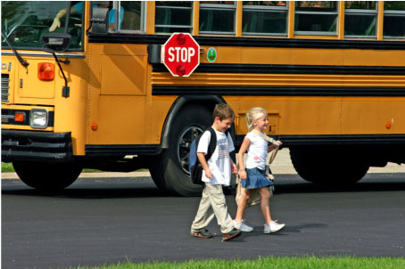

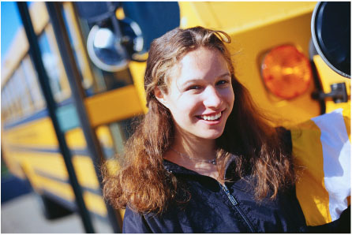
Question
Why Think About Relationships?

Slide 15
Bullying
“Bullying is a relationship problem that requires relationship solutions.”
“A problem behavior based on power relationships in which a student or a group of students uses power aggressively to cause emotional or physical pain or distress to another student.”

Slide 16
The Relationship Solution
When there is a strong, positive bond between a driver and his or her students, behavior on the bus tends to be positive and less problematic for the driver.
“Why would anyone want to be mean when the driver is so nice?”
Citation 2

Slide 17
Question
Bill
Rachel
Aisha
Celeste
Why Are Names Important?
Julieta
Habib
Paul
Omar
Harmony
Derek
Dorothy
Zahra
Darnell
Hadara
Reuben
Brooker

Slide 18
Individual Recording
In the first section of Handout 3, record up to three strategies that you already use in building positive relationships with the students on your bus.
2. In the second section of Handout 3, record one strategy that you would like to employ in building positive relationships with your students.

Slide 19
Consulting Groups
Share the strategies you already use on the bus.
Share the new strategy you would like to implement with your students.
Respond to the following questions:
Why did you choose that strategy?
What do you envision it will look like when you implement the strategy?
What are your concerns as you anticipate trying something new?
Use the rest of the planning sheet to record any helpful ideas you receive from your “consultants.”

Slide 20
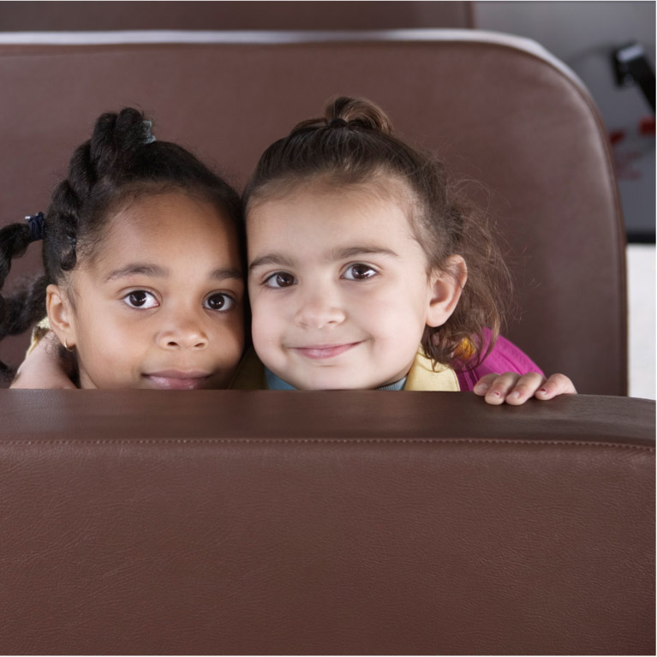
Thanks for participating!

