Slide 1
Bullying Prevention and Response Training and Continuing Education
Online Program

Slide 9
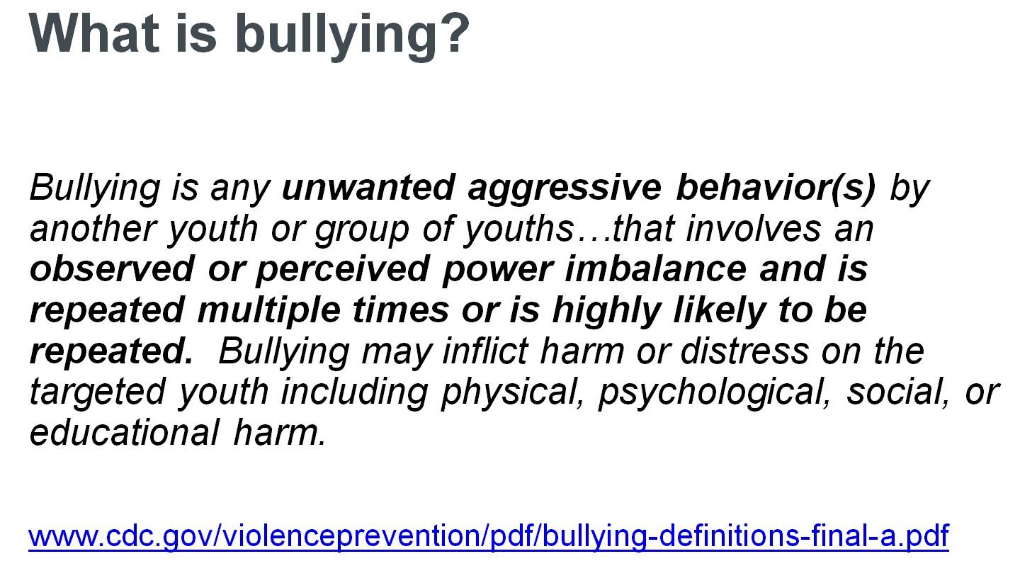

Slide 21
How are children and youth bullied?

Slide 22
Finding #2: There are Similarities and Differences Among Boys and Girls in Their Experiences With Bullying

Slide 23
Boys’ and Girls’ Experiences of Being Bullied and Bullying Others

Slide 24
Boys’ and Girls’ Experiences of Being Bullied and Bullying Others

Slide 25
Finding #3: Children’s Experiences with Bullying Vary by Age

Slide 26
Age Trends in the Frequency of Being Bullied

Slide 27
Finding #4: There Are Multiple Risk Factors and Protective Factors for Bullying

Slide 28
Risk Factors for Bullying

Slide 29
Examples of Individual Factors Related to Involvement in Bullying

Slide 30
Examples of Peer Factors Related to Involvement in Bullying

Slide 31
Examples of Family Factors Related to Involvement in Bullying

Slide 32
Examples of School Factors Related to Involvement in Bullying

Slide 33
Examples of Community Factors Related to Involvement in Bullying

Slide 34
Protective Factors for Bullying

Slide 35
Protective Community Factors

Slide 36
Finding #5: Although Any Child May be Targeted, Some Are at Particular Risk of Being Bullied

Slide 37
Children and Youth At Higher Risk for Being Bullied

Slide 38
Finding #6: Bullying Can Affect the Health, Mental Health, and Academic Well-Being of Children Who are Targeted

Slide 39
Effects on Bullied Children and Youth

Slide 40
Biological Mechanisms Associated with Bullying

Slide 41
Biological Mechanisms Associated with Bullying

Slide 42
Finding #7: Children Who Bully Are More Likely Than Others to Be Engaged in Other Antisocial Behavior

Slide 43
Concern for Children Who Bully:

Slide 44
Concern for Children Who Bully:

Slide 45
Finding #8: Many Children Do Not Report Bullying Experiences to Adults

Slide 46
Likelihood of Reporting

Slide 47
Likelihood of Reporting

Slide 48
Finding #9: Many Children and Youth Are Concerned About Bullying

Slide 49
Peers’ Attitudes and Responses to Bullying

Slide 50
Finding #10: A Variety of Laws in the U.S. Address Bullying

Slide 51
Federal Laws and Bullying and Harassment

Slide 52
School Districts and Federal Civil Rights

Slide 53
State Anti-Bullying Laws and Policies

Slide 54
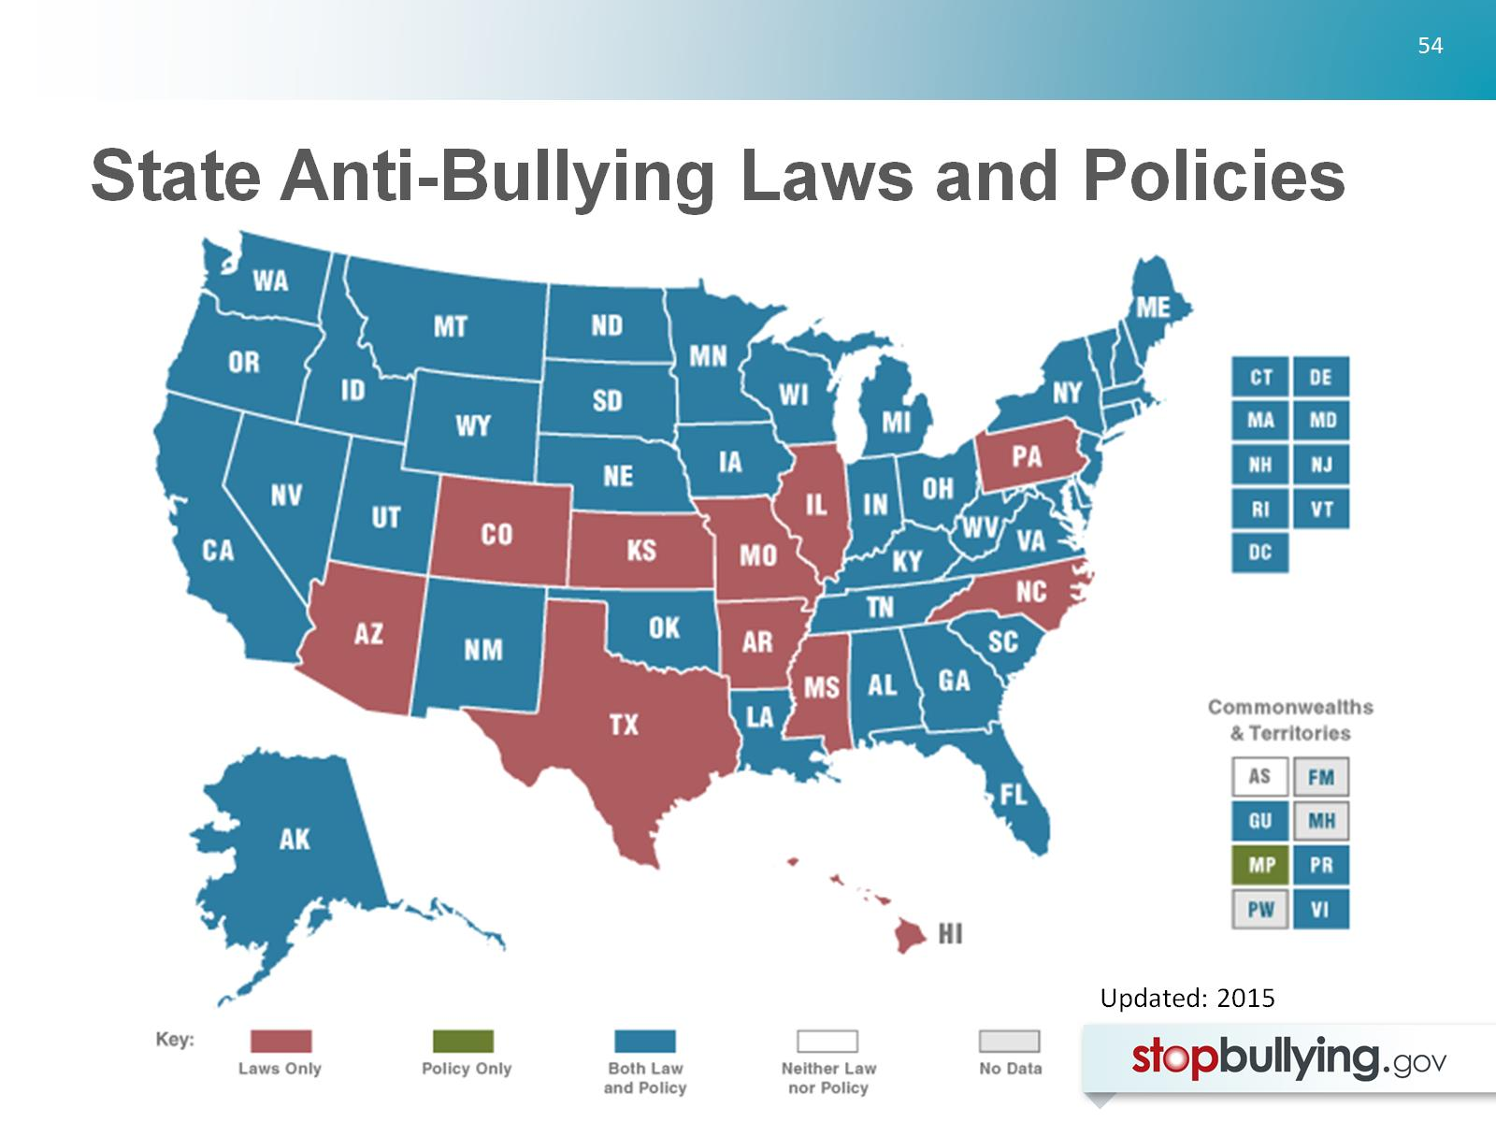
State Anti-Bullying Laws and Policies

Slide 55
Chapter Check-in:

Slide 56
Chapter Check-in:

Slide 58
Misdirection #1: Zero Tolerance for Bullying

Slide 59
Misdirection #2: Conflict Resolution and Peer Mediation

Slide 60
Misdirection #2: Conflict Resolution and Peer Mediation

Slide 61
Misdirection #3: Group Therapeutic Treatment

Slide 62
Misdirection #4: Overstating or Simplifying the Relationship Between Bullying and Suicide

Slide 63
Misdirection #4: Overstating or Simplifying the Relationship Between Bullying and Suicide

Slide 64
Misdirection #5: Simple, Short-Term Solutions

Slide 65
Chapter Check-in:

Slide 66
Chapter Check-in:

Slide 68
#1: Focus on the Social Climate

Slide 69
#2: Conduct Community-Wide Assessments of Bullying

Slide 70
#3: Seek Out Support for Bullying Prevention

Slide 71
#4: Coordinate and Integrate Prevention Efforts

Slide 72
#4: Coordinate and Integrate Prevention Efforts

Slide 73
#4: Coordinate and Integrate Prevention Efforts

Slide 74
#5: Provide Training in Bullying Prevention and Response

Slide 75
#5: Provide Training in Bullying Prevention and Response

Slide 76
#5: Provide Training in Bullying Prevention and Response

Slide 77
#5: Provide Training in Bullying Prevention and Response

Slide 78
#6: Organize a Community Event to Catalyze Efforts

Slide 79
#6: Organize a Community Event to Catalyze Efforts

Slide 80
#6: Organize a Community Event to Catalyze Efforts

Slide 81
#7: Set Policies and Rules About Bullying

Slide 82
#8: Respond Consistently and Appropriately When Bullying Happens

Slide 83
#8: Respond Consistently and Appropriately When Bullying Happens

Slide 84
#8: Respond Consistently and Appropriately When Bullying Happens

Slide 85
#9: Spend Time Talking with Children and Youth About Bullying

Slide 86
#9: Spend Time Talking with Children and Youth About Bullying

Slide 87
#10: Continue Efforts Over Time and Renew Community Interests

Slide 88
Chapter Check-in:

Slide 89
In Conclusion
The next step in continuing education
Thank you for participating
Remember to visit boxoutbullying.com for additional resources

Slide 90
References Ali, R. (2010) U. S. Department of Education, Office for Civil Rights (2010). Dear colleague letter: Harassment and bullying. Retrieved from http://www2.ed.gov/about/offices/list/ocr/letters/colleague-201010.pdf American Psychological Association Zero Tolerance Task Force (2008). Are zero tolerance policies effective in the schools? An evidentiary review and recommendations. American Psychologist, 63, 852-862. Arsenault, L., Walsh, E., Trzesniewski, K., Newcombe, R., Caspi, A. and Moffitt, E. (2006) Bullying victimization uniquely contributes to adjustment problems in young children: A nationally representative cohort study, Pediatrics, 118, 130-138. Baldry, A. C. (2003). Bullying in schools and exposure to domestic violence. Child Abuse & Neglect, 27, 713-732.

Slide 91
Baldry, A. C. (2004). The impact of direct and indirect bullying on the mental and physical health of Italian youngsters. Aggressive Behavior, 30, 343-355. Baldry, A. C., & Farrington, D. P. (2005). Protective factors as moderators of risk factors in adolescence bullying. Social Psychology of Education, 8, 263-284. Berthold, K. A., & Hoover, J. H. (2000). Correlates of bullying and victimization among intermediate students in the Midwestern USA. School Psychology International, 21, 65-78. Boulton, M. J., & Underwood, K. (1992). Bully/victim problems among middle school children. British Journal of Educational Psychology, 62, 73-87. Bowes, L., Arseneault, L., Maughan, B., Taylor, A., Caspi, A., & Moffitt, T. E. (2009). School, neighborhood, and family factors are associated with children's bullying involvement: A nationally representative longitudinal study. Journal of the American Academy of Child & Adolescent Psychiatry, 48, 545-553.

Slide 92
Buhs, E. S., Ladd, G. W., & Herald, S. L. (2006). Peer exclusion and victimization: Processes that mediate the relation between peer group rejection and children's classroom engagement and achievement? Journal of educational psychology, 98, 1-13. Byrne, B. J. 1994. Bullies and victims in school settings with reference to some Dublin schools. Irish Journal of Psychology,15, 574-86. Centers for Disease Control and Prevention. (2012a). Suicide: Facts at a glance. Retrieved from: http://www.cdc.gov/ViolencePrevention/pdf/Suicide_DataSheet-a.pdf Commission for the Prevention of Youth Violence. (2000). Youth and violence: Medicine, nursing, and public health: Connecting the dots to prevent violence. Cook, C. R., Williams, K. R., Guerra, N. G., & Kim, T. E. (2010). Variability in the prevalence of bullying and victimization: A cross-national and methodological analysis. In S. R. Jimerson, S. M. Swearer, & D. L. Espelage (Eds.), Handbook of bullying in schools: An international perspective (pp. 347-362). New York: Routledge.

Slide 93
Cook, C. R., Williams, K. R., Guerra, N. G., Kim, T. E., & Sadek, S. (2010). Predictors of bullying and victimization in childhood and adolescence: A meta-analytic investigation. School Psychology Quarterly, 25, 65-83. Copeland, W. E., Wolke, D., Angold, A., & Costello, E. J. (2013). Adult psychiatric outcomes of bullying and being bullied by peers in childhood and adolescence. JAMA Psychiatry, 70, 419-426. Cornell, D., & Limber, S. P. (2015). Law and policy on the concept of bullying at school. American Psychologist, 70, 333-343. Dawkins, J. L. (1996). Bullying, physical disability and the paediatric patient. Developmental Medicine & Child Neurology, 38, 603-612. Dishion, T. J., McCord, J., & Poulin, F. (1999). When interventions harm: Peer groups and problem behavior. American Psychologist, 54, 755-764.

Slide 94
Durlak, J. A., Weissberg, R. P., Dymnicki, A. B., Taylor, R. D., & Schellinger, K. B. (2011). The impact of enhancing students’ social and emotional learning: A meta-analysis of school-based universal interventions. Child Development, 82, 405-432. Espelage, D. L., & Swearer, S. M. (2010). A social-ecological model for bullying prevention and intervention. In S. R. Jimerson, S. M. Swearer, & D. L. Espelage (Eds.), Handbook of bullying in schools: An international perspective (pp. 61-72). New York: Routledge. Espelage, D. L., Aragon, S. R., Birkett, M., & Koenig, B. W. (2008). Homophobic teasing, psychological outcomes, and sexual orientation among high school students: What influence do parents and schools have? School Psychology Review, 37, 202-216. Espelage, D. L., Basile, K. C., & Hamburger, M. E. (2012). Bullying perpetration and subsequent sexual violence perpetration among middle school students. Journal of Adolescent Health, 50, 60-65. Faris, R., & Felmlee, D. (2014). Casualties of social combat: School networks of peer victimization and their consequences. American Sociological Review, 79, 228-257.

Slide 95
Finkelhor, D., Turner, H., Ormrod, R., & Hamby, S. L. (2009). Violence, abuse, and crime exposure in a national sample of children and youth. Pediatrics, 124, 1411-1423. Fonzi, A. Genta M.L., Menesini E., Bacchini D., Bonino S. & Costabile A. (1999). The nature of school bullying. In P.K. Smith, Y. Morita, J. Junger-Tas, D. Olweus, R. Catalano & P. Slee (Eds.). The nature of school bullying (pp. 174-187). London: Routledge Gini, G. & Pozzoli, T. (2013). Bullied children and psychosomatic problems: A meta-analysis. Pediatrics, 132, 720-729. Gladden, R. M., Vivolo-Kantor, A. M., Hamburger, M. E., & Lumpkin, C. D. (2014). Bullying surveillance among youths: Uniform definitions for public health and recommended data elements, version 1.0. Atlanta, GA: National Center for Injury Prevention and Control, Centers for Disease Control and Prevention and U.S. Department of Education.

Slide 96
Glew, G. M., Fan, M. Y., Katon, W., Rivara, F. P., & Kernic, M. A. (2005). Bullying, psychosocial adjustment, and academic performance in elementary school. Archives of Pediatrics & Adolescent Medicine, 159, 1026-1031. Gray, W. N., Kahhan, N. A., & Janicke, D. M. (2009). Peer victimization and pediatric obesity: A review of the literature. Psychology in the Schools, 46, 720-727. Gregory, A., Cornell, D., Fan, X., Sheras, P., Shih, T. H., & Huang, F. (2010). Authoritative school discipline: High school practices associated with lower bullying and victimization. Journal of Educational Psychology, 102, 483-496. Hamiwka, L. D., Yu, C. G., Hamiwka, L. A., Sherman, E. M. S., Anderson, B., & Wirrell, E. (2009). Are children with epilepsy at greater risk for bullying than their peers? Epilepsy & Behavior, 15, 500-505.

Slide 97
Hargreaves, A., Earl, L., & Ryan, J. (1996). Schooling for change: reinventing schools for early adolescents. London: Routledge Falmer. Harris Interactive and GLSEN (2005). From teasing to torment: School climate in America, A survey of students and teachers. New York: GLSEN. Harris, S., Petrie, G., & Willoughby, W. (2002). Bullying among 9th graders: An exploratory study. NASSP Bulletin, 86(630), 3-14. Hinduja, S. & Patchin, J. W. (2010). Bullying, cyberbullying, and suicide. Archives of Suicide Research, 14, 206-221. Hodges, E., Boivin, M., Vitaro, F., & Bukowski, W. M. (1999). The power of friendship: Friendship as a factor in the cycle of victimization and maladjustment. Developmental Psychology, 35, 94-101

Slide 98
Hong, J. S., & Espelage, D. L. (2012). A review of research on bullying and peer victimization in school: An ecological system analysis. Aggression and Violent Behavior, 17, 311-322. Hoover, J. H., Oliver, R., & Hazler, R. J. (1992). Bullying: Perceptions of adolescent victims in the Midwestern USA. School Psychology International, 13, 5-16. IOM (Institute of Medicine) and NRC (National Research Council). 2014. Building capacity to reduce bullying: Workshop summary. Washington, DC: The National Academies Press. Juvonen, J., Wang, Y., & Espinoza, G. (2013). Physical aggression, spreading of rumors, and social prominence in early adolescence: reciprocal effects supporting gender similarities? Journal of Youth and Adolescence, 42, 1801-1810.

Slide 99
Kann, L., Kinchen, S., Shanklin, S. L., Flint, K. H., Kawkins, J., Harris, W. A., ... & Zaza, S. (2014). Youth risk behavior surveillance—United States, 2013. MMWR Surveillance Summary, 63 (Suppl. 4), 1-168. Karch, D. L., Logan, J., McDaniel, D. D., Floyd, C. F., & Vagi, K. J. (2013). Precipitating circumstances of suicide among youth aged 10-17 years by sex: Data from the National Violent Death Reporting System, 16 states, 2005-2008. Journal of Adolescent Health, 53, S51-S53. Klomek, A. B., Sourander, A., Kumpulainen, K., Piha, J., Tamminen, T., Moilanen, I., Almqvist, F., & Gould, M. S. (2008). Childhood bullying as a risk for later depression and suicidal ideation among Finnish males. Journal of Affective Disorders, 109, 47-55. Klomek, A. B., Sourander, A., Niemelä, S., Kumpulainen, K., Piha, J., Tamminen, T., ... & Gould, M. S. (2009). Childhood bullying behaviors as a risk for suicide attempts and completed suicides: A population-based birth cohort study. Journal of the American Academy of Child & Adolescent Psychiatry, 48, 254-261.

Slide 100
Kochenderfer, B. J., & Ladd, G. W. (1996). Peer victimization: Cause or consequence of school maladjustment? Child Development, 67, 1305-1317. Kosciw, J. G., Greytak, E. A., Bartkiewicz, M. J., Boesen, M. J., & Palmer, N. A. GLSEN, (2011). The 2011 National School Climate Survey. Retrieved from http://glsen.org/sites/default/files/2011 National School Climate Survey Full Report.pdf. Kowalski, R. M., & Fedina, C. (2011). Cyber bullying in ADHD and Asperger Syndrome populations. Research in Autism Spectrum Disorders, 5, 1201-1208. Kowalski, R. M., Limber, S., Limber, S. P., & Agatston, P. W. (2012). Cyberbullying: Bullying in the digital age. New York: Wiley/Blackwell.

Slide 101
Lereya, S. T., Copeland, W. E., Costello, E. J., & Wolke, D. (2015). Adult mental health consequences of peer bullying and maltreatment in childhood: two cohorts in two countries. The Lancet Psychiatry, 2, 524-531. Lhamon (2014) Lhamon, C. E., U.S. Department of Education, Office of Civil Rights (2014). Dear colleague letter: Responding to bullying of students with disabilities. Retrieved from http://www2.ed.gov/about/offices/list/ocr/letters/colleague-bullying-201410.pdf Limber, S. P. & Snyder, M. (2006). What works and doesn’t work in bullying prevention and intervention. The State Education Standard, July, 24-28. Luxenberg, H., Limber, S. P., & Olweus, D. (2014). Bullying in U.S. schools: 2013 status report. Center City, MN: Hazelden Foundation. Lynn Hawkins, D., Pepler, D. J., & Craig, W. M. (2001). Naturalistic observations of peer interventions in bullying. Social Development, 10, 512-527.

Slide 102
Magin, P., Adams, J., Heading, G., Pond, D., & Smith, W. (2008). Experiences of appearance-r elated teasing and bullying in skin diseases and their psychological sequelae: results of a qualitative study. Scandinavian Journal of Caring Sciences, 22, 430-436. Martlew, M., & Hodson, J. (1991). Children with mild learning difficulties in an integrated and in a special school: Comparisons of behaviour, teasing and teachers’ attitudes. British Journal of Educational Psychology, 61, 355-372. Mepham, S. (2010). Disabled children: The right to feel safe. Child Care in Practice, 16, 19-34. Merrell, K.W., Gueldner, B.A., Ross, S.W., & Isava, D.M. (2008). How effective are school bullying intervention programs? A meta-analysis of intervention research. School Psychology Quarterly, 23, 26-42.

Slide 103
Mishna, F. (2003). Learning disabilities and bullying: Double jeopardy. Journal of Learning Disabilities, 36, 336-347. Molnar-Main, S. (2014). Integrating bullying prevention and restorative practices in schools: Considerations for practitioners and policy-makers. Retrieved from http://www.safeschools.info/content/BPRPWhitePaper2014.pdf Mulvey, E. P., & Cauffman, E. (2001). The inherent limits of predicting school violence. American psychologist, 56, 797-802. Musgrove, M., & Yudin, M. K., U. S. Department of Education, Office of Special Education and Rehabilitative Services (2013). Dear colleague letter : Bullying of students with disabilities. Retrieved from http://www2.ed.gov/policy/speced/guid/idea/memosdcltrs/bullyingdcl-8-20-13.pdf

Slide 104
Nansel, T. R., Craig, W., Overpeck, M. D., Saluja, G., & Ruan, W. J. (2004). Cross-national consistency in the relationship between bullying behaviors and psychosocial adjustment. Archives of Pediatrics & Adolescent Medicine, 158, 730-736. Nansel, T. R., Overpeck, M., Pilla, R. S., Ruan, W. J., Simons-Morton, B., & Scheidt, P. (2001). Bullying behaviors among US youth: Prevalence and association with psychosocial adjustment. Journal of the American Medical Association, 285, 2094-2100. Olweus, D. (1993). Bullying at school: What we know and what we can do. New York: Blackwell. Olweus, D., & Limber, S. P. (2010). Bullying in school: Evaluation and dissemination of the Olweus Bullying Prevention Program. American Journal of Orthopsychiatry, 80, 124- 134.

Slide 105
Ouellet-Morin, I., Wong, C. C. Y., Danese, A., Pariante, C. M., Papadopoulos, A. S., Mill, J., & Arseneault, L. (2013). Increased serotonin transporter gene (SERT) DNA methylation is associated with bullying victimization and blunted cortisol response to stress in childhood: A longitudinal study of discordant monozygotic twins. Psychological Medicine, 43, 1813-1823. Payne, A. A., Gottfredson, D. C., & Gottfredson, G. D. (2003). Schools as communities: The relationships among communal school organization, student bonding, and school disorder. Criminology, 41, 749-778. Pellegrini, A. D. (1998). Bullies and victims in school: A review and call for research. Journal of Applied Developmental Psychology, 19, 165-176. Pellegrini, A. D., & Bartini, M. (2000). An empirical comparison of methods of sampling aggression and victimization in school settings. Journal of Educational Psychology, 92, 360-366.

Slide 106
Puhl, R. M., Luedicke, J., & Heuer, C. (2011). Weight‐Based Victimization Toward Overweight Adolescents: Observations and Reactions of Peers. Journal of School Health, 81, 696-703. Reijntjes, A., Kamphuis, J. H., Prinzie, P., & Telch, M. (2010). Peer victimization and internalizing problems in children: A meta-analysis of longitudinal studies. Child Abuse & Neglect, 34, 244-252. Reijntjes, A., Kamphuis, J. H., Prinzie, P., Boelen, P. A., Van der Schoot, M., & Telch, M. J. (2011). Prospective linkages between peer victimization and externalizing problems in children: A meta‐analysis. Aggressive Behavior, 37, 215-222. Rigby, K. & Slee, P. T. (1993). Dimensions of interpersonal relation among Australian children and implications for psychological well-being. British Journal of Educational Psychology, 133, 33-42.

Slide 107
Storch, E. A., Roth, D. A., Coles, M. E., Heimberg, R. G., Bravata, E. A., & Moser, J. (2004). The measurement and impact of childhood teasing in a sample of young adults. Journal of Anxiety Disorders, 18, 681-694. Substance Abuse and Mental Health Services Administration (2014). SAMHSA’s Concept of Trauma and Guidance for a Trauma-Informed Approach. Rockville, MD: Substance Abuse and Mental Health Services Administration. Retrieved from http://www.traumainformedcareproject.org/resources/SAMHSA%20TIC.pdf Sugden, K., Arseneault, L., Harrington, H., Moffitt, T. E., Williams, B., & Caspi, A. (2010). Serotonin transporter gene moderates the development of emotional problems among children following bullying victimization. Journal of the American Academy of Child & Adolescent Psychiatry, 49, 830-840. Swearer, S. M., & Doll, B. (2001). Bullying in schools: An ecological framework. Journal of Emotional Abuse, 2, 7-23.

Slide 108
Swearer, S. M., Espelage, D. L., Koenig, B., Berry, B., Collins, A., & Lembeck, P. (2012). A social- ecological model of bullying prevention and intervention in early adolescence. In S. R. Jimerson, A. B. Nickerson, M. J. Mayer, & M. J. Furlong (Eds.), Handbook of school violence and school safety: International research and practice (pp. 333-355). New York: Routledge. Swearer, S. M., Espelage, D. L., Vaillancourt, T., & Hymel, S. (2010). What can be done about school bullying? Linking research to educational practice. Educational Researcher, 39, 38-47. Trach, J., Hymel, S., Waterhouse, T., & Neale, K. (2010). Bystander responses to school bullying: A cross-sectional investigation of grade and sex differences. Canadian Journal of School Psychology, 25, 114-130. Ttofi, M. M. & Farrington, D. P. (2009). What works in preventing bullying: Effective elements of anti-bullying programmes. Journal of Aggression, Conflict and Peace Research, 1, 13- 24.

Slide 109
Ttofi, M. M. & Farrington, D.P. (2011). Effectiveness of school-based programs to reduce bullying: A systematic meta-analytic review. Journal of Experimental Criminology, 7, 27-56. Ttofi, M. M., Farrington, D. P., Lösel, F., & Loeber, R. (2011a). Do the victims of school bullies tend to become depressed later in life? A systematic review and meta-analysis of longitudinal studies. Journal of Aggression, Conflict and Peace Research, 3, 63-73. Ttofi, M. M., Farrington, D. P., Lösel, F., & Loeber, R. (2011b). The predictive efficiency of school bullying versus later offending: A systematic/meta-analytic review of longitudinal studies. Criminal Behaviour and Mental Health, 21, 80-89. Twyman, K. A., Saylor, C. F., Saia, D., Macias, M. M., Taylor, L. A., & Spratt, E. (2010). Bullying and ostracism experiences in children with special health care needs. Journal of Developmental & Behavioral Pediatrics, 31, 1-8. U.S. Department of Education (2011). Analysis of state bullying laws and policies. Washington, DC: Author.

Slide 110
U.S. Department of Education (2014). Guiding principles: A resource guide for improving school climate and discipline. Washington, DC: Author. U.S. Department of Education (2015). Student reports of bullying and cyber-bullying: Results from the 2013 School Crime Supplement to the National Crime Victimization Survey. Retrieved from: http://nces.ed.gov/pubs2015/2015056.pdf. Vaillancourt, T. and Edgerton, E. (April, 2015). Bullying gets under your skin: Health effects of bullying on children and youth. Retrieved from: http://www.stopbullying.gov/blog/2015/04/21/bullying-gets-under-your-skin-health- effects-bullying-children-and-youth Wang, J., Iannotti, R. J., & Luk, J. W. (2010). Bullying victimization among underweight and overweight US youth: Differential associations for boys and girls. Journal of Adolescent Health, 47, 99-101.

Slide 111
Whitney, I., & Smith, P. K. (1993). A survey of the nature and extent of bullying in junior/middle and secondary schools. Educational Research, 35, 3-25. Wiener, J., & Mak, M. (2009). Peer victimization in children with Attention‐Deficit/Hyperactivity Disorder. Psychology in the Schools, 46, 116-131. Wilkins, N., Tsao, B., Hertz, M., Davis, R., Klevens, J. (2014). Connecting the dots: An overview of the links among multiple forms of violence. Atlanta, GA: National Center for Injury Prevention and Control, Centers for Disease Control and Prevention.

