Slide 1
Understanding Educator Resilience & Developing a Self-Care Plan
info@remstacenter.org | https://rems.ed.gov/ | @remstacenter

Slide 2
Presentation Outline
Introduction to the Topic of Resilience
Understanding Compassion Fatigue
Summary and Next Steps
Developing a Self-Care Plan
Notes:
This purpose of this training is to provide educators with a better understanding of resilience strategies and compassion fatigue, and to consider how these things impact you as an educator working with students. Ideally, you will walk away from this training with actionable steps you can take to help prevent burnout and compassion fatigue. The goal is to help you work more effectively with the students we serve — not just students impacted by a specific event but also those impacted by life stress, loss, trauma, and community violence; any type of man-made or natural disasters; and economic hardships. We want to talk about how these things impact you and how you can work more effectively while you serve students.
This training has three main objectives:
One, to introduce the concept of resilience and the impact of stress, burnout, and compassion fatigue on the education environment. We want to think about the impact of stress on your ability to function.
Another objective is to identify signs and symptoms of compassion fatigue. How do you even know if you are having compassion fatigue? How do you know if this is affecting you? It may be easier to recognize it happening in someone else, but harder to recognize it in ourselves.
Our third objective will be to create a self-care plan that you can actually use and activate in your life, so that the work you are doing with students can move forward and reach its highest potential.
But, first, let’s see how this topic fits into the broader concepts of emergency management planning important to your school or institution.

Slide 3
Federal Agency Partners
Notes:
First, we want to provide you with some background on school emergency management from the Federal level.
Following the events of Newtown, CT, the U.S. Departments of Education (ED); Homeland Security (DHS), led by the Federal Emergency Management Agency (FEMA); Justice (DOJ), led by the Federal Bureau of Investigation (FBI); and Health and Human Services (HHS) worked together to provide the best possible guidance to communities on how to plan for and recover from the many emergency situations they may encounter.
Together, these six agencies drew upon their respective areas of expertise in this field and customized these recommendations to schools. As a result, one product created by the group was the Guide for Developing High-Quality School Emergency Operations Plans, also known as the School Guide. The Guide aligns and builds upon years of emergency planning work by the Federal government and, along with Guides for institutions of higher education (IHEs) and places of worship, is the first joint product of ED, DHS, DOJ, and HHS on this critical topic. The School Guide describes how the five mission areas, which will be discussed on the next slide, apply to K-12 schools and describes a six-step planning process to create a high-quality emergency operations plan (EOP).
Each agency is now sharing this information with its respective state and local entities, and everyone is being encouraged to use the same process and guidance. Not only is this a first-ever collaboration among Federal agencies in this manner, but it is also promoting similarly aligned collaboration all the way to the local level.

Slide 4
Five Preparedness Missions
Prevention
Recovery
Mitigation
Response
Protection
Before
During
After
an incident or emergency
Notes:
The School Guide describes the nation’s approach to preparedness, which is defined around the five mission areas of Prevention, Mitigation, Protection, Response, and Recovery. This approach is based on the National Preparedness Goal and National Preparedness System.
The five mission areas are defined as follows:
Prevention means the capabilities necessary to avoid, deter, or stop an imminent crime or threatened or actual mass casualty incident.
Mitigation means the capabilities necessary to eliminate or reduce the loss of life and property damage by lessening the impact of an event or emergency.
Protection means the capabilities to secure schools against acts of violence and man-made or natural disasters.
Response means the capabilities necessary to stabilize an emergency once it has already happened or is certain to happen in an unpreventable way.
Recovery means the capabilities necessary to assist schools affected by an event or emergency in restoring the learning environment.
Of the five mission areas, Recovery may be the most important in the context of our training today, as mental health and psychological recovery is an important part of restoring a school environment following an emergency incident or series of events.
These mission areas generally align with the three timeframes associated with an incident: before, during, and after. Recovery, including mental health recovery, specifically, is typically associated with the timeframe of “after” an incident, but there are also steps that can be taken in the “before” timeframe to help educators bounce back faster following an event. We will discuss these in more depth in our training today.

Slide 5
Planning Principles
Supported by Leadership
Provides for Whole School Community
Considers All Settings & All Times
Collaborative Process
Uses Assessments To Customize
Takes an All-Hazards Approach
Notes:
As the School Guide explains, the following principles are key to developing a comprehensive school emergency operations plan (school EOP) that addresses a range of threats and hazards:
Planning must be supported by leadership. At the district and school levels, senior-level officials can help the planning process by demonstrating strong support for the planning team. It is important to get buy-in from leadership throughout the process, as well as at the end (leadership needs to sign off on it).
2. Creation and revision of a model school EOP are done by following a collaborative process. The School Guide provides a process, a plan format, and content guidance that are flexible enough for use by all school emergency planning teams. If a planning team also uses templates, it must first evaluate their usefulness to ensure that the tools do not undermine the collaborative initiative and collectively shared plan.
The process must take into account a wide range of possible threats and hazards that may impact the school, addressing safety needs before, during, and after an incident.
3. Effective planning is built around comprehensive, ongoing assessment of the school community to customize plans to the building level, taking into consideration the school’s unique circumstances and resources.
4. A comprehensive school emergency planning process must take into account a wide range of possible threats and hazards that may impact the school, addressing safety needs before, during, and after an incident.
5. Planning provides for the access and functional needs of the whole school community, which includes
Students, staff, and visitors
Children, adults, and older adults (e.g., Grandparents Day)
Individuals with disabilities and others with access and functional needs including language, transportation, and medical needs
Those from religiously, racially, and ethnically diverse backgrounds
People with limited English proficiency
6. School EOPs must account for incidents that may occur during and outside the school day as well as on and off campus (e.g., school bus, sporting events, field trips), including:
Outside activities (e.g., recess, physical education)
Before and after school—include the school bus, gathering times and places immediately before and after school
Outside of the school day (e.g., after-school athletic programs, club meetings, school dances, weekend sporting events)
Field trips during the school day and extended trips

Slide 6
Six-Step Planning Process
Notes:
The guidance also recommends a six-step planning process for developing a high-quality plan, including:
Step 1: Form a Collaborative Planning Team
Step 2: Understand the Situation
Step 3: Determine Goals and Objectives
Step 4: Plan Development (Identifying Courses of Action)
Step 5: Plan Preparation, Review, & Approval
Step 6: Plan Implementation & Maintenance
A school’s or district’s planning team can work through these six steps to:
Develop a plan;
Do a comprehensive review of its existing plan; and
Conduct reviews of the plan’s component parts.
These steps are sequenced to support a collaborative process that invites multiple perspectives for information gathering, prioritizing, goal setting, execution of specific activities, and evaluation. The process is intended to be cyclical and ongoing.

Slide 7
School Emergency Operations Plan
FUNCTIONAL ANNEXES
BASIC PLAN
THREAT- AND HAZARD-SPECIFIC ANNEXES
SCHOOL EMERGENCY OPERATIONS PLAN (EOP)
Notes:
The School Guide also recommends a traditional plan format that can be tailored to meet individual school needs. This traditional format has three sections: the Basic Plan, Functional Annexes, and Threat- and Hazard-Specific Annexes.
The Basic Plan section of the school EOP provides an overview of the school’s approach to emergency operations.
The Functional Annexes section details the goals, objectives, and courses of action of essential functions (e.g., evacuation, lockdown, communications, accounting for students, etc.) that apply across multiple threats or hazards.
The Threat- and Hazard-Specific Annexes section specifies the goals, objectives, and courses of action that a school will follow before, during, and after a particular type of threat or hazard (e.g., hurricane, active shooter, fire).
Again, today, we will be discussing concepts that relate to Recovery, which would fall into the Functional Annexes component of a plan. To learn more about these concepts and the new Federal guidance, visit the REMS TA Center’s Website. Now, let’s begin discussing our topic for today.

Slide 8
What Is Resilience?
Resilience is defined as “the process of adapting well in the face of adversity, trauma, tragedy, threats or even significant sources of stress.”
— American Psychological Association, http://www.apa.org/helpcenter/road-resilience.aspx
8
Notes:
What is resilience? As defined by the American Psychological Association, resilience is “the process of adapting well in the face of adversity, trauma, tragedy, threats or even significant sources of stress.”
Being resilient does not mean that a person doesn't experience difficulty or distress. It is common to experience emotional pain and sadness after suffering major adversity or trauma. However, resilience is the ability to bounce back quickly and effectively from difficult circumstances.
Resilience can be learned and developed in anyone.

Slide 9
Basic Caregiver Resilience Assumptions
Caring and compassion are required when working with stress, loss, and trauma.
Caring and compassion require interest, empathy, and interaction.
Exposure to others’ distress can be challenging to educators and other school personnel, particularly if it is associated with their own experiences.
Notes:
As educators, we are often in the caregiver role when working with students and staff who have experienced loss, stressors, trauma, etc. We know that the more of each of these things that someone has, the more it impacts us, our day-to-day work with students, and our ability to fulfill our mission.
When thinking about this role, and its relationship to resilience, we can make the following assumptions:
Caring and compassion are required when working with stress, loss, and trauma;
Caring and compassion require interest, empathy, and interaction; and
Exposure to others’ distress can be challenging to educators and other school personnel, particularly if it is associated with their own experiences.
Educators are at risk for compassion fatigue because they have compassion, caring, and empathy for the students they work with.

Slide 10
Basic Caregiver Resilience Assumptions (continued)
Working with others impacted by stress, trauma, and loss can be rewarding and inspire a sense of pride and satisfaction.
Most educators and school personnel have the ability to bounce back or even gain a higher level of functioning — to be resilient — after exposure to stress, trauma, or loss.
Building or enhancing and maintaining resilience is the “antidote” to compassion fatigue.
Notes:
As educators, we work with youths because we are passionate about them and we believe we can make a difference. That is part of who we are, but it can also affect our compassion fatigue.
Working with others impacted by stress, trauma, and loss can be rewarding and inspire a sense of pride and satisfaction.
Most educators and school personnel have the ability to bounce back or even gain a higher level of functioning — to be resilient — after exposure to stress, trauma, or loss.
Building or enhancing and maintaining resilience is the “antidote” to compassion fatigue.
We believe strongly that all of us have the capacity to not just bounce back to where we were but also to attain a level of improvement — post-traumatic growth — to gain a higher level than where we were by improving our relationships and our outlook on life. We think the best way to do that is by building and maintaining resilience.
The question is — how do we become resilient across situations?

Slide 11
What Is Compassion Fatigue?
Compassion fatigue is a term that emerged in the ‘80s and ‘90s, but is also closely related to the concepts of secondary traumatic stress, secondary victimization, and vicarious traumatization.
Notes:
“Compassion fatigue” is a term that emerged in the ‘80s and ‘90s, but is also closely related to the concepts of secondary traumatic stress, secondary victimization, and vicarious traumatization.
Compassion fatigue is the cumulative physical, emotional, and psychological effects of exposure to traumatic stories or events in our work of helping others. That, coupled with our own personal life stress, can cause us to become fatigued because we really want to help the people we are working with. Sometimes, it is just one student or one case that you connect or resonate with that can cause feelings of fatigue.
Variations on this definition of compassion fatigue include:
The experience of short-term exhaustion and traumatic stress reactions associated with exposure to the suffering of one’s clients. (Boscarino, Figley, & Adams, 2004)
The weariness that comes from caring. (Johnson, 1997)

Slide 12
Overall Signs of Compassion Fatigue
Intense connection with those you help
Increased irritability
Pushing yourself too much
Self-esteem changes
Problems with concentration
Reactions similar to post-traumatic stress disorder (PTSD)
Physical complaints
Notes:
Signs of compassion fatigue include the following:
An intense connection with the people you are helping — For educators, this is an intense connection with your students and peers. This is different from the fact “I care.” With compassion fatigue, you care not just how Dorothy is doing today, but care about every little nuance of her life; you get really invested in her life and can’t step back because you’re thinking, “She might need me,” even though that isn’t your job.
Increased irritability — You have increased irritability; maybe you feel short tempered or little things get to you.
Pushing yourself too hard — There is so much need out there that you think you can’t afford to take time away for yourself. You feel like you have “to do it all.” When this happens, however, you stop seeing the worth of working on a team or the importance of not pushing yourself beyond your capacities.
Self-esteem — You may experience feelings of inadequacy or low self-esteem. Or, conversely, you have feelings of grandiosity.
Problems with concentration — You may have a lack of focus or an inability to concentrate.
Reactions similar to post-traumatic stress disorder (PTSD) — You may develop symptoms similar to those of PTSD, such as sleep disturbances or intrusive thoughts or feelings of being sad, frightened, overanxious, or even disconnected. We may not have PTSD, but you work enough with students who do, educators who do, and guess what? It is sort of catching, and pretty soon we have developed similar symptoms ourselves.
Physical complaints — You may find yourself going to the doctor more because stress affects us in our bodies as well as in our mind.

Slide 13
Introducing the Seven Topics: Personal Impact of Compassion Fatigue
Physical
Emotional
Behavioral
Cognitive
Interpersonal
Spiritual
Professional
Notes:
Compassion fatigue affects all of these areas of our lives. Next, let’s examine in more detail each of these areas impacted by compassion fatigue and what these impacts look like.

Slide 14
1. Physical Impact
Fatigue
Numbness
Nausea
Rapid heartbeat
Difficulty sleeping
Impaired immune system
Notes:
With physical impact, our energy level is lower, we are feeling more fatigued, and it is harder to get out of bed in the morning.
Sometimes it is because we feel numb due to all the stories we are hearing.
But from a physical end, sometimes we have more stomach upset and nausea. Hearing these stories again and again and my heart races — the story is having a physical impact on me. When your heart is racing, you aren’t paying as much attention either, because you are thinking about those symptoms you are experiencing.
You also aren’t breathing as well — so think about relaxed breathing, taking slow breaths. The bottom line is — we are more susceptible to getting ill when we are in this condition. But just because we feel sick doesn’t mean we don’t go in and work an extra hour, and so we keep pushing ourselves and get sicker.
[Ask participants: Would anyone like to share examples of physical impacts you have experienced or others you are aware of, but aren’t on this list?]

Slide 15
2. Emotional Impact
Emotional roller coaster or shutdown
Denial
Anxiety
Powerlessness
Sadness
Hypersensitivity
Minimization
Irritability
Notes:
There are basically four human emotions: mad, sad, glad, and scared. Compassion fatigue can enhance these emotions with feelings of being overwhelmed, powerless, hypersensitive, or maybe even hopeless.
Grief, anger, and depression are all emotional feelings one may experience with compassion fatigue.
You may even be feeling guilty that you cannot do or take on more!
[Ask participants: Would anyone like to share examples of emotional impacts you have experienced or others you are aware of, but aren’t on this list?]

Slide 16
3. Behavioral Impact
Changes in routine
Changes in interactions with others
Withdrawal
Sleep disturbances
Absent-mindedness and accident proneness
Self-harm/suicidal behaviors
Notes:
With children who have been through trauma, we often talk about their reactions — they have a harder time sitting still, finishing their work, being organized, getting homework done — all signs of children who have been through a trauma. But why do we expect just our students to have these reactions from a trauma? We experience these, too, as adults.
For example:
You may change your routine of things or experience appetite changes.
Your behavior toward others at work and at home is impacted.
You may have emotional outbursts or suddenly find yourself impatient and get more upset.
You may have an elevated startle response.
More severe impacts can be the use of self-destructive coping mechanisms like drugs, alcohol, or excessive gambling or shopping.
[Ask participants: Would anyone like to share examples of behavioral impacts you have experienced or others you are aware of, but aren’t on this list?]

Slide 17
4. Cognitive Impact
Diminished concentration
Difficulty in decisionmaking
Apathy
Rigidity
Self-doubt
Thoughts of harm
Blaming of others
Notes:
Compassion fatigue has an impact on how we think. We talked about concentration, but concentration has many other impacts.
We may make poor decisions or poor choices. We may think that the meaning we once had for things in our life isn’t there anymore, so then we start to feel bad about ourselves, which may lead to apathy.
[Point to the “Bird in a Cage” image. Ask the audience, “What do you see?” Then go on to explain that with compassion fatigue, we may become very rigid. Whereas before, I may have been able to go with the flow, now I see that things can be done in only one way. When you are rigid, you can’t see as well how to support students and educators, because you can’t see other options. Sometimes this leads to blaming others or self-doubt.]
Lastly, you may become hypervigilant or experience trauma imagery, that is, seeing events over and over again.
[Ask participants: Would anyone like to share examples of cognitive impacts you have experienced or others you are aware of, but aren’t on this list?]

Slide 18
5. Interpersonal Impact
Physically withdrawn
Emotionally unavailable
Isolation from family, friends, support systems
Impact on parenting (protectiveness, abandonment, shame)
Intolerance
Loneliness, isolation
Notes:
We may have a decrease in the ability to be physically available; intimacy takes a hit, which affects interpersonal relationships and parenting. As a result, we become isolated, and when you are stressed, there is nothing worse than becoming isolated, feeling alone.
You may be physically withdrawn or emotionally unavailable to your coworkers or your family.
You may become impatient or intolerant of others or situations around you.
There may be a projection of anger and shame onto others, or we simply may not trust others.
[Ask participants: Would anyone like to share examples of interpersonal impacts you have experienced or others you are aware of, but aren’t on this list?]

Slide 19
6. Spiritual Impact
Questioning the meaning of life
Loss of purpose
Anger at God or a Higher Power
Questioning prior religious or spiritual beliefs
Notes:
When we think about the spiritual impact of compassion fatigue, we find that those experiencing compassion fatigue begin to question their faith and beliefs and lose a sense of purpose. They get angry, at God or a Higher Power — how dare God bring this on? Why would the Higher Power do this?
Sometimes we question our beliefs when belief systems are most needed for support.
A sense of hopelessness may set in. We may lack self-satisfaction.
[Trainer note: Religion is very, very personal. Always be mindful and cognizant of this content and where you are geographically when presenting this particular slide.]
[Ask participants: Would anyone like to share examples of spiritual impacts you have experienced or others you are aware of, but aren’t on this list?]

Slide 20
7. Professional Impact
Performance of job tasks
Morale
Interpersonal relationships
Attitude
Notes:
Compassion fatigue takes a toll professionally on your team, too.
You may experience low performance of job tasks and responsibilities.
Your morale on the job can be low or your relationships with colleagues may suffer or maybe you just bring an attitude to work every day.
We need to think about how we can help educators take care of themselves so they can do their best every day they go to work. That is a tall order; if we don’t, though, it trickles down to affect others.
Remember, part of this IS compassion satisfaction — we take pride in what we do. How can we maintain that level of self-care every day so we can continue to do the job we do?
Next, we will discuss self-care and how it can help prevent compassion fatigue.

Slide 21
Self-Care Defined
Physical
Intellectual
Environmental
Emotional
Financial
Social
Spiritual
Occupational
Notes:
If compassion fatigue affects all of these areas, then self-care must also affect all of these areas. Let’s examine ways that we can mitigate the impact of compassion fatigue, but, first, let’s make sure we are on the same page concerning our understanding of these terms.

Slide 22
Definitions
Intellectual
Environmental
Emotional
Physical
Notes:
Physical: Recognizing the need for physical activity, diet, sleep, and nutrition.
Intellectual: Recognizing creative abilities and finding ways to expand knowledge and skills. An example is TODAY’S training, reading, and graduate coursework. Think what would happen if you were not intellectually stimulated for long periods of time.
Environmental: Maintaining good health by occupying pleasant, stimulating environments that support well-being.
Emotional: Developing skills and strategies to cope with stress.

Slide 23
Definitions (continued)
Financial
Social
Spiritual
Occupational
Notes:
Financial: You don’t have to go far to read about the impact of financial worries on this country; we all struggle every day with this. When there is a stress on our finances, it contributes to our stress at work, our compassion fatigue.
Social: Although we may want to spend time alone, which is perfectly okay, as humans we need to stay connected to others — people who care for us and those we care for. And we need to have a well-defined support system.
Spiritual: What we mean here is the search for meaning and purpose in the human experience.
Occupational: Gaining personal satisfaction and enrichment from one’s work. Imagine if our work environments were toxic or dysfunctional for long periods of time.

Slide 24
Another Self-Care Tool: BASIC Ph
Beliefs (values, beliefs, self-statements)
Affect (expression of feelings)
Social (time with others)
Imagination (creativity, humor)
Cognition (information gathering, organizing)
Physical (body and mind)
Notes:
Another tool to help remember self-care areas of importance is known as BASIC Ph. Based on the work of Mooli Lahad, a mental health professional from Israel, Basic Ph is a quick and easy way to remember the science of what we know about good self-care:
Beliefs (values, beliefs, self-statements)
Affect (expression of feelings)
Social (time with others)
Imagination (creativity, humor)
Cognition (information gathering, organizing)
Physical (for your body and your mind)
Everyone’s self-care needs are unique, so it is important to create a menu of self-care activities for YOU to pick from — activities that will work just for you. Each letter in the Basic Ph helps us to develop a beginning menu.

Slide 25
Developing Your Wellness/Self-Care Plan
What commitments will you make today to taking care of yourself …
Physically;
Emotionally;
Intellectually;
Socially;
Financially; and
Spiritually?
What kind(s) of support do you need to succeed at making your wellness a priority?
Notes:
Now, using the “Building a Self-Care Action Plan” worksheet that accompanies this presentation, let’s take the next several minutes to brainstorm individually on how you might develop your wellness/self-care plan to meet these needs.
If you have time, or at home, think about how often you might do these activities, who else might enjoy them with you, etc.
Then we’ll discuss them as a group. Be sure to think about not just what activities you can do to promote self-care, but also what kinds of support you need to make these activities and your wellness a priority.

Slide 26
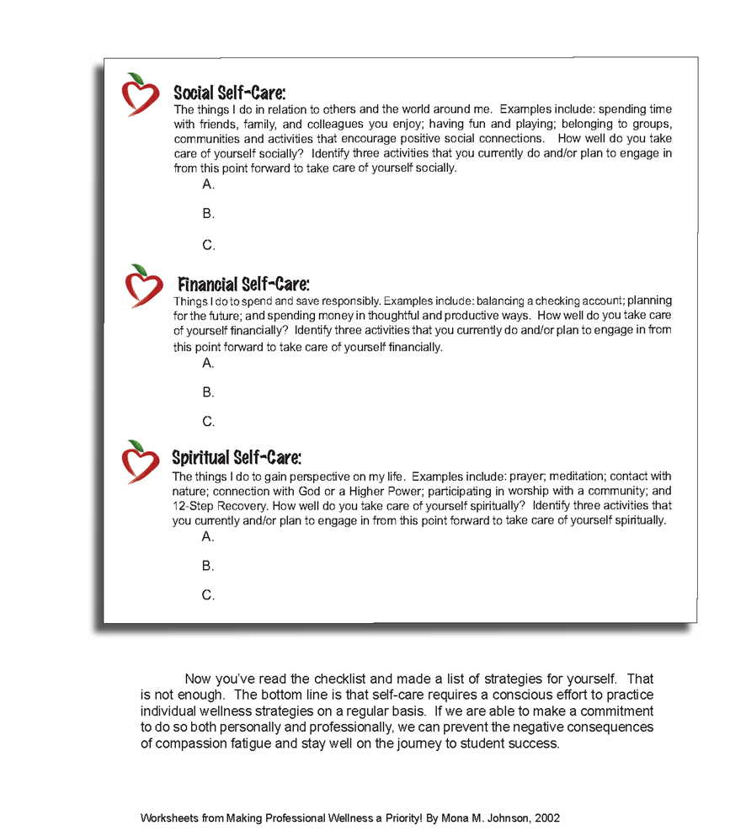
Activity
Notes:
Allow 10 to 15 minutes for participants to complete their plan. However, participants should not be pressured to fill out three examples per category, but rather one or two per category. They can further develop this plan on their own time.
Discuss each area briefly.
Examples as prompts:
Physical: Nutrition, exercise, regular doctor visits
Emotional: Journaling, talking about feelings in healthy ways, counseling/therapy
Cognitive: Reading for pleasure or work, writing, continuing education
Social: Spending time with friends/family, having fun and playing, belonging to social/activity groups
Financial: Balancing the bank account, planning for the future, spending money responsibly
Spiritual: Praying, meditating, being in contact with nature, attending a house of worship

Slide 27
Challenges to Self-Care
Making time
Feeling guilt
Believing those around you are doing fine
Lacking support
Notes:
Although each of us can make a menu of self-care possibilities, that does not always mean that we will implement them. There may be several reasons that we do not engage in self-care activities, such as:
Finding it difficult to make time when those all around you seem to need your help;
Feeling guilt and shame for taking time for yourself;
Believing those around you are doing fine, so you should be doing fine, too; and
Lacking modeling or support from administration for self-care activities.
No matter what our reasons, when we do not take care of ourselves, we are not able to provide the best level of support to students and our family, friends, and coworkers.

Slide 28
Exercise: Commitment to Self-Care
Make it part of your daily routine.
Find a self-care buddy.
Advocate for self-care as part of your professional development.
Encourage sharing of self-care ideas.
Continue to monitor your compassion fatigue/Take the ProQOL.
Recognize commitment to self-care actions.
Notes:
Activity: Have training participants list three things they each plan to do to commit to self-care and share with others, if appropriate. Possible activities they could consider include:
Make self-care part of your daily routine;
Find a self-care buddy;
Advocate for self-care as part of your professional development;
Encourage sharing of self-care ideas;
Continue to monitor your compassion fatigue/Take the ProQOL; and
Recognize a commitment to self-care actions.

Slide 29
Summary
Identified signs and symptoms of compassion fatigue, both professionally and personally.
Created a professional self-care plan to support and improve effectiveness of current and future work with students impacted by stress, loss, and trauma.
Discussed concepts of resilience, including caregiver resilience.
Notes:
If you recall, we first said that the aim of this training is to think about compassion fatigue and talk about how to work more effectively with the other educators and the students we serve — not just those impacted by a specific event but also those impacted by life stress, loss, trauma, and community violence; any type of man-made or natural disasters; and economic hardships.
We talked about the impact of stress, burnout, and compassion fatigue on the educational environment.
We talked about how these things impact you and how you can work more effectively with the students you serve.
We introduced the important concept of self-care and developing a self-care plan to include multiple components:
Physical
Emotional
Cognitive
Social
Financial
Spiritual

Slide 30
Next Steps
What are three things I learned from this presentation?
What steps will I take to carry forward personally what I learned in today’s presentation?
What steps will I take to share the information learned today with my peers or colleagues?
Notes:
For the next steps,
Think about the three main ideas that were most relevant or impactful to you, such as things learned that revealed a need you have, or a way you can enhance the planning efforts already in place.
Think through the steps you will take to set these changes into motion and how to see them through to completion/implementation. What is needed to put these changes into place? How will these changes be maintained?
What steps will you take to share this information with others who may find it useful? This may include encouraging others to develop and maintain their own self-care plans.
Finally, we’d like to share with you a little bit more about the REMS TA Center and the other resources you can use to help you in your efforts for comprehensive emergency management planning.

Slide 31
What Is the REMS TA Center?
A hub of information and services supporting the development of high-quality emergency operations plans (EOPs) and comprehensive emergency management planning efforts!
Phone: (855) 781-REMS [7367]
Email: info@remstacenter.org
Web: https://rems.ed.gov
Twitter: @remstacenter
Notes:
The Readiness and Emergency Management for Schools (REMS) Technical Assistance (TA) Center (referred to as TA Center from this point forward) was established in October 2004 by ED and is administered by the Office of Safe and Healthy Students (also known as OSHS). The TA Center serves as a hub of information and services to support K-12 schools and IHEs, both public and private, and their community partners, as well as partners at the local, state, and Federal levels, in maintaining comprehensive, all-hazard, and high-quality EOPs.
The TA Center supports these stakeholder populations with responsive TA via the TA Center’s dedicated email address and toll-free phone number, virtual trainings, tools, information and resources, guidance documents, publications, and on-site trainings by request (TBRs).

Slide 32
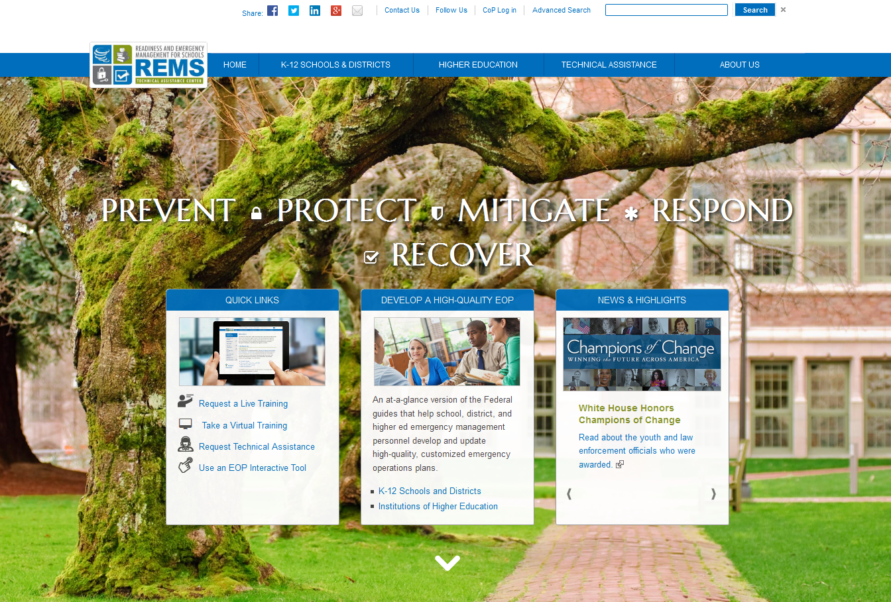
https://rems.ed.gov
Notes:
The primary hub for accessing the TA Center’s resources is the TA Center Website, https://rems.ed.gov.
This slide displays a screen shot of the homepage — which is updated frequently to highlight new TA Center projects and resources as well as information important to the field.
The box on the left provides Quick Links to the actions many visitors take when they visit the Website, such as to request TA or an on-site training, to take a virtual training, or to use an EOP Interactive Tool.
The center box profiles information critical to EOP development for schools and IHEs. Here, you can see Federal guidance highlighted and a link to more information for each of the TA Center’s main stakeholder audiences. You’ll see the blue navigation bar across the top of the page also provides tabs with drop-down menus for accessing information specific to stakeholder audiences, as well as by type of assistance needed.
Finally, the box on the right showcases News & Highlights.

Slide 33
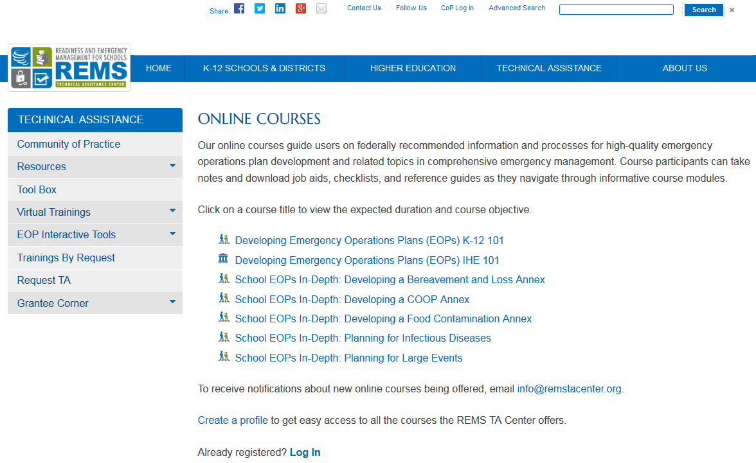
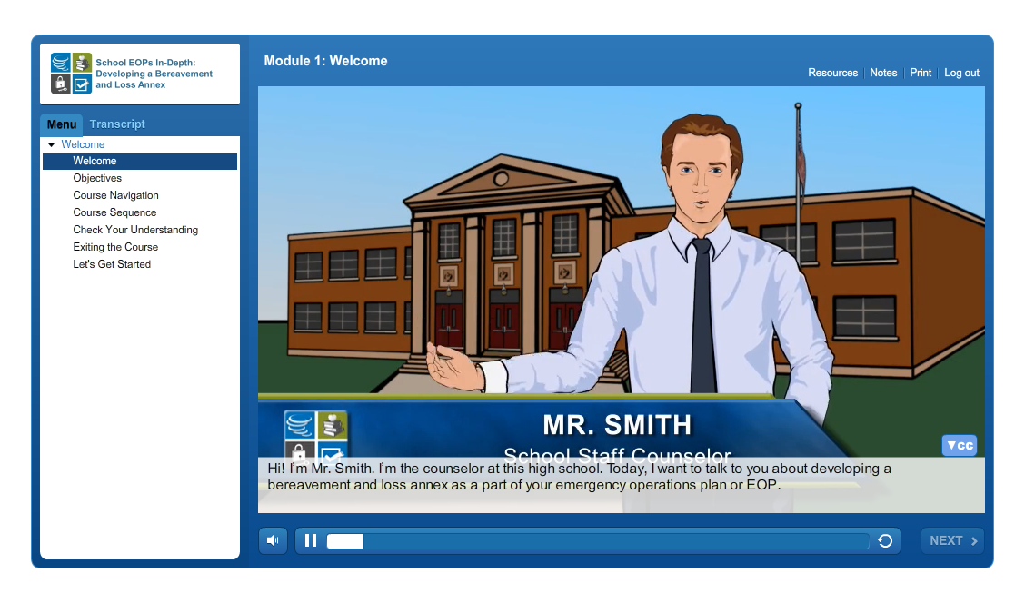
Online Courses
Notes:
The TA Center offers self-paced online courses, which are available free of charge and for use at any time, to provide school emergency management practitioners with an overview on the basics of developing an EOP, as well as in-depth information on school EOPs, including:
Developing a Bereavement and Loss Annex;
Developing a COOP (Continuity of Operations) Annex;
Developing a Food Contamination Annex;
Planning for Infectious Diseases; and
Planning for Large Events.

Slide 34
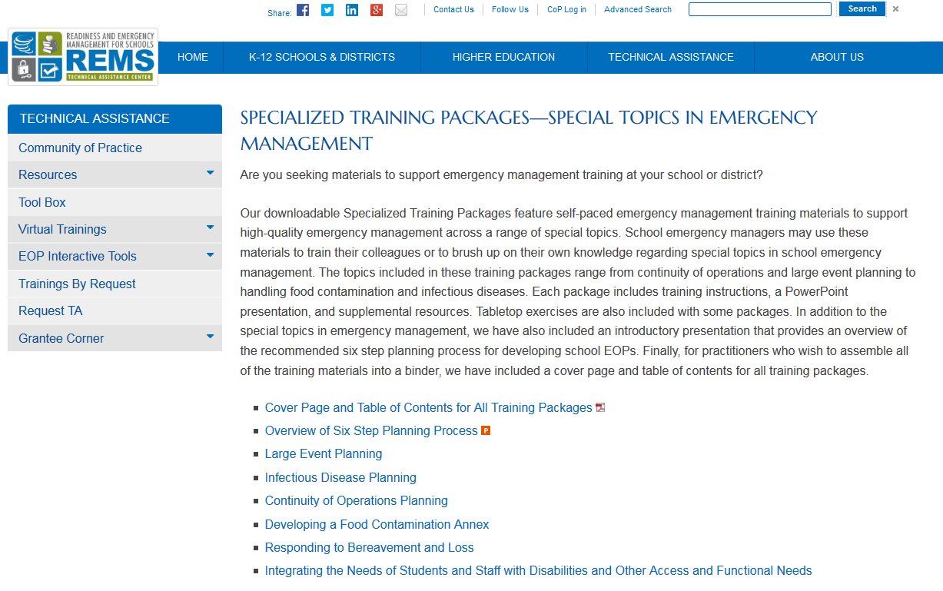
Specialized Training Packages
Overview of the Six-Step Planning Process
Large Event Planning
Infectious Disease Planning
Continuity of Operations Planning
Developing a Food Contamination Annex
Responding to Bereavement and Loss
Integrating the Needs of Students and Staff with Disabilities and Other Access and Functional Needs
Developing a Family Reunification Annex
Notes:
The TA Center offers downloadable materials, such as this training, to help K-12 emergency management practitioners train themselves and their stakeholders on select topics in emergency management. These Specialized Training Packages feature self-paced training materials to support high-quality emergency management across a range of special topics. Each package includes training instructions, a PowerPoint presentation, and supplemental resources. Tabletop exercises are also included with some packages.
Other topics available include:
Overview of the Six-Step Planning Process
Large Event Planning
Infectious Disease Planning
Continuity of Operations Planning
Developing a Food Contamination Annex
Responding to Bereavement and Loss
Integrating the Needs of Students and Staff with Disabilities and Other Access and Functional Needs
Developing a Family Reunification Annex
In addition to the special topics in emergency management, the TA Center has also created an introductory presentation that provides an overview of the recommended six-step planning process for developing school EOPs. For practitioners who wish to assemble all of the training materials into a binder, there is a print-ready cover page and table of contents for all training packages provided.

Slide 35
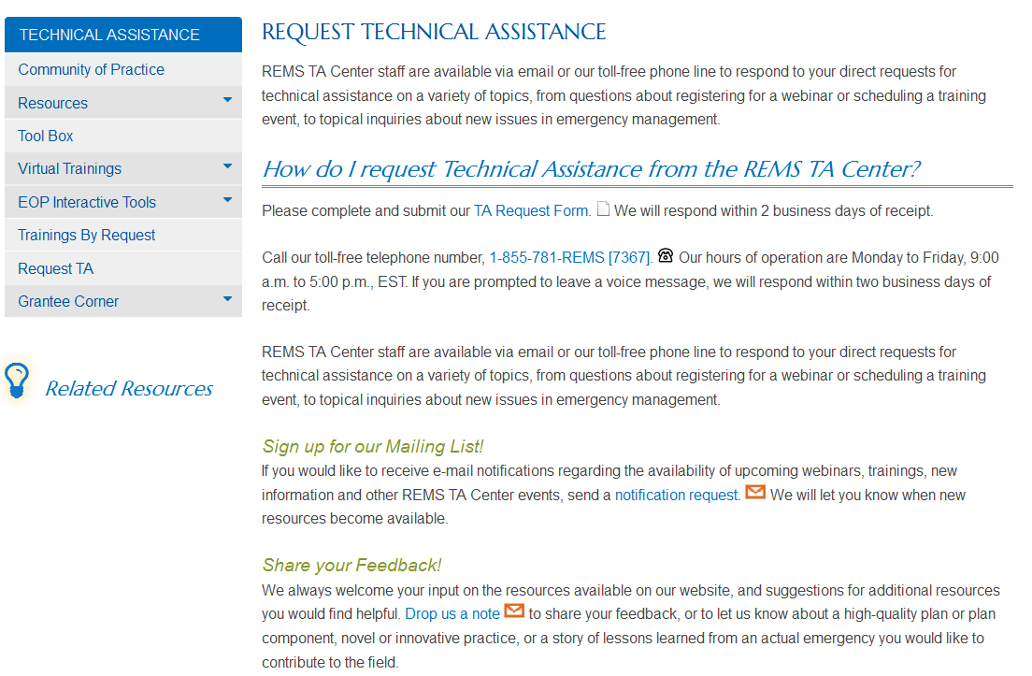
And Much More…!
Notes:
The TA Center also provides responsive TA, which means if you have specific questions you’d like to direct to TA Center staff, you can use this form on the Website to submit your question. To access this form, visit the “Request TA” Web page. This page also provides contact information for the TA Center, as well as links to subscribe to the TA Center’s mailing list or share your feedback with the TA Center. Answers to frequently asked questions are also provided through this Web page.

Slide 36
Get Connected
For additional information, resources, training, and technical assistance, please contact the REMS TA Center.
Request Technical Assistance
Connect on Twitter @REMSTACenter
Request an
On-Site Training
Phone: (855) 781-7367 (REMS)
Email: info@remstacenter.org
Notes:
You can connect to us in a variety of ways, including our toll-free phone line and info@remstacenter.org. Be sure to find us on Twitter for daily updates on TA Center activities and important information and services from our collaborative partners!

Slide 37
Thank You!
For all you do each day to assist your students and your peers!

